Slide 1
READ ME!
Hello friend! Please either save a copy to your machine to edit this PPT (and delete this slide) or copy/paste the slides you’d like into a new project. When pasting, choose “Keep Source Formatting” to maintain the correct colors. Thanks, and happy presenting!

Slide 2
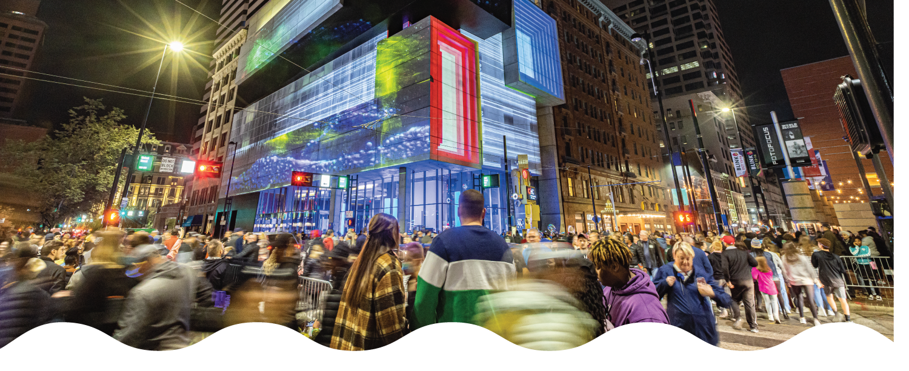
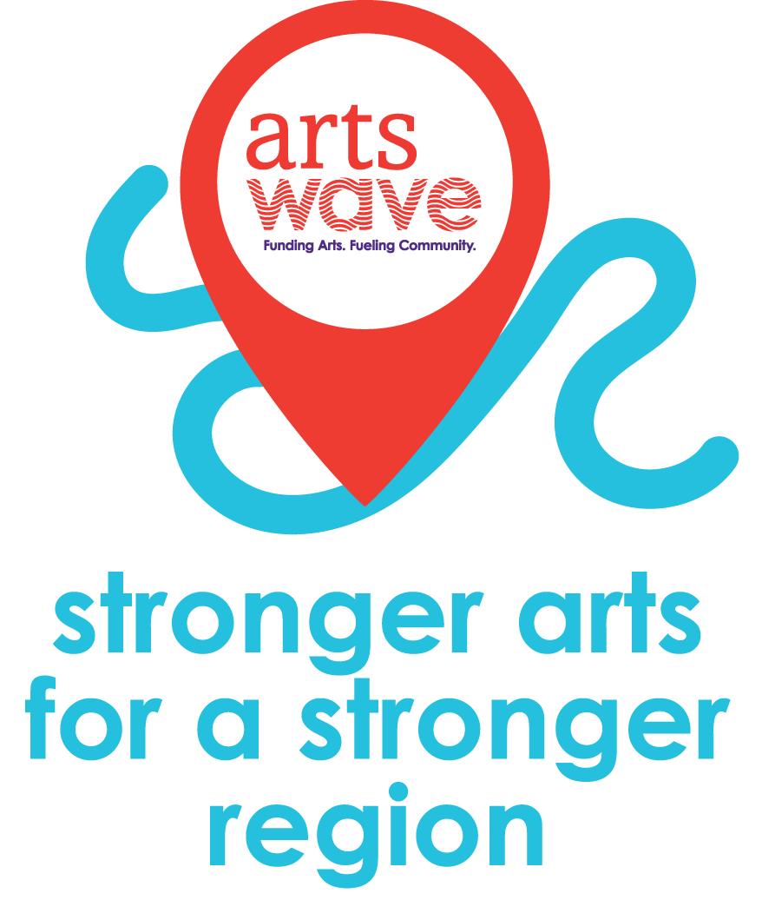
Company XYZ Kick-Off
Insert Date Here
Notes:
[Introduction]
Welcome to the XYZ company kick-off! I’m ______ from ______. Thank you for being here/tuning in/logging on today!
[insert personal introduction here. Ex. This is my third time heading up the campaign and things are going to look different this year, etc.]
Before we start today, I’d like to play a little game called what’s missing”?
[click to next slide]

Slide 3
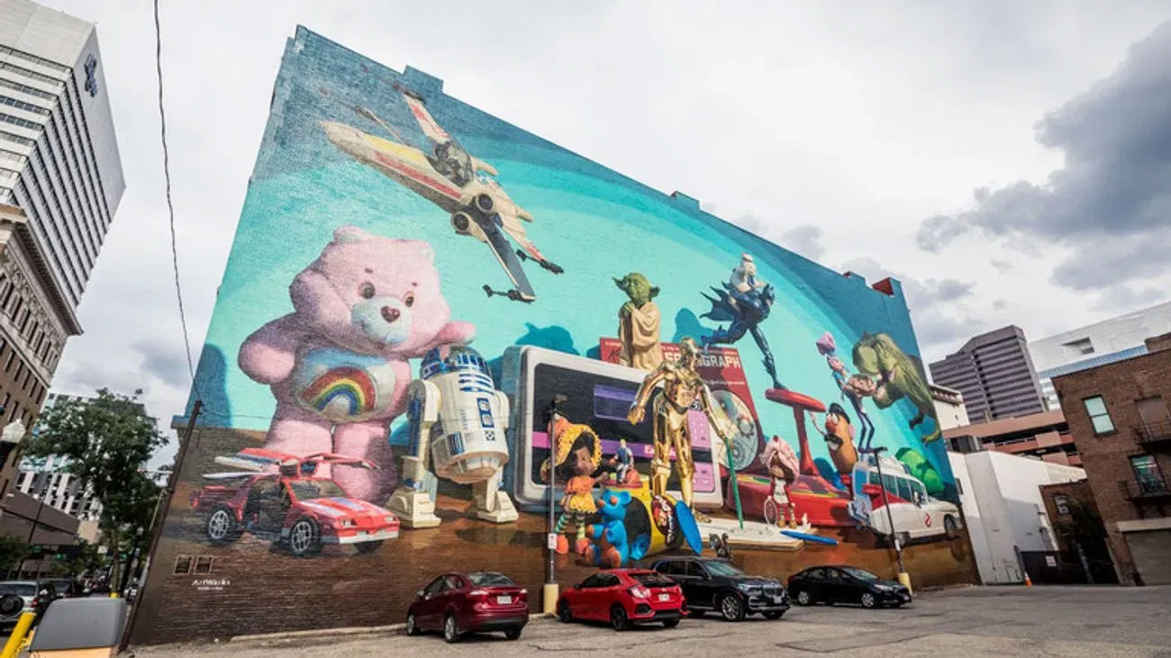
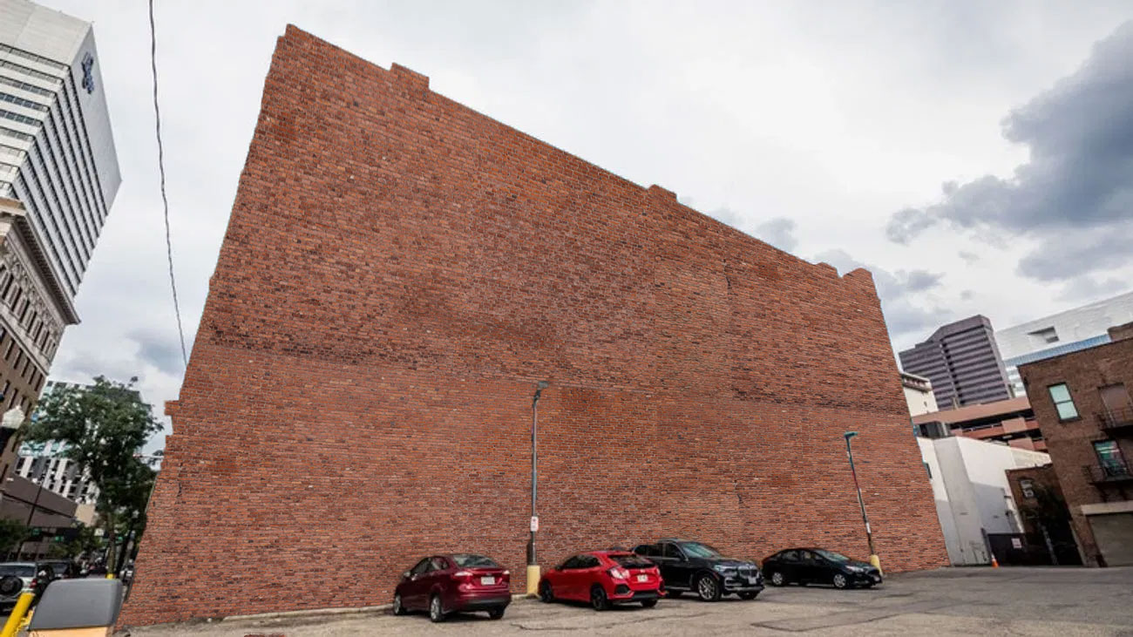
This is where text can go. It’s a text block on a page with multiple text blocks.
This is where text can go. It’s a text block on a page with multiple text blocks.
WHAT’S MISSING?
Notes:
First up, have a non-descript brick wall. At first glance, you’d think nothing was missing. It’s a wall. But there IS something missing.
[CLICK]
How about that to get someone out of their Monday morning funk as they pull up and park next to it?! Cincinnati is #2 in the country for street art and our murals play a major role in transforming the city into one big canvas, giving everyone who lives here a sense of pride in where they live and work.

Slide 4
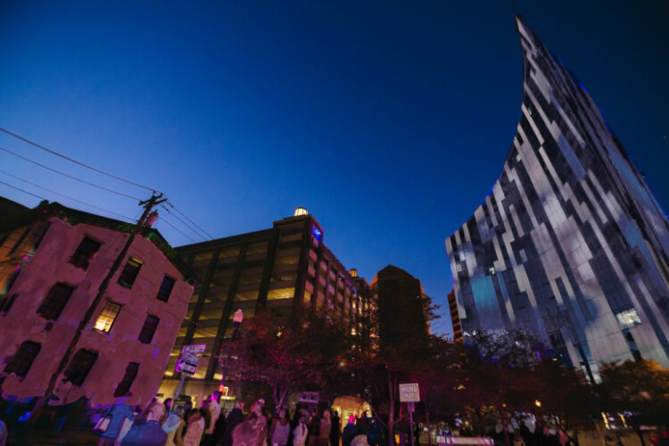
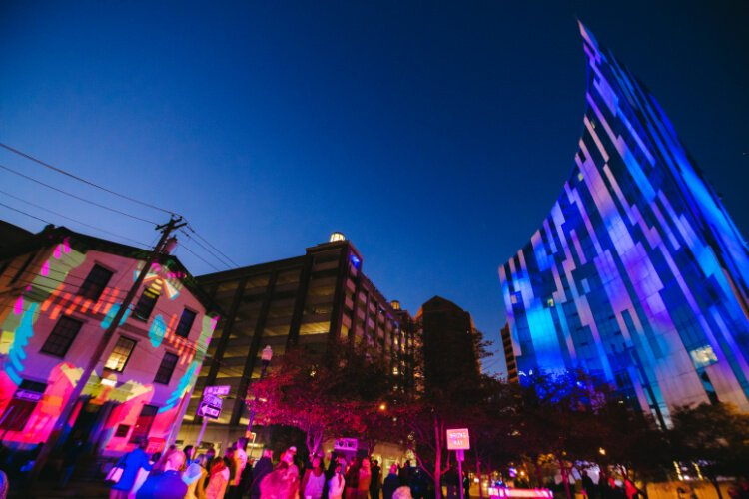
This is where text can go. It’s a text block on a page with multiple text blocks.
This is where text can go. It’s a text block on a page with multiple text blocks.
WHAT’S MISSING?
Notes:
How about this one? Some of you may recognize this as one of the iconic buildings on the river in Northern Kentucky. Although the building and the surrounding area are nice, what’s missing?
[CLICK]
It’s BLINK, illuminated by ArtsWave, the region’s largest event ever and the largest immersive art event in the nation.
[CLICK TO NEXT SLIDE]

Slide 5
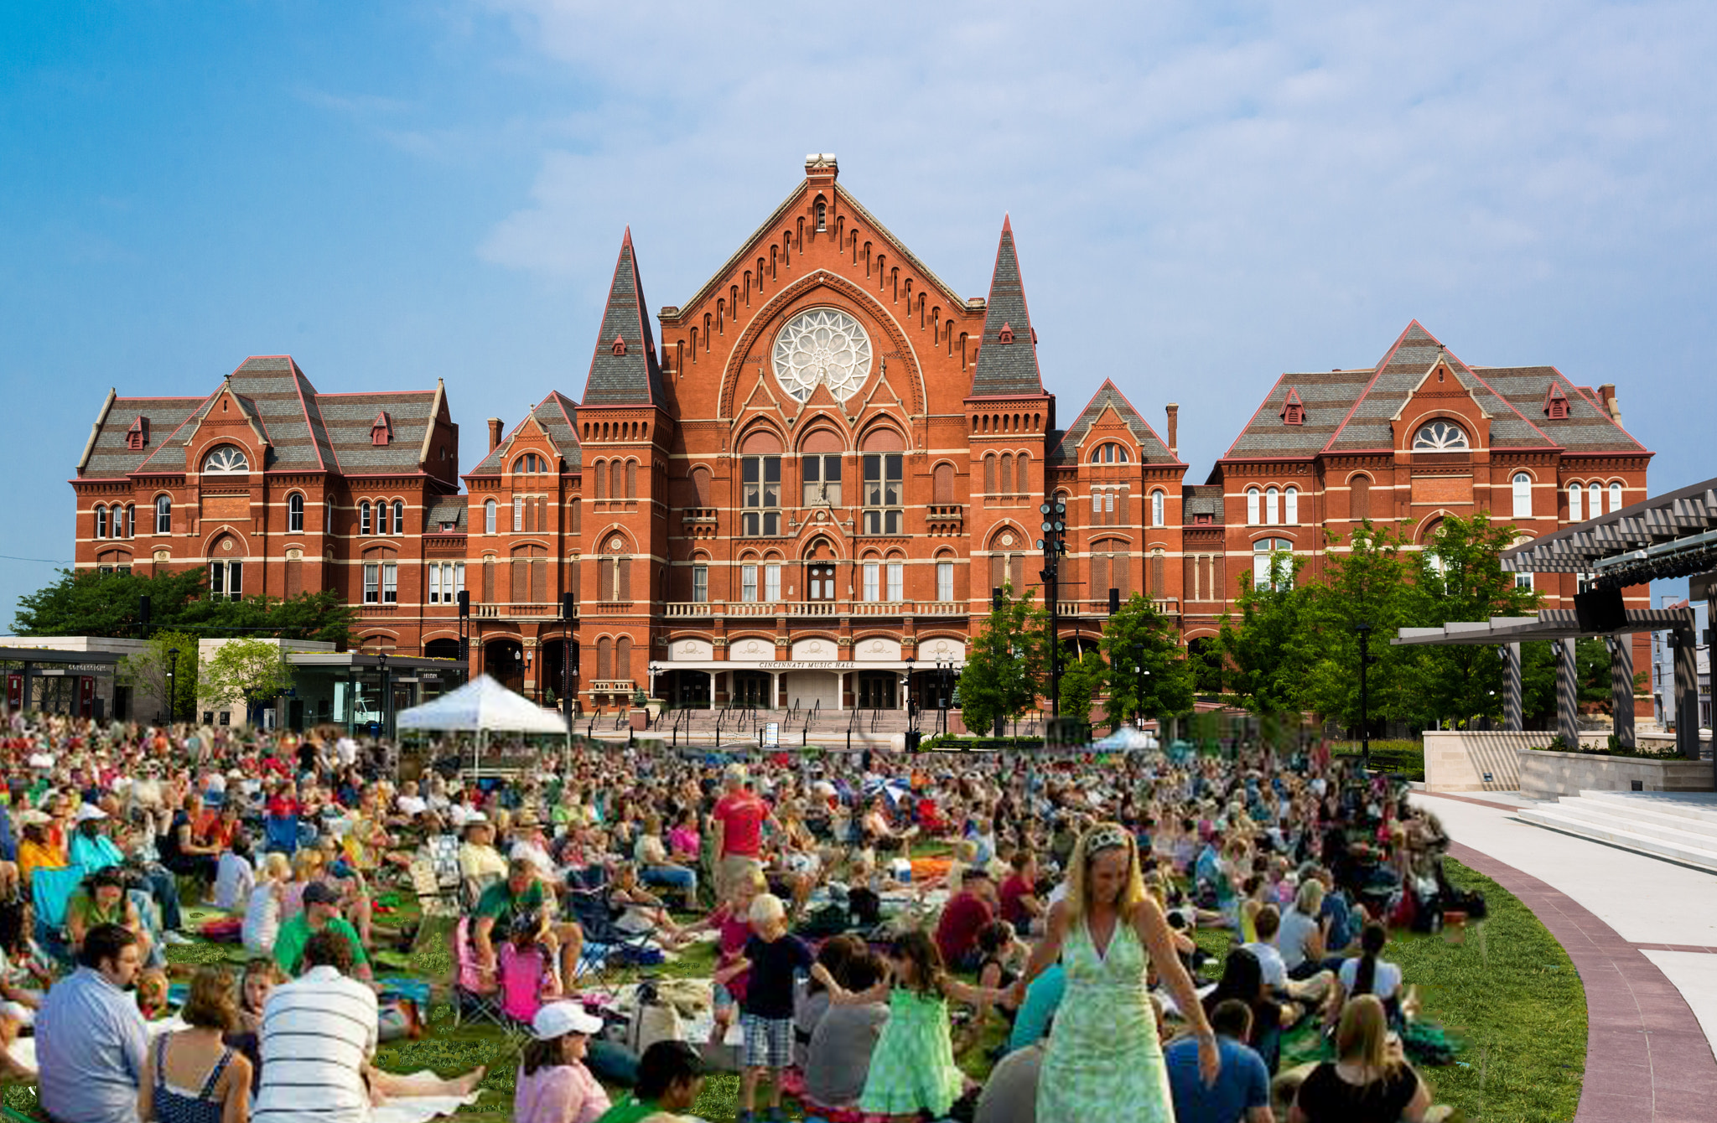
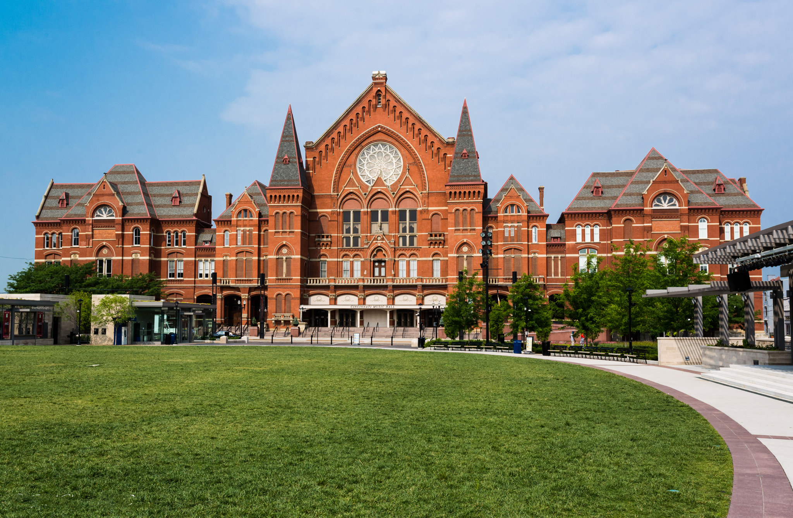
WHAT’S MISSING?
Notes:
Last but not least, we have a lovely photo of Music Hall and Washington Park, but it looks a bit boring and stodgy here. What’s missing?
[CLICK]
There we go! Free and low-cost concerts and festivals happen all the time there, turning it from a nice park with an old building next to it to a vibrant, community-first venue that makes this part of the neighborhood come alive with energy and creativity and a feeling of togetherness.
So, what was missing in all of those photos? What made each location more vibrant?
THE ARTS!
[CLICK TO NEXT SLIDE]

Slide 6
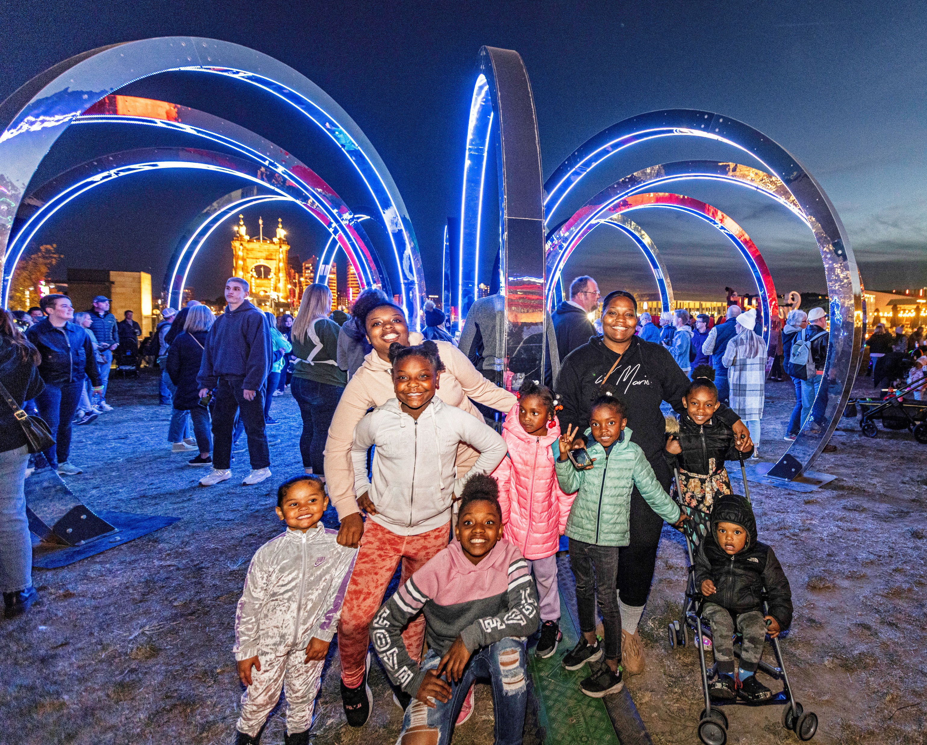
CINCY’S ARTS: POWERING OUR REGION
Our arts make our region STRONGER, defining it as a VIBRANT and CONNECTED community.
Notes:
Those were just a few small examples of what our arts do for our region. But, on the whole…
[READ SLIDE]
How do they do that?
[CLICK SLIDE]

Slide 7
CINCY’S ARTS: POWERING OUR REGION
The ARTS create opportunities for youth
The ARTS bridge cultural divides
The ARTS build strong relationships
The ARTS give Cincy a competitive advantage
Notes:
Here’s a few examples:
[READ FIRST POINT] Studies show that kids who are involved in the arts are 5x less likely to drop out of school and 2x more likely to graduate college.
[READ SECOND POINT] 91% in a recent study reported making new friends as a result of participating in the arts. In our culture, as the epidemic of loneliness continues to get worse, the arts are a bright spot in building human connections.
[READ THIRD POINT] 90% of those in a study by University of Cincinnati agreed that the arts help them understand perspectives from other cultures. We’re more tribal than ever these days and the arts can help combat that.
[READ FOURTH POINT] For the third year in a row, the Cincinnati region was named a top 20 arts-vibrant community, with special recognition given to our plentiful public art. Everyone that was around the past few years probably remembers BLINK, illuminated by ArtsWave. It has become the largest immersive arts experience in the nation and the largest event of any kind in Cincinnati. That’s a great example of the arts showcasing our region and bringing folks from every walk of life together.
So, what does all this that have to do with ArtsWave?
[CLICK SLIDE]

Slide 8
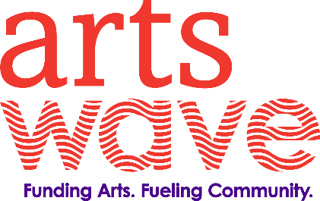
YOUR GIFT TO ARTSWAVE (plus 25,000 others!) UNLEASHES THAT POWER!
For nearly 100 years, gifts to ArtsWave have been the primary way Cincy’s arts are funded.
Notes:
It’s YOUR gift to ArtsWave that makes this possible.
[READ RED TEXT AFTER IT COMES IN]
Since 1927, the community has invested more than $350 million through ArtsWave, creating a dynamic foundation for our arts and our region to thrive. This started with a lead gift of $1 million from the Taft family, but was then matched and surpassed that same year with 2.5 million from regular folks in the community! So, from the beginning, this campaign has relied on thousands across the region.
Let’s look at where your gift goes today.
[CLICK SLIDE]

Slide 9
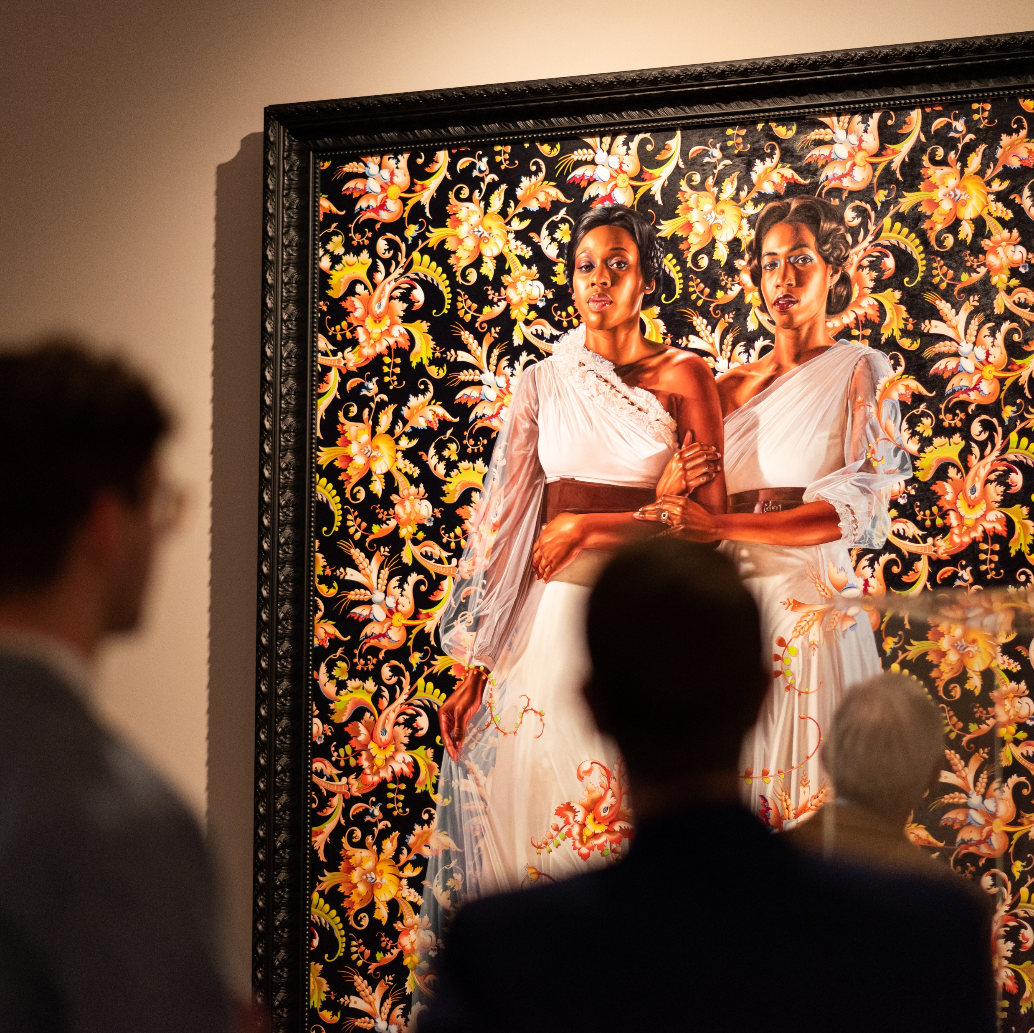
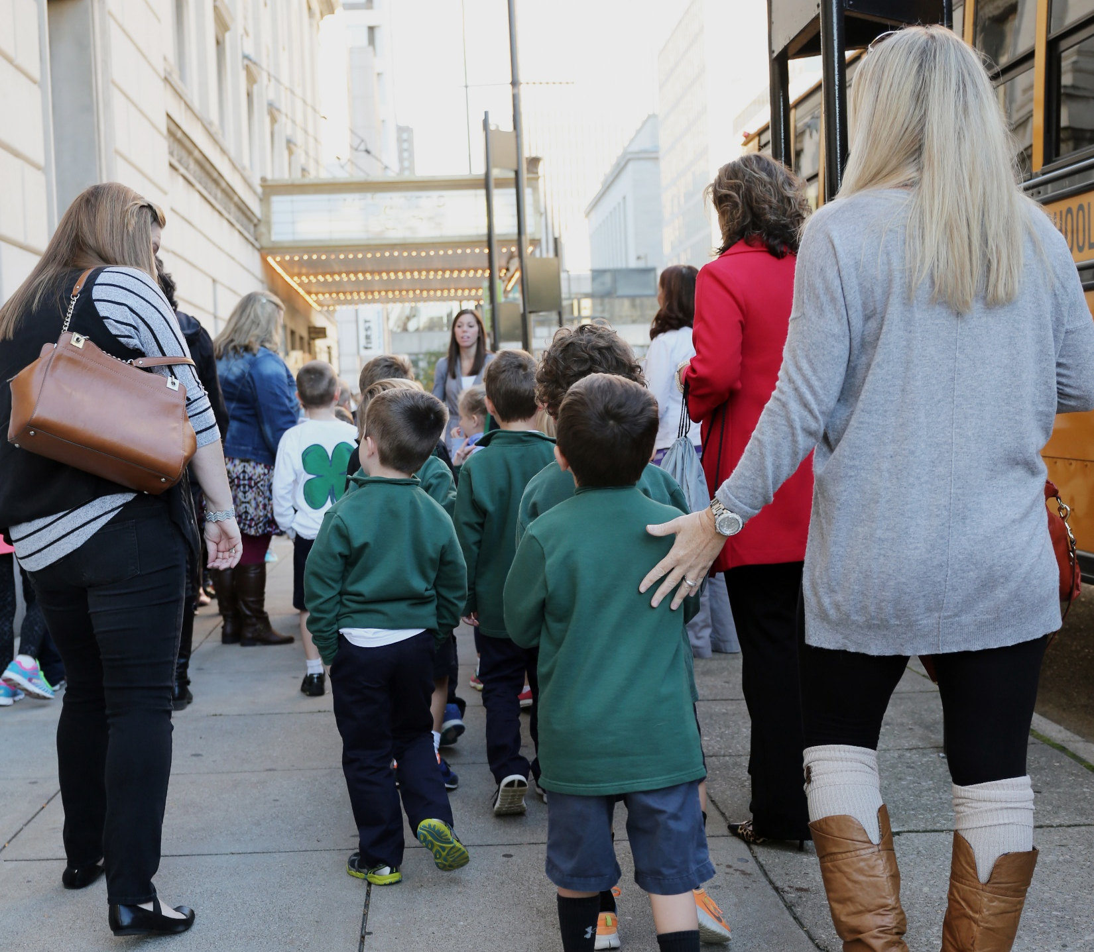
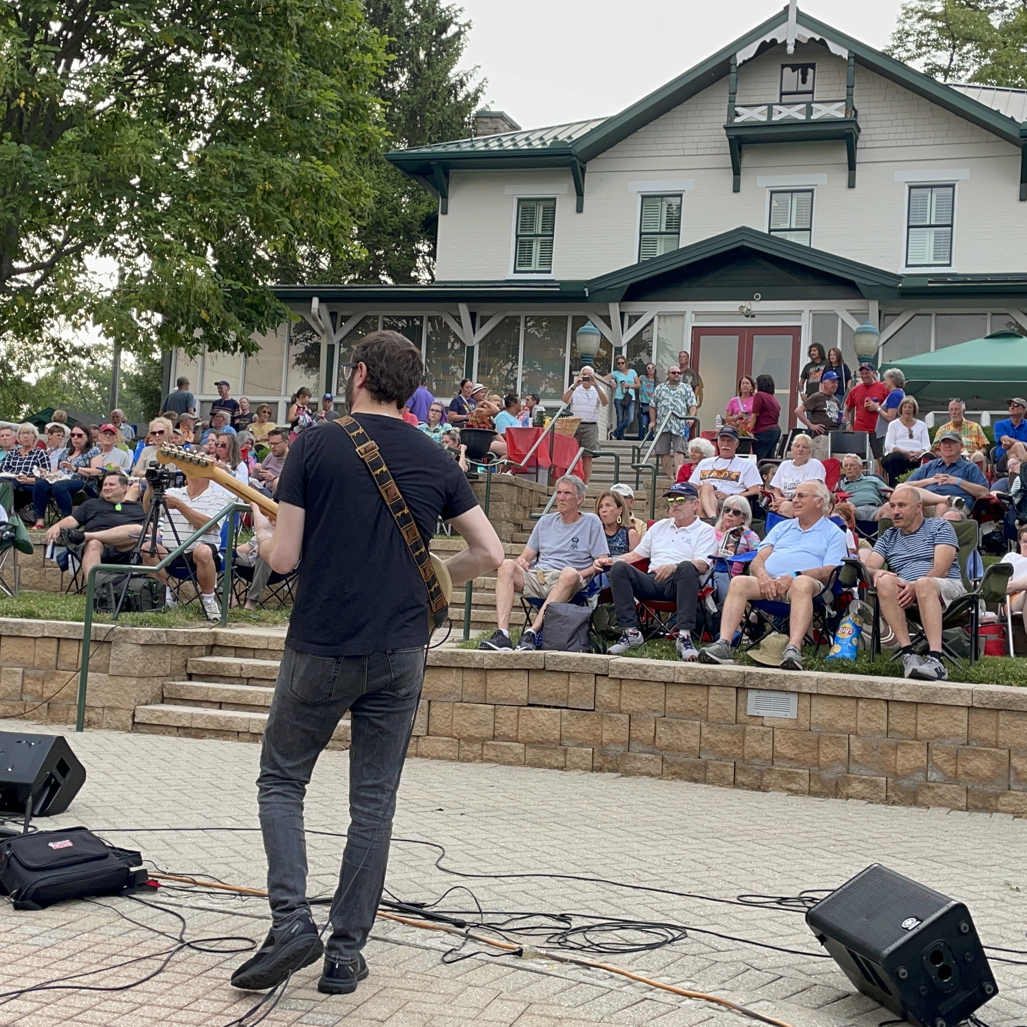
YOUR GIFT TO ARTSWAVE (plus 25,000 others!) UNLEASHES THAT POWER!
Your gift is invested in 150+ organizations, artists and projects.
Your gift supports arts experiences for kids.
Your gift impacts where you live.
Notes:
[read slide – special emphasis on ‘25,000 others’]
[READ first point] They’ll go on to create thousands of concerts, shows, exhibitions, arts education programming, public art, festivals, events like BLINK® and more.
[READ second point] In primary education, the arts have been on the chopping block for decades. This only accelerated during and after the worst of the pandemic. One example of what ArtsWave is doing to combat this is ArtsWave’s “More Arts, More Kids” initiative which is providing annual arts field trips for all 1st-6th graders in Cincinnati Public Schools and soon expanding into Northern Kentucky. These experiences can uniquely open up a childs world to perspectives from communities outside of their own, increase empathy and spur on creative pursuits further down the line in their educational journey.
[READ third point] Last year, a total of 2.3 million people attended free or low-cost neighborhood events by ArtsWave-funded organizations, bringing us together through the arts. This represented events by large organizations like the Symphony and Cincinnati Shakespeare, and by smaller neighborhood-based organizations like Clifton Cultural Arts Center, Oxford Community Arts Center and down in Northern Kentucky at The Carnegie.

Slide 10
Notes:
We’ve heard a lot about what your gifts to ArtsWave do and the impact they can have. This video really puts it all together. Let’s watch.
[AFTER VIDEO]: So now you know more about how we fund the arts in Cincinnati and the important role each of us plays in that funding.
[click to next slide]

Slide 11
REPLACE PHOTO
SPEAKER XYZ LIVE OR ON ZOOM
Name
Company or Organization XYZ
Notes:
[IF ARTS SPEAKER WAS RECRUITED. IF NOT, REMOVE THIS SLIDE]:
To give you a deeper and more specific sense of the impact your gifts have on the region, and the types of organizations and projects that ArtsWave supports, we have _______ [name] here from __________ [organization,] one of the organizations/projects/artists that a gift to ArtsWave supports.
[click to the speaker’s slides or go on after the speaker is finished]
Thanks _______!

Slide 12
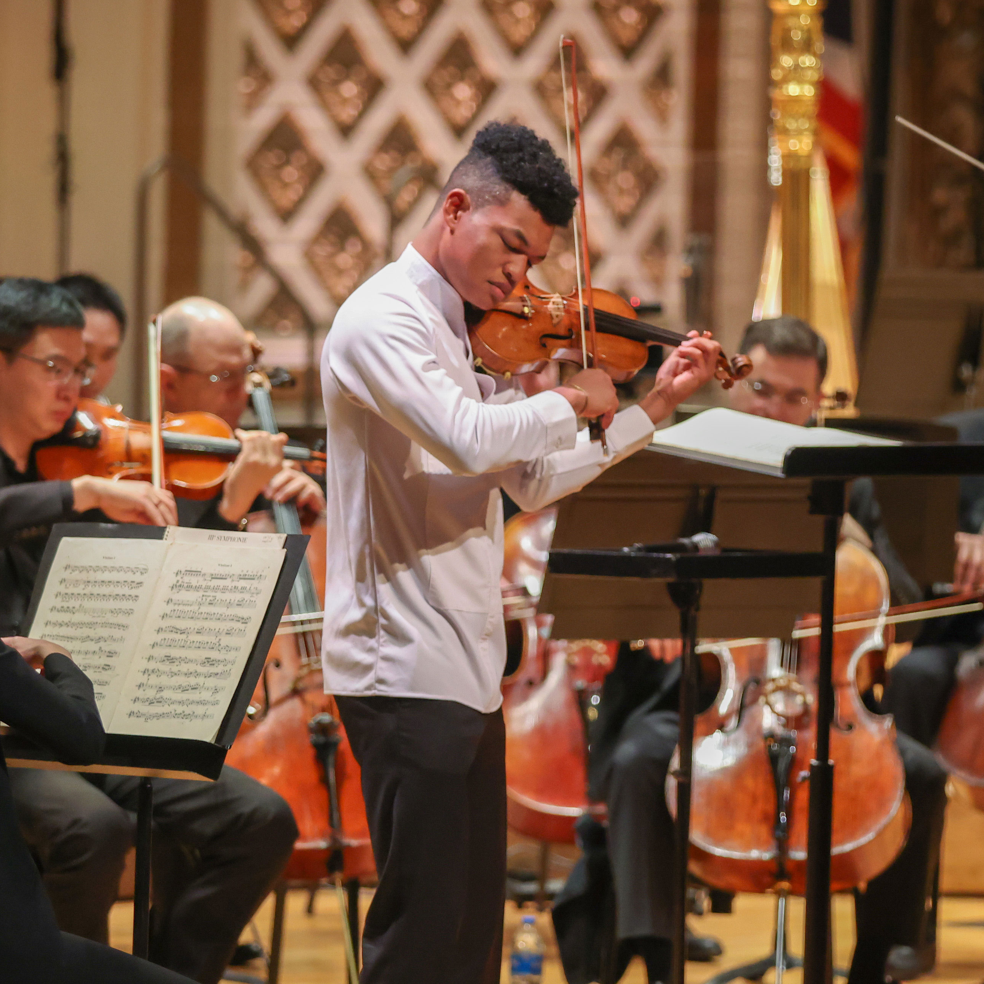
BENEFITS TO GIVING
NEW GIFT OR 10%+ INCREASE
Team Cincinnati
Two tickets to the Reds and an experience with FC Cincinnati.
ArtsWave Pass
One-year membership to BOGO-to-share arts tickets, restaurant and shop offers and more!
$75+
$150+
Enjoy the Arts at BLINK®! ​
Two tickets to one of the most talked about exhibitions at BLINK® 2024, illuminated by ArtsWave.
Notes:
[IF ARTS SPEAKER WAS RECRUITED:] Thank you _______! Hopefully that showed you the impact that your gifts can have on one organization. your gifts not only go to [organization x], but to over 150 organizations that create thousands of performances, community events, festivals and more each year.
[IF NO ARTS SPEAKER: GO ON TO THE BELOW]
When you give, you not only will be contributing to the impact you’ve been hearing about, but you also get some great benefits for you and your family.
[go over benefits. Each click reveals a new benefit level]
[IF YOU HAVE A PARTICULAR BENEFIT THAT YOU RECEIVE, TELL A PERSONAL STORY ABOUT YOUR EXPERIENCE WITH THAT BENEFIT]
[CLICK TO NEXT PAGE]

Slide 13
BENEFITS TO GIVING
$250+
The Children’s Theatre Preview & Hard Hat Tour
Experience the iconic Emery Theater during its transformation into a state-of-the-art performance venue in the heart of OTR.
$500+
BLINK® 2024 VIP Lounge
Make our exclusive Donor Lounge your hub as you experience BLINK 2024, illuminated by ArtsWave.
$1,500+
Leadership Giving
Invitations to special arts events, membership in leadership giving groups, recognition in ArtsWave’s community report and access to the Team Cincinnati benefit.
Notes:
[Read what you’d like, SAME AS LAST SLIDE]
[click to next slide]

Slide 14
JOIN A GROUP, GET CONNECTED
Notes:
When you give to ArtsWave you also have the opportunity to join groups centered around a shared understanding of the arts’ role in our community. You can see first-hand how the arts bring people together in these groups.
[Go over each of the affinity groups if you’d like, if you’re part of one, talk personally about that].
[click to next slide]

Slide 15
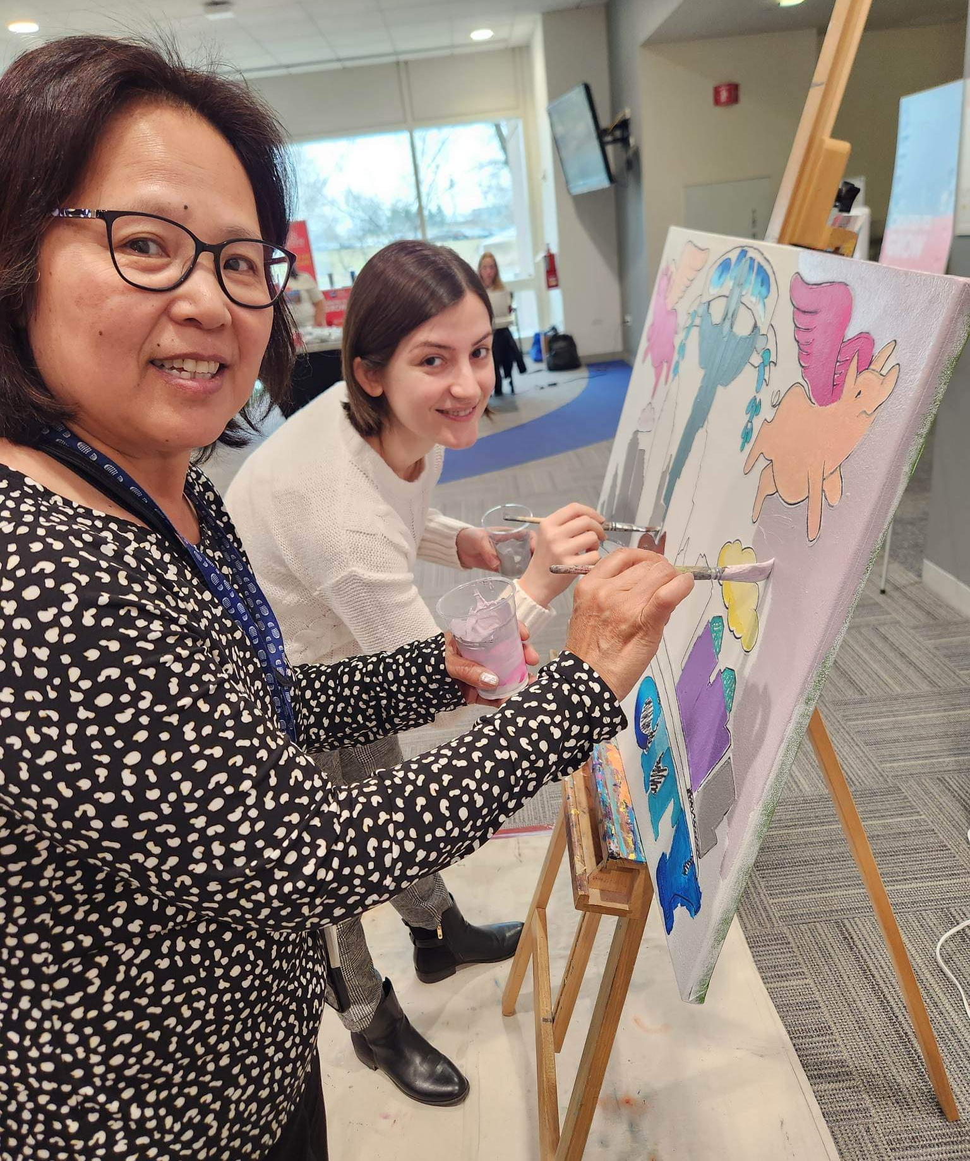
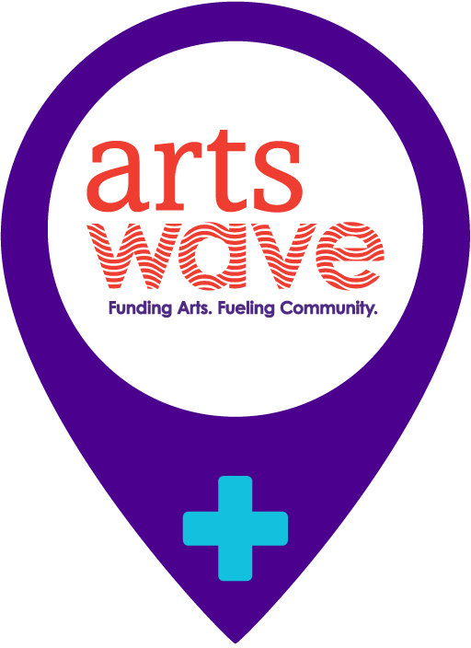
COMPANY XYZ
INITIATIVES/EVENTS
Fill in company-specific campaign events, items, giveaways, info, etc. here. Feel free to copy this page.
Be sure to remember to let people know how they should give to the campaign! (e-pledge, pledge cards, online, etc.)
Notes:
[Fill this slide in with your company’s information, including how to give ]
[click to next slide]

Slide 16
+ YOU
Your gift ripples out across our communities and creates a vibrant future for everyone.
Notes:
Since the artswave campaign began, it’s always been about the community coming together. Over nearly a century, hundreds of thousands of donors have invested over $350 million back into the community. This year, your gift will be combined with over 25,000 other people’s from across the region, creating a more vibrant future for everyone.

Slide 17
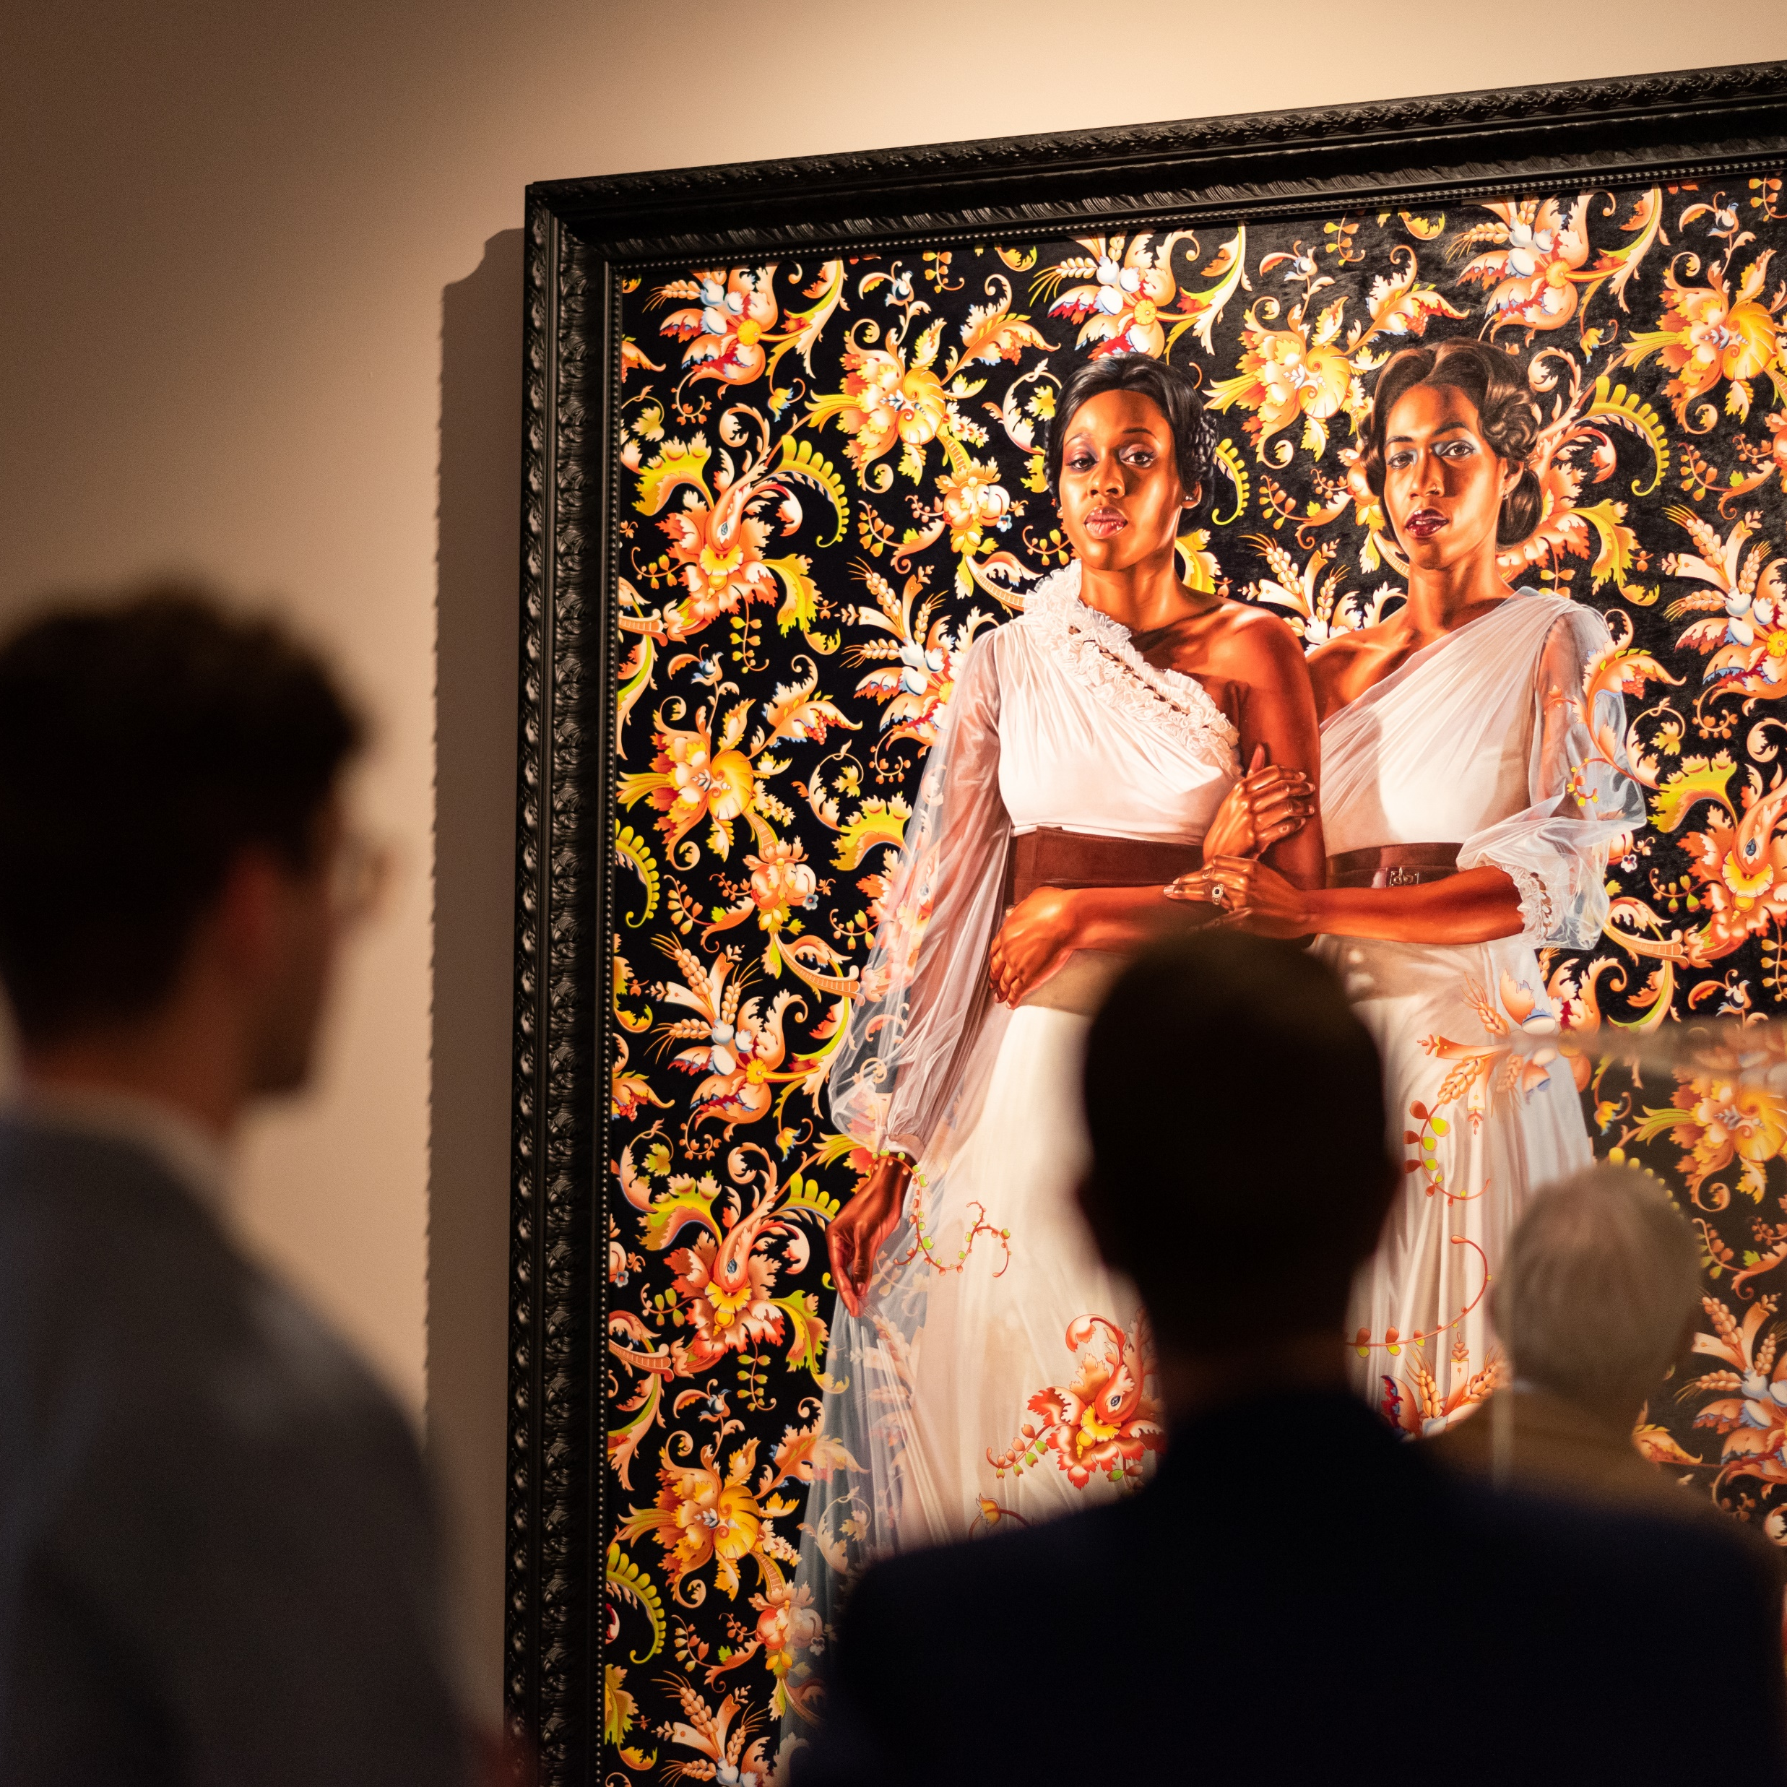
THANK
YOU!
Notes:
Thank you for being here / logging in / etc. today!
[insert any last minute reminders and giving instructions]
Thanks again!

Slide 18
READ ME!
This slide and the ones following are hidden in this presentation. They will not show up when you present this deck. We have included these slides in case you would like to add them into your presentation. To do so, place and re-order these slides as you like, and unhide them before presenting.

Slide 19
GROWING IMPACT
Steady Support to Sustain Arts Vibrancy
48
A Mindful Moment (The Well)
American Legacy Theatre
ArtsConnect
ArtWorks
Behringer-Crawford Museum
Bi-Okoto Drum & Dance Theatre
Cincinnati Art Museum
Cincinnati Ballet
Cincinnati Boychoir
Cincinnati Chamber Orchestra
Cincinnati Landmark Productions
Cincinnati Men's Chorus
Cincinnati Musical Festival Association
Cincinnati Opera
Cincinnati Playhouse in the Park
Cincinnati Shakespeare Company
Cincinnati Symphony Orchestra
Cincinnati Youth Choir
Clifton Cultural Arts Center
Contemporary Arts Center
Elementz Hip Hop Cultural Art Center
Ensemble Theatre Cincinnati
Fitton Center for Creative Arts
Kennedy Heights Arts Center
Kentucky Symphony Orchestra
Know Theatre of Cincinnati
Learning Through Art, Inc.
Linton Chamber Music
MUSE Cincinnati's Women's Choir
Mutual Dance Theatre and Arts Centers
My Nose Turns Red Youth Circus
NrityArpana School Of Indian Classical Dance
Over-the-Rhine International Film Festival
Oxford Community Arts Center
Pones
Price Hill Will
Professional Artistic Research Projects
Pyramid Hill Sculpture Park and Museum
Queen City Opera
Revolution Dance Theatre
Taft Museum of Art
The Carnegie
The Children's Theatre of Cincinnati
Visionaries and Voices
Vocal Arts Ensemble of Cincinnati
Wave Pool
Wyoming Fine Arts Center
Young Professionals Choral Collective
Sustaining Impact Grants
Unrestricted operating support awarded in 3-year cycles
Grant amount based on budget and community impact
No other community does this at this scale
Notes:
[THIS YEAR, WE ARE PROVIDING A RECORD 49 ARTS ORGANIZATIONS WITH UNRESTRICTED OPERATING SUPPORT TO SUSTAIN THEIR COMMUNITY IMPACT IN THOSE FIVE AREAS.
in aggregate, THE ArtsWave CAMPAIGN IS FUNDING 6% OF THESE TOTAL BUDGETS. This rePRESENts AN irreplaceable, STABLE FOUNDATION from WHICH organizations then deliver thousands of uplifting and inspiring experiences.

Slide 20
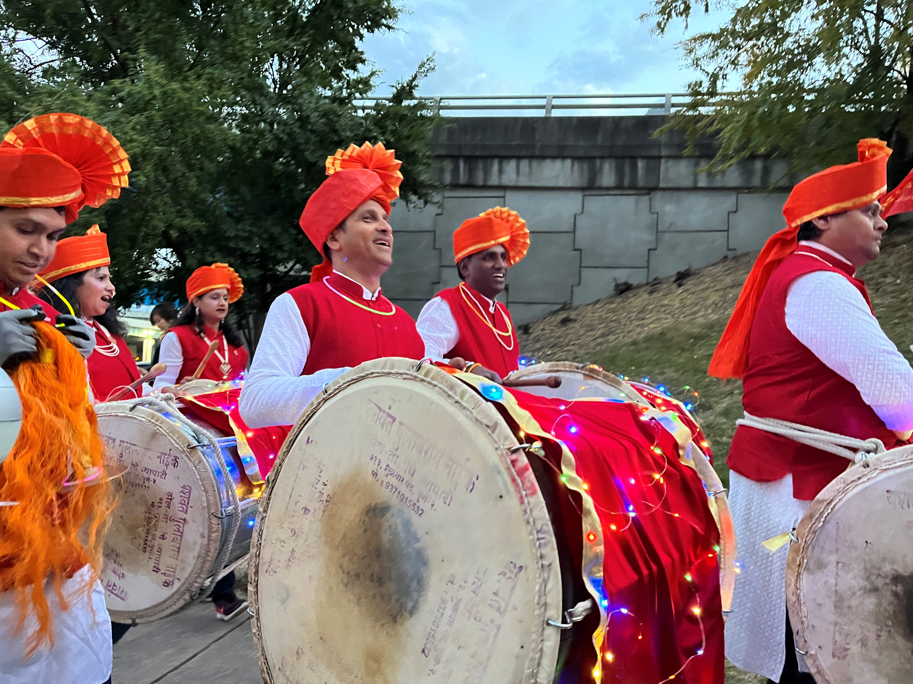
WIDENING IMPACT
Grants to Organizations, Artists and Projects
8
The Circle Grants for African American Arts
7
ArtsWave Pride Grants
36
Catalyzing Impact Grants
8
ArtsWave YP Grants
18
Black & Brown Artist Program
36
Strategic Partnership, Sponsorship and Local Illuminations Grants
Notes:
And that impact is broadening to affect more in our region through what is being accomplished.

Slide 21
A STRONGER REGION FOR ALL
What the journey looks like
Calling on 48 of the region’s largest arts organizations to develop and track DEIA plans.
Building the region’s largest funding mechanisms for Black and Brown artists.
Showcasing new works by Black and Brown artists each summer.
Convening arts professionals of color to create supportive new networks.
Growing culturally curious audiences through Flow.
Offering board training and matching through Boardway Bound.
Providing ongoing professional development and DEIA training for the sector.
Notes:
ArtsWave is working to make inclusion a hallmark of the region’s arts. Like the Blueprint for Collective Action, ArtsWave also has a DEIA Plan that is intentional in making progress. It’s holding itself and its arts partners accountable thRough various KPIs and review mechanisms.

Slide 22
LAST Campaign Results
$11,915,739 24,556 donors
102% of Goal!

Slide 23
A SHARED VISION
from the start
Notes:
[in 1927, Charles and anna sinton taft decided to leave their home and art collection to the people of Cincinnati -- along with $1m -- provided that the people match their investment.
Within 3 months, in 1927, $2.5M had been donated by several thousand individuals and businesses and a permanent arts legacy was born.
The mission of the organization, which today we call ArtsWave, was to ensure the strength of the arts already in existence, which you see here, and to support organizations and art forms ‘yet to be imagined.’

Slide 24
A SHARED VISION
accelerates
Notes:
It was a highly visionary and inclusive idea at the time, and nearly 100 years later, ARTSWAVE continues to innovate and grow this arts landscape.

Slide 25
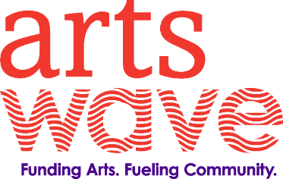
DRIVING IMPACT
ArtsWave invests in five economic and social outcomes…through 150+ arts partners & projects
BLUEPRINT
for collective action
Notes:
with your help, ArtsWave invests more than $11M in this arts landscape each year, using a five-part blueprint for funding decisions.
We support arts organizations and projects that do these five things – bridge divides, enliven neighborhoods, deepen your sense of rootedness and belonging, inspire kids to learn and create, and build our region’s reputation as a great place to live and work.

Slide 26
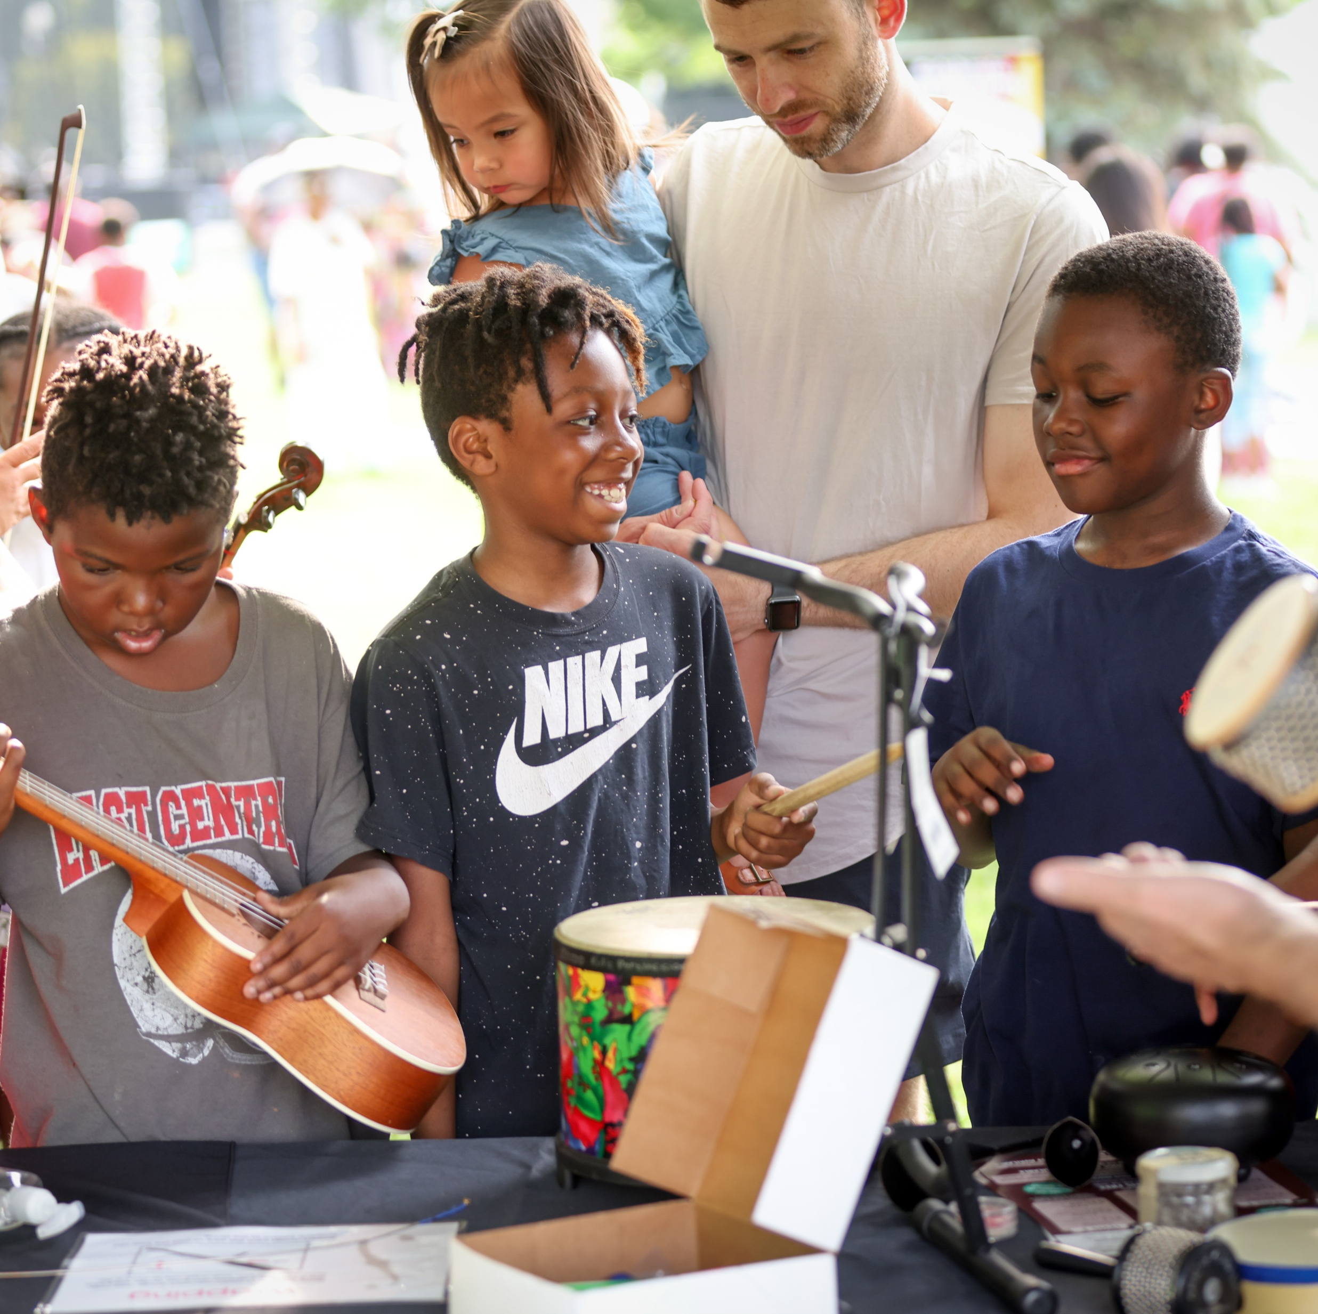
ARTS ENLIVEN NEIGHBORHOODS
When after-school arts programs are available, neighborhood crime drops up to 5%.
Residents of arts-rich neighborhoods are 2x as likely to feel connected.
Last year, ArtsWave organizations inspired 2.3 million people with free or low-cost arts events in neighborhoods across the region.
Notes:
Arts programs reduce crime levels. Participation in afterschool arts programs causes juvenile crime to fall by 4.2% on average, and slightly more (5.4%) in lower-income cities.
For every $1 spent on after-school programs, $9 is saved by reducing welfare and crime costs, improving academic performance, and increasing kids’ earning potential.
- Gregg, M., Gupta, R., & Bach-Coulibaly, M. (2014, May 6). After-school Programs & the Arts as Tools for Youth Development. Footnote. Retrieved 4 February 2018 from https://footnote.co/after-school-programs-the-arts-as-tools-for-youth-development
…[1.6x] TWICE as likely to feel more connected to neighbors:
Art and community development strengthens social networks. Residents living on a block where such projects took place were 1.6 times more likely to report they felt more connected to the neighbors.
- Nicodemus, A., Engh, R., Mascaro, C. & Metris Arts Consulting. (2016). Adding It Up: An Evaluation of Arts on Chicago & Art Blocks Executive Summary, 5 [Electronic version]. Metris Arts Consulting. Retrieved 28 January 2018 at https://metrisarts.com/wp-content/uploads/2014/05/adding-it-up-executive-summary.pdf
Optional: Tell Price Hill Will Story about homesteading program starting through sustained contact through violin lessons as part of MYCincinnati.

Slide 27
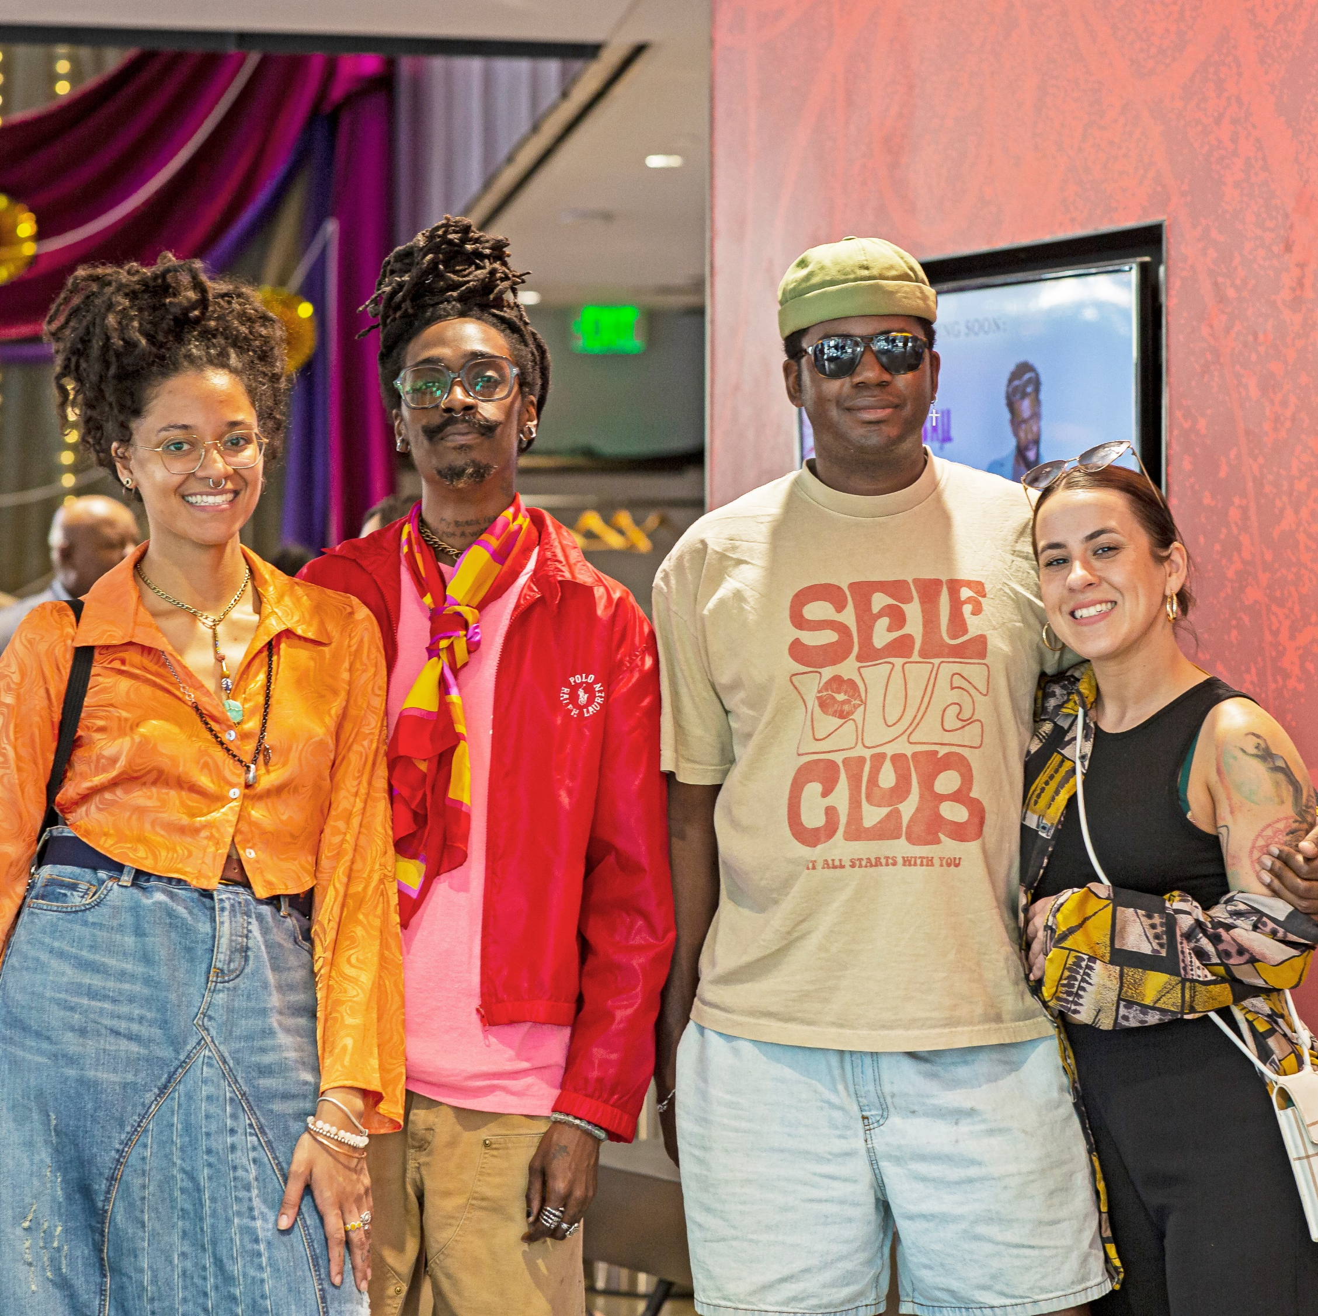
ARTS BRIDGE CULTURAL DIVIDES
Arts Bridge Cultural Divides
making our region more inclusive, diverse, equitable and respectful of all.
Students who participate in the arts are 40% more likely to have friends of diverse races & ethnicities.
Arts field trips can create significant increases in empathy and tolerance.
ArtsWave is building culturally curious audiences through Flow Pass – a 5-event subscription series celebrating Black artistry.
Notes:
STUDENTS WHO PARTICIPATE IN THE ARTS ARE 40% MORE LIKELY TO HAVE DIVERSE FRIENDS.
Participation in arts activities increases tolerance. 12th graders who participate in the arts are 40% more likely to have friends from different racial groups and 29% less likely to feel that it is ok to make a racist remark.
Catterall, J., Dumais, S., & Hampden-Thompson, G. (2012). The Arts and Achievement in At-Risk Youth: Findings from Four Longitudinal Studies. (Research Report #55). National Endowment for the Arts. Retrieved 20 January 2018 from https://www.arts.gov/sites/default/files/Arts-At-Risk-Youth.pdf
a school tour of an art museum increases student tolerance by 7 percent of a standard deviation. the benefits are much larger for students in disadvantaged groups. Rural students experienced a 13 percent of a standard deviation improvement in tolerance. For students at high-poverty schools, the benefit is 9 percent of a standard deviation.
https://www.educationnext.org/the-educational-value-of-field-trips

Slide 28
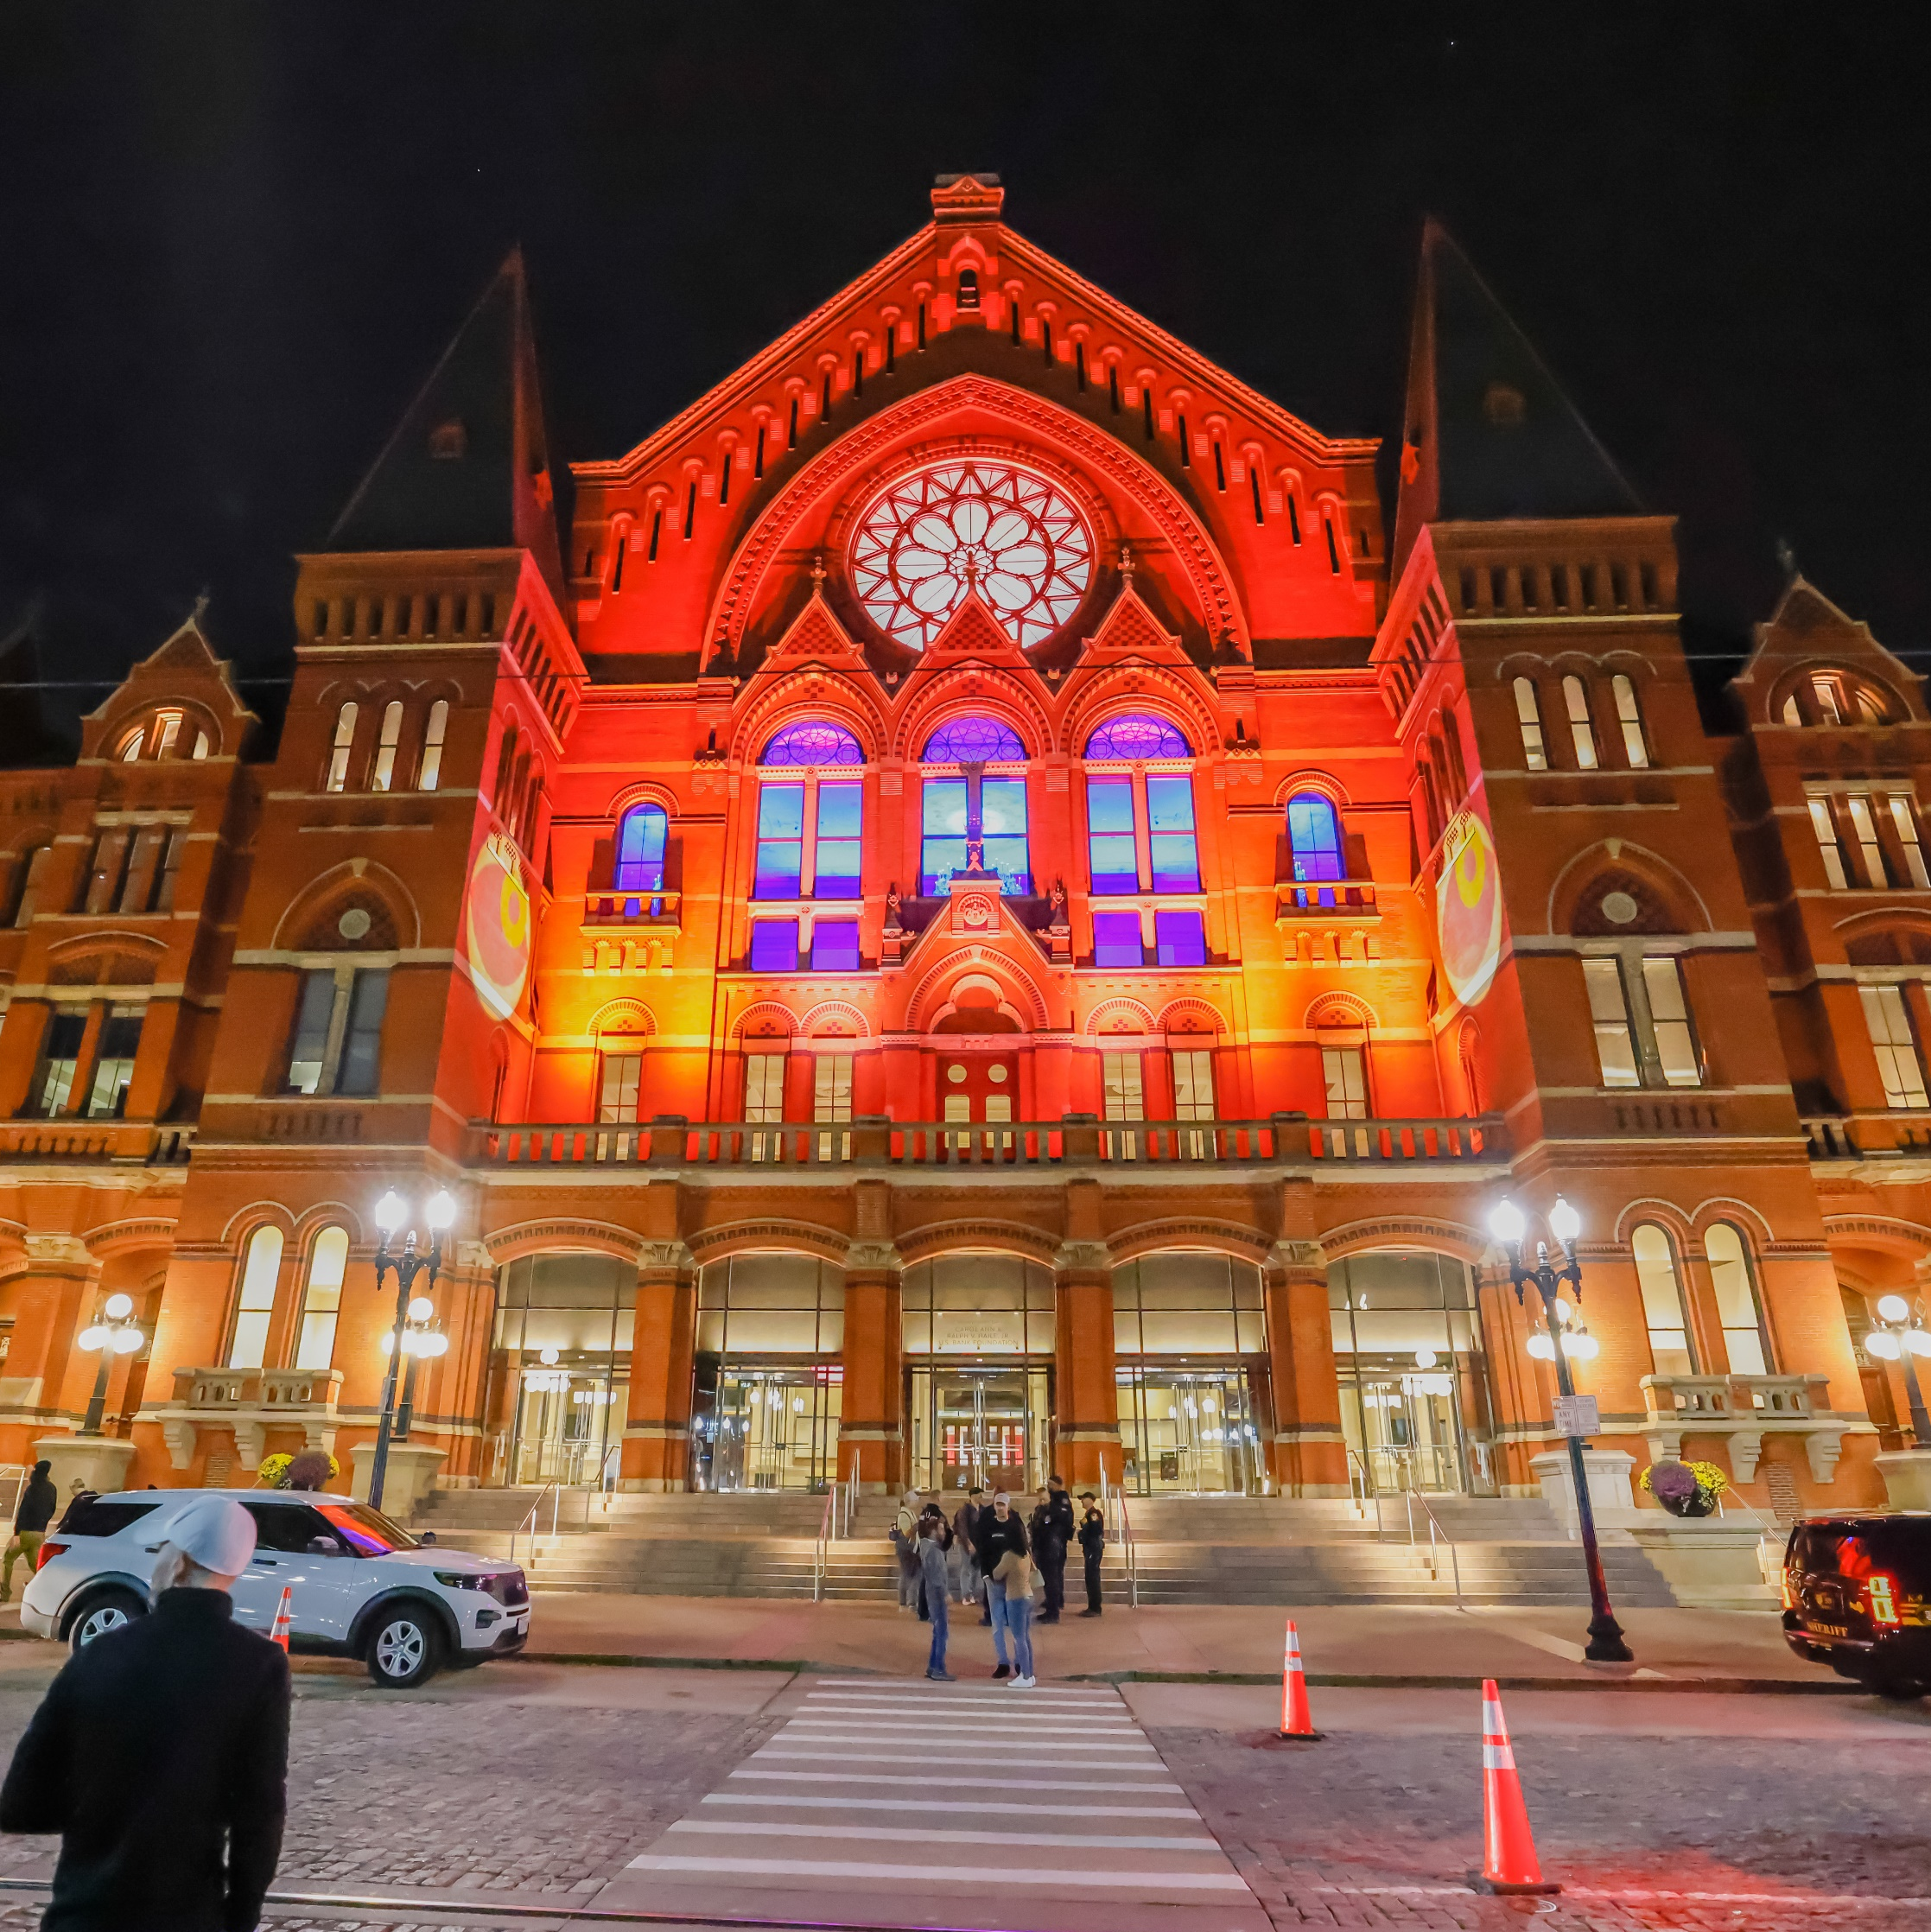
ARTS PUT CINCINNATI ON THE MAP
Arts Put Cincinnati on the Map
attracting employees, new businesses and tourists.
Cincinnati’s creative industries lead Ohio in economic contribution.
Cincinnati ranks No. 2 in the nation for Street Art.
BLINK®, illuminated by ArtsWave, welcomed 2+ Million people in 2022, making it Cincy’s largest event ever and the largest immersive art experience in the nation.
Notes:
The arts drove two-thirds of all tourism, nationally. – NEED CITATION
Cultural tourists spend 2X as much while travelling as other tourists do. - ABS. (2013) Arts and Culture in Australia: A Statistical Overview, 2012. Statistics retrieved 16 May 2018 from http://artfacts.australiacouncil.gov.au/overview/global-13/ov-fact48/.
The Cincy region’s overall reputation has been strengthened through the arts with ??? in national media impressions.

Slide 29
ARTS FUEL CREATIVITY AND LEARNING
Arts Fuel Creativity and Learning
preparing kids to be productive citizens and future employees, and live creative lives.
Low-income students who are highly engaged in the arts are 5X less likely to drop out and 2X more likely to graduate college.
Students with 4 years of art & music score 100 points better on SAT tests than students without arts ed.
ArtsWave’s “More Arts, More Kids” Initiative will make 50,000 arts field trips possible, reaching all CPS 1st-6th grade students.
Notes:
Low-income students who are highly engaged in the arts are 2X more likely to graduate college, compared to those with no arts education.
Arts Education Navigator: Facts & Figures. Americans for the Arts. Retrieved on 13 May 2018 from https://www.americansforthearts.org/by-program/networks-and-councils/arts-education-network/tools-resources/arts-ed-navigator/facts-figures
Students who participate in the arts are 5x less likely to drop out. Students excited by school stay in school. Low-income students who participate in the arts, both in school and after school have a drop out rate of just 4%--5x lower than their peers.
- Same citation as above.
ArtsWave is funding 50,000 field trips over five years, in addition to almost 16,000 arts experiences happening annually so that every elementary school student will experience the arts.

Slide 30
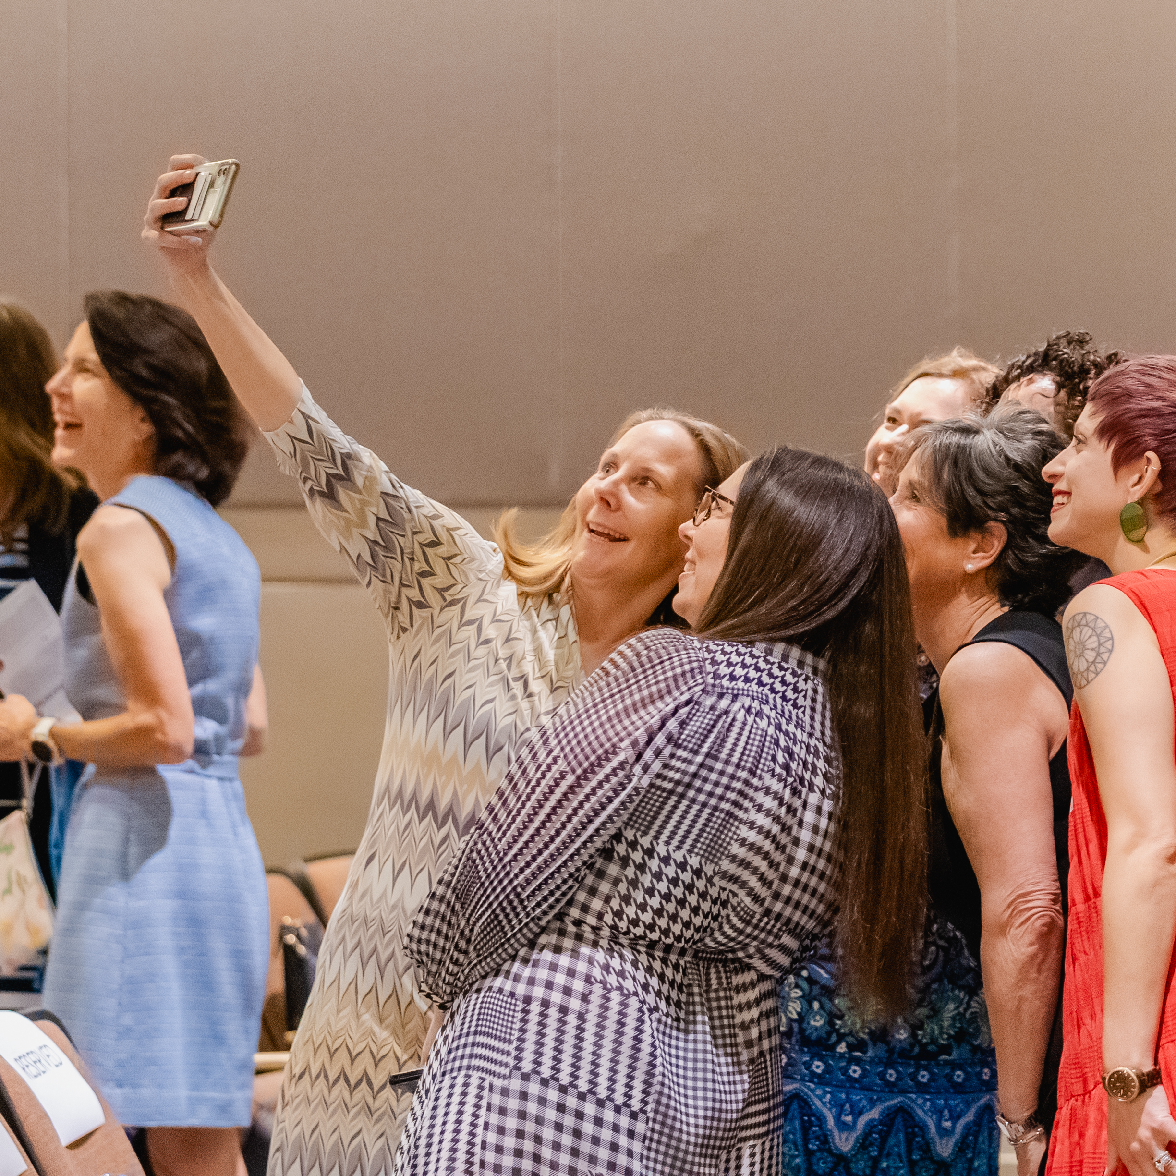
ARTS DEEPEN ROOTS IN THE REGION
Arts Deepen Roots in the Region
retaining employees and residents, including new college grads.
40% feel more positive about their community after participating in arts.
9 out of 10 arts participants report making new friends through their arts experience.
More than 5,600 people joined ArtsWave affinity groups, further connecting to each other and the community.
Notes:
9 out of 10 arts participants report meeting new people and making new friends through their arts experiences.
Stern, M. & Seifert, S. (2001). Culture Builds Communities Evaluation Summary Report. Philadelphia: Penn School of Social Policy & Practice, University of Pennsylvania. Retrieved 16 May 2023 from https://core.ac.uk/download/pdf/214208983.pdf
40% FEEL MORE POSITIVE ABOUT THEIR COMMUNITY AFTER TAKING PART IN THE ARTS.
Participatory arts projects celebrate local culture and heritage, making marginalized groups more visible and promoting positive community connections. In the UK, 40% of participants felt more positive about where they lived after participating in an arts activity.

