Slide 1
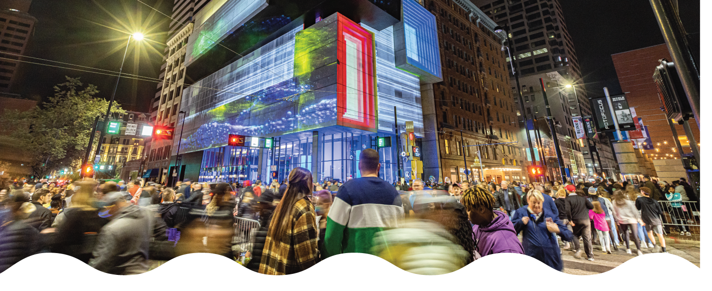
ArtsWave Campaign Coordinator Workshop
Notes:
[Introduction]
Welcome to the XYZ company kick-off! I’m ______ from ______. Thank you for being here/tuning in/logging on today!
[insert personal introduction here. Ex. This is my third time heading up the campaign and things are going to look different this year, etc.]
Before we start today, I’d like to play a little game called what’s missing”?
[click to next slide]

Slide 2
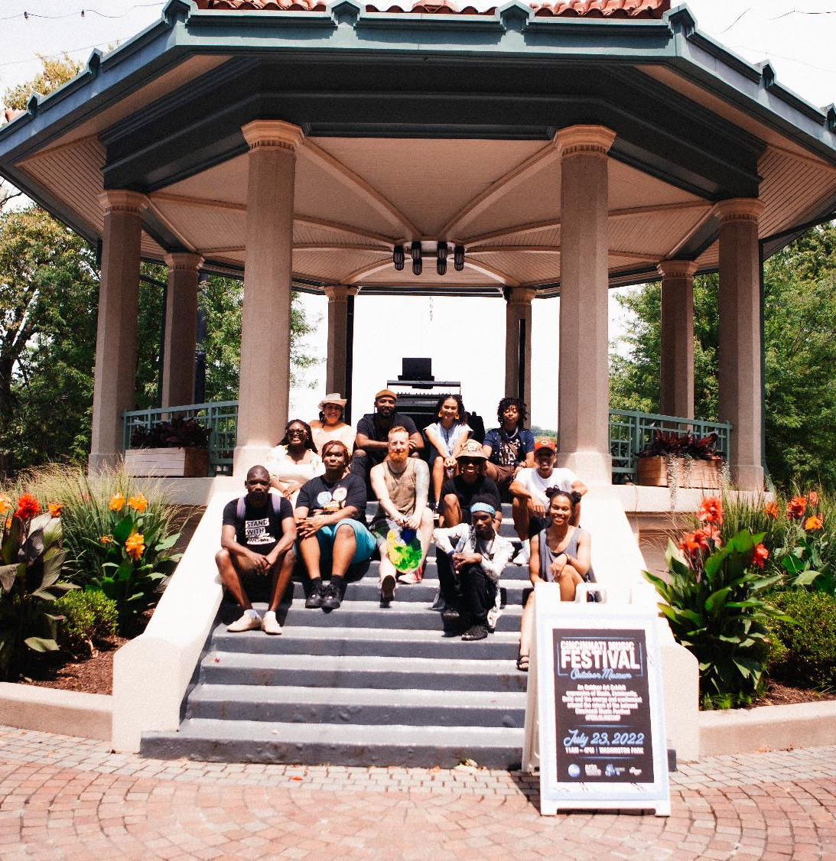
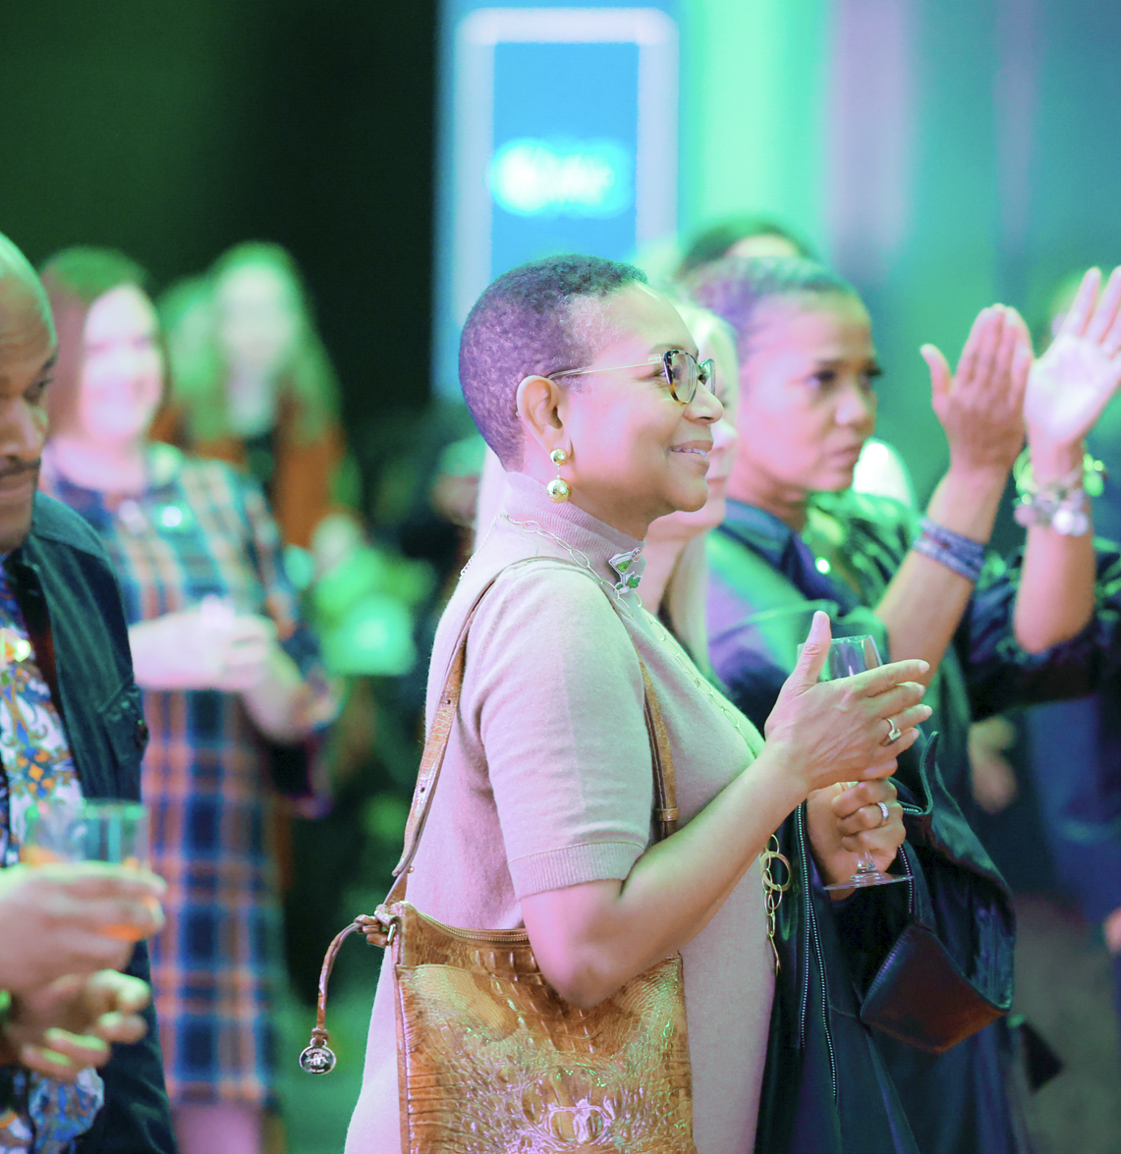
WELCOME
Agenda
The Importance of ArtsWave and Local Arts
Role of the Campaign Coordinator
Discussion
Materials, Tools, Activities & Resources
Donor Benefits & Affinity Groups
Events & Important Dates

Slide 3
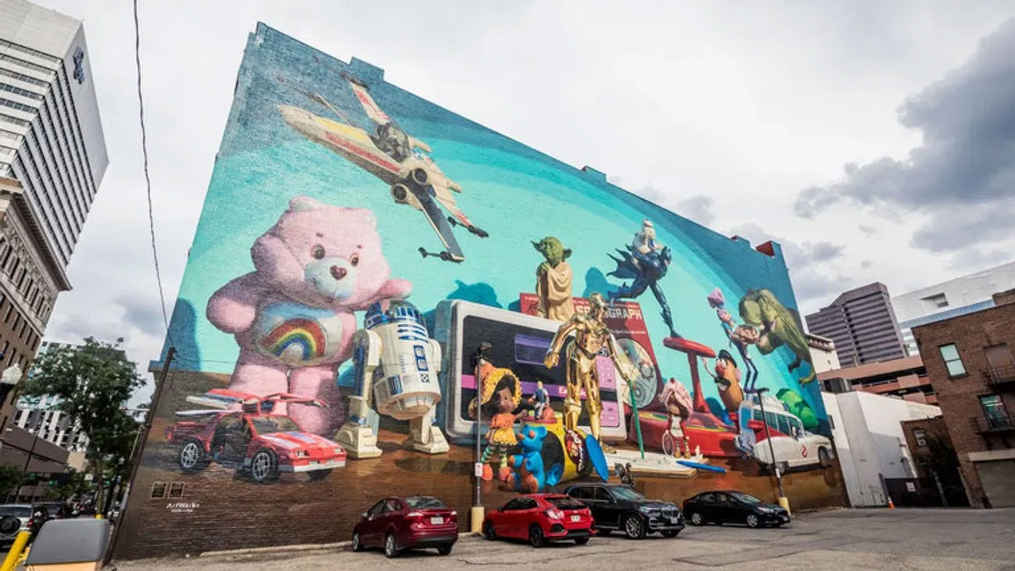
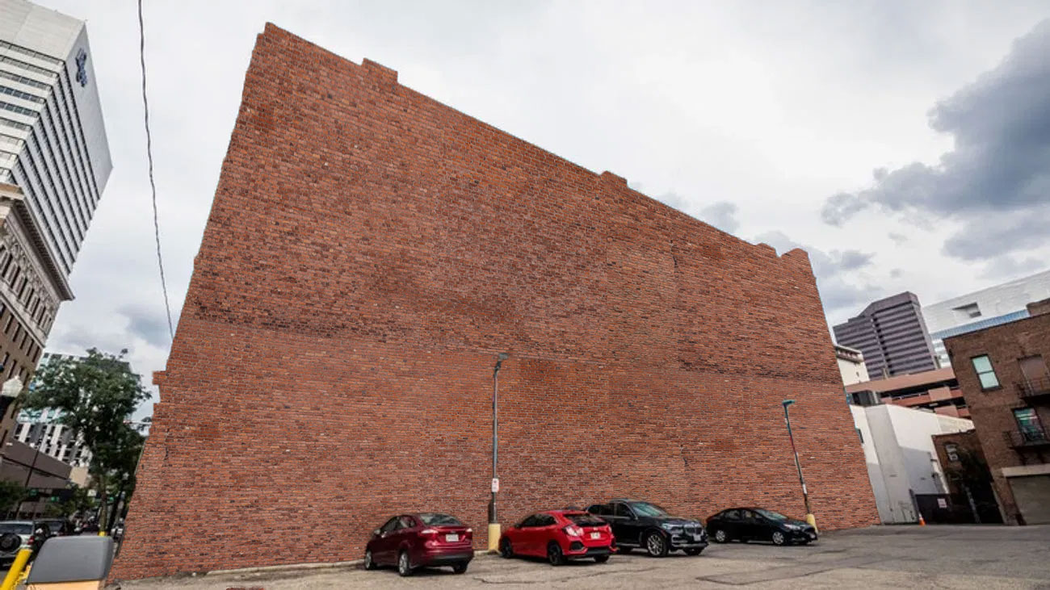
This is where text can go. It’s a text block on a page with multiple text blocks.
This is where text can go. It’s a text block on a page with multiple text blocks.
WHAT’S MISSING?
Notes:
First up, have a non-descript brick wall. At first glance, you’d think nothing was missing. It’s a wall. But there IS something missing.
[CLICK]
How about that to get someone out of their Monday morning funk as they pull up and park next to it?! Cincinnati is #2 in the country for street art and our murals play a major role in transforming the city into one big canvas, giving everyone who lives here a sense of pride in where they live and work.

Slide 4
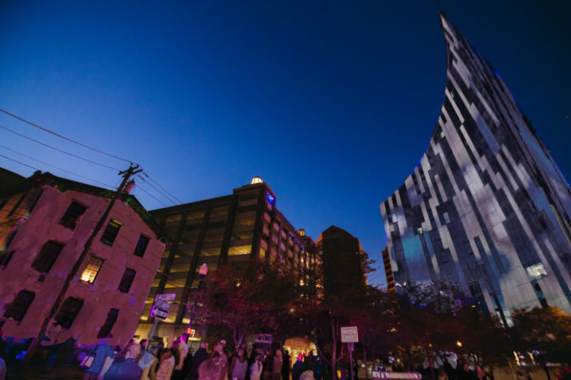
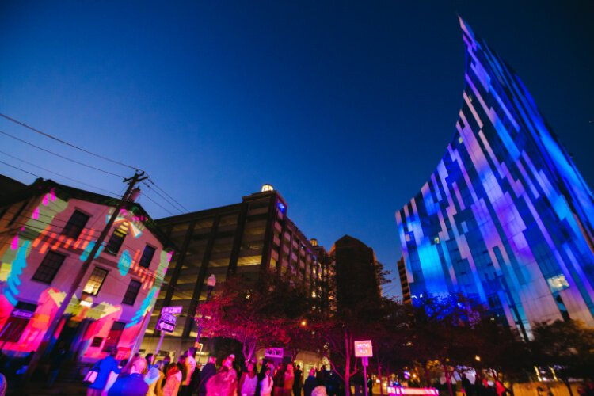
This is where text can go. It’s a text block on a page with multiple text blocks.
This is where text can go. It’s a text block on a page with multiple text blocks.
WHAT’S MISSING?
Notes:
How about this one? Some of you may recognize this as one of the iconic buildings on the river in Northern Kentucky. Although the building and the surrounding area are nice, what’s missing?
[CLICK]
It’s BLINK, illuminated by ArtsWave, the region’s largest event ever and the largest immersive art event in the nation.
[CLICK TO NEXT SLIDE]

Slide 5
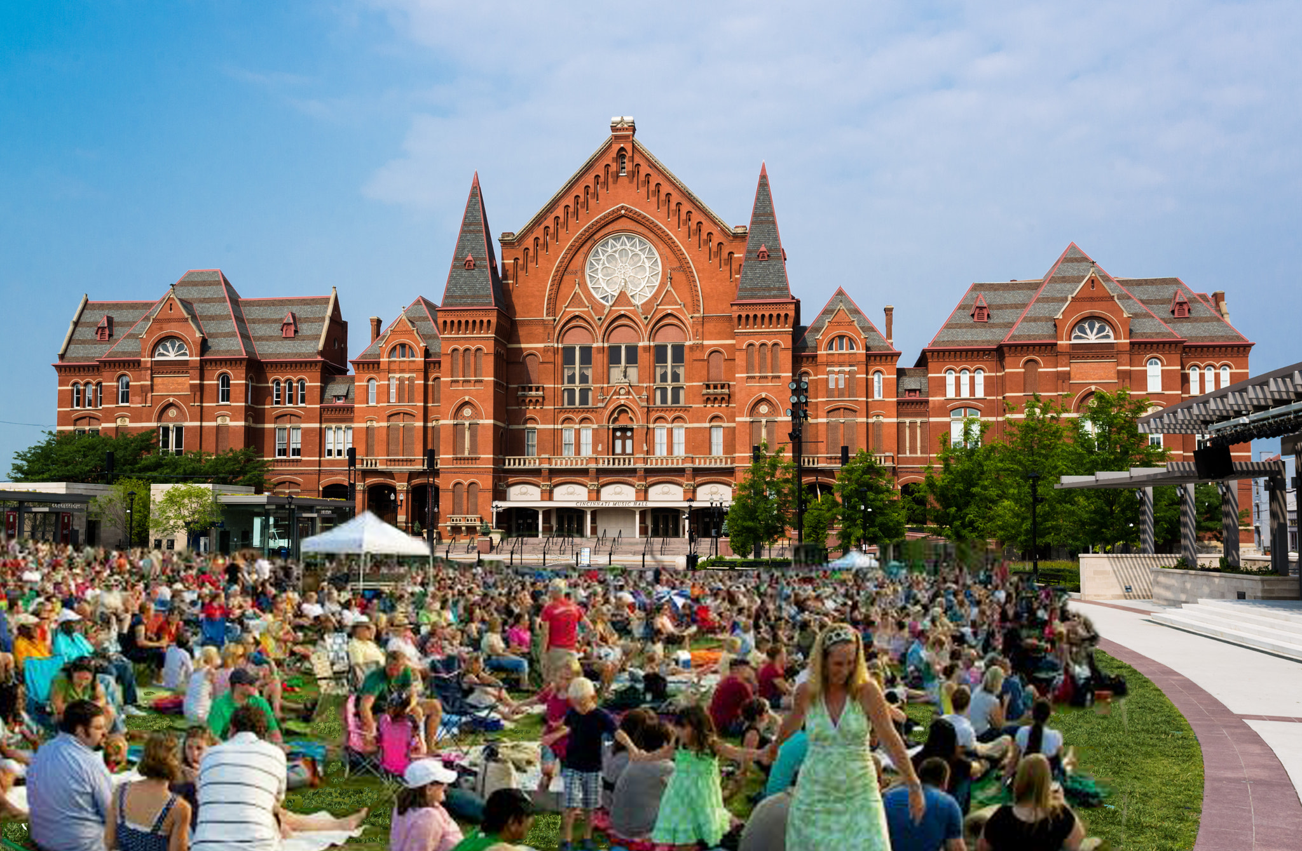
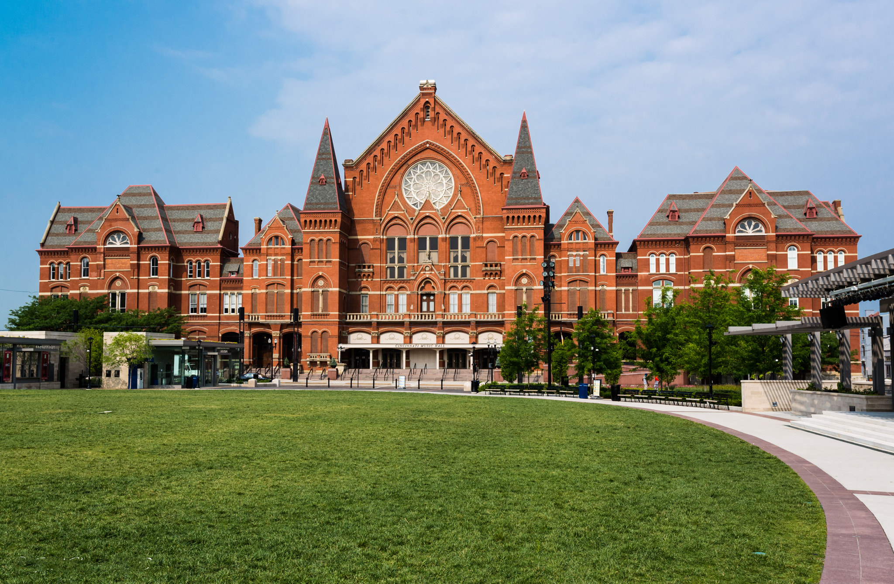
WHAT’S MISSING?
Notes:
Last but not least, we have a lovely photo of Music Hall and Washington Park, but it looks a bit boring and stodgy here. What’s missing?
[CLICK]
There we go! Free and low-cost concerts and festivals happen all the time there, turning it from a nice park with an old building next to it to a vibrant, community-first venue that makes this part of the neighborhood come alive with energy and creativity and a feeling of togetherness.
So, what was missing in all of those photos? What made each location more vibrant?
THE ARTS!
[CLICK TO NEXT SLIDE]

Slide 6
Notes:
We’ve heard a lot about what your gifts to ArtsWave do and the impact they can have. This video really puts it all together. Let’s watch.
[AFTER VIDEO]: So now you know more about how we fund the arts in Cincinnati and the important role each of us plays in that funding.
[click to next slide]

Slide 7
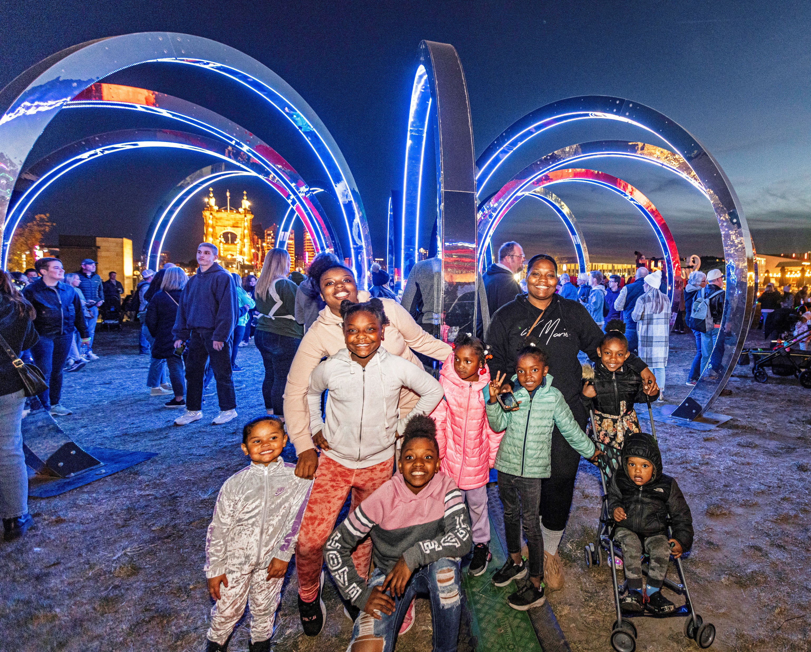
CINCY’S ARTS: POWERING OUR REGION
Our arts make our region STRONGER, defining it as a VIBRANT and CONNECTED community.
Notes:
Those were just a few small examples of what our arts do for our region. But, on the whole…
[READ SLIDE]
How do they do that?
[CLICK SLIDE]

Slide 8
CINCY’S ARTS: POWERING OUR REGION
The ARTS create opportunities for youth
The ARTS bridge cultural divides
The ARTS build strong relationships
The ARTS give Cincy a competitive advantage
Notes:
Here’s a few examples:
[READ FIRST POINT] Studies show that kids who are involved in the arts are 5x less likely to drop out of school and 2x more likely to graduate college.
[READ SECOND POINT] 91% in a recent study reported making new friends as a result of participating in the arts. In our culture, as the epidemic of loneliness continues to get worse, the arts are a bright spot in building human connections.
[READ THIRD POINT] 90% of those in a study by University of Cincinnati agreed that the arts help them understand perspectives from other cultures. We’re more tribal than ever these days and the arts can help combat that.
[READ FOURTH POINT] For the third year in a row, the Cincinnati region was named a top 20 arts-vibrant community, with special recognition given to our plentiful public art. Everyone that was around the past few years probably remembers BLINK, illuminated by ArtsWave. It has become the largest immersive arts experience in the nation and the largest event of any kind in Cincinnati. That’s a great example of the arts showcasing our region and bringing folks from every walk of life together.
So, what does all this that have to do with ArtsWave?
[CLICK SLIDE]

Slide 9
YOUR GIFT TO ARTSWAVE (plus 25,000 others!) UNLEASHES THAT POWER!
For nearly 100 years, gifts to ArtsWave have been the primary way Cincy’s arts are funded.
Notes:
It’s YOUR gift to ArtsWave that makes this possible.
[READ RED TEXT AFTER IT COMES IN]
Since 1927, the community has invested more than $350 million through ArtsWave, creating a dynamic foundation for our arts and our region to thrive. This started with a lead gift of $1 million from the Taft family, but was then matched and surpassed that same year with 2.5 million from regular folks in the community! So, from the beginning, this campaign has relied on thousands across the region.
Let’s look at where your gift goes today.
[CLICK SLIDE]

Slide 10
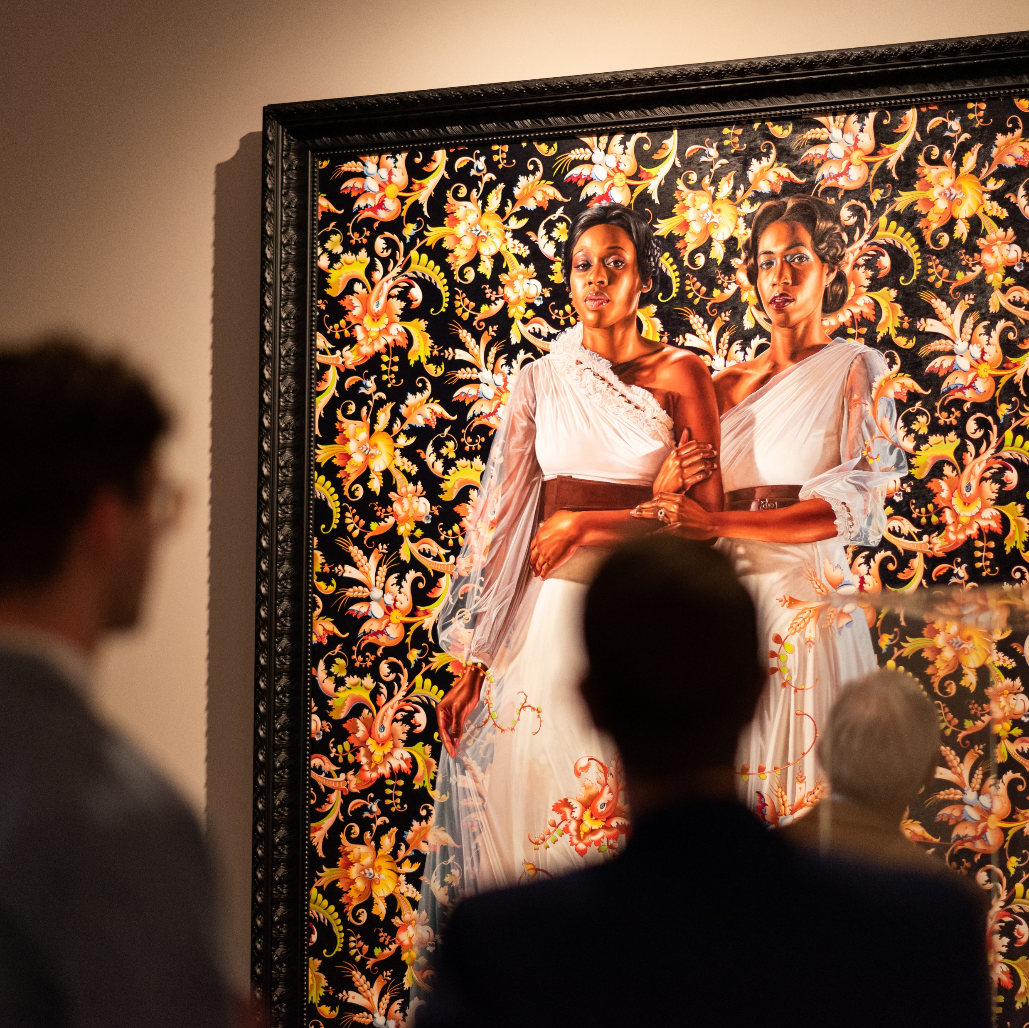
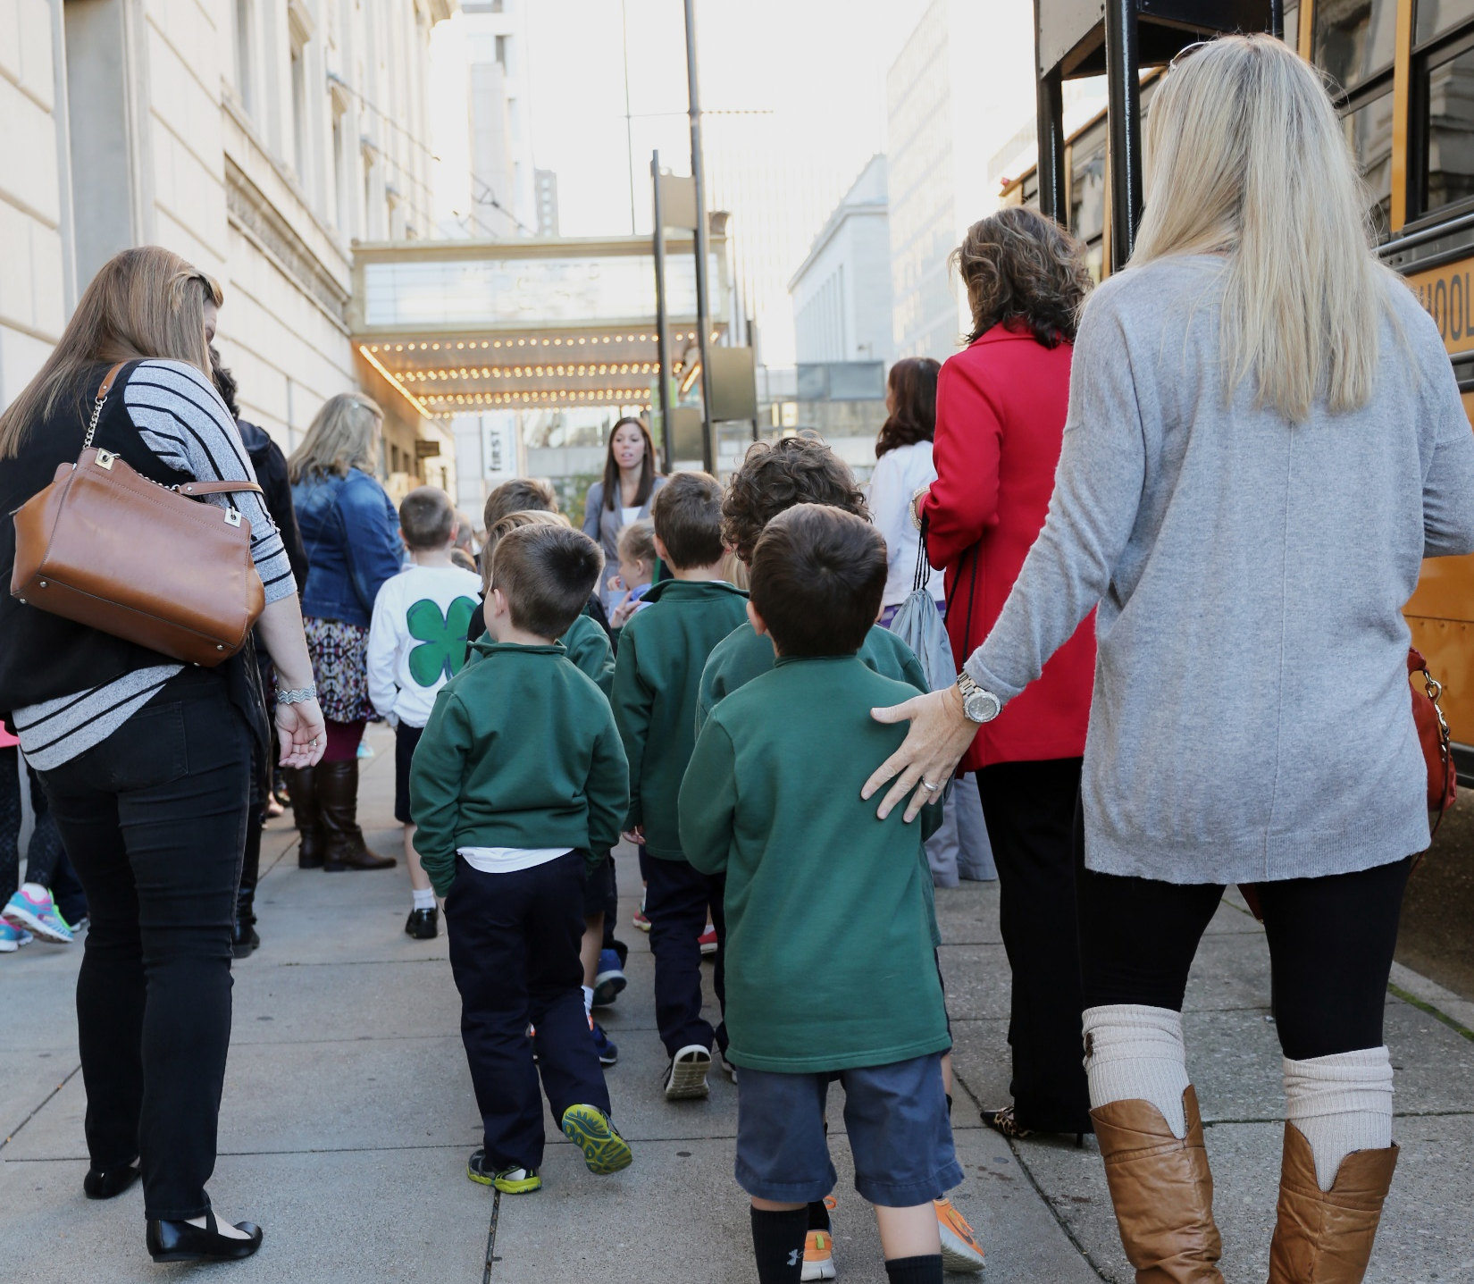
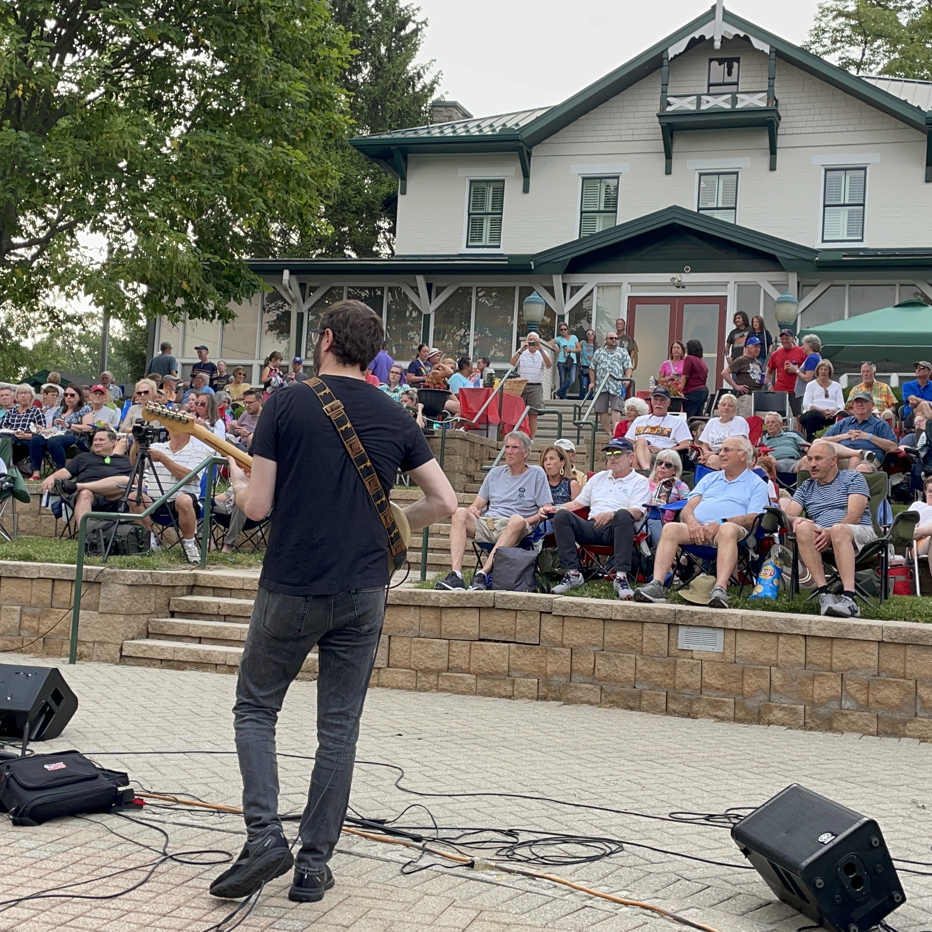
YOUR GIFT TO ARTSWAVE (plus 25,000 others!) UNLEASHES THAT POWER!
Your gift is invested in 150+ organizations, artists and projects.
Your gift supports arts experiences for kids.
Your gift impacts where you live.
Notes:
[read slide – special emphasis on ‘25,000 others’]
[READ first point] They’ll go on to create thousands of concerts, shows, exhibitions, arts education programming, public art, festivals, events like BLINK® and more.
[READ second point] In primary education, the arts have been on the chopping block for decades. This only accelerated during and after the worst of the pandemic. One example of what ArtsWave is doing to combat this is ArtsWave’s “More Arts, More Kids” initiative which is providing annual arts field trips for all 1st-6th graders in Cincinnati Public Schools and soon expanding into Northern Kentucky. These experiences can uniquely open up a childs world to perspectives from communities outside of their own, increase empathy and spur on creative pursuits further down the line in their educational journey.
[READ third point] Last year, a total of 2.3 million people attended free or low-cost neighborhood events by ArtsWave-funded organizations, bringing us together through the arts. This represented events by large organizations like the Symphony and Cincinnati Shakespeare, and by smaller neighborhood-based organizations like Clifton Cultural Arts Center, Oxford Community Arts Center and down in Northern Kentucky at The Carnegie.

Slide 11
LAST Campaign Results
$11,915,739 24,556 donors
102% of Goal!

Slide 12
GROWING IMPACT
Steady Support to Sustain Arts Vibrancy
48
A Mindful Moment (The Well)
American Legacy Theatre
ArtsConnect
ArtWorks
Behringer-Crawford Museum
Bi-Okoto Drum & Dance Theatre
Cincinnati Art Museum
Cincinnati Ballet
Cincinnati Boychoir
Cincinnati Chamber Orchestra
Cincinnati Landmark Productions
Cincinnati Men's Chorus
Cincinnati Musical Festival
Association
Cincinnati Opera
Cincinnati Playhouse in the Park
Cincinnati Shakespeare Company
Cincinnati Symphony Orchestra
Cincinnati Youth Choir
Clifton Cultural Arts Center
Contemporary Arts Center
Elementz Hip Hop Cultural Art Center
Ensemble Theatre Cincinnati
Fitton Center for Creative Arts
Kennedy Heights Arts Center
Kentucky Symphony Orchestra
Know Theatre of Cincinnati
Learning Through Art, Inc.
Linton Chamber Music
MUSE Cincinnati's Women's Choir
Mutual Dance Theatre and Arts
Centers
My Nose Turns Red Youth Circus
NrityArpana School Of Indian
Classical Dance
Over-the-Rhine International Film Festival
Oxford Community Arts Center
Pones
Price Hill Will
Professional Artistic Research Projects
Pyramid Hill Sculpture Park and
Museum
Queen City Opera
Revolution Dance Theatre
Taft Museum of Art
The Carnegie
The Children's Theatre of Cincinnati
Visionaries and Voices
Vocal Arts Ensemble of Cincinnati
Wave Pool
Wyoming Fine Arts Center
Young Professionals Choral Collective
Sustaining Impact Grants
Unrestricted operating support awarded in 3-year cycles
Grant amount based on budget and community impact
No other community does this at this scale
Notes:
[THIS YEAR, WE ARE PROVIDING A RECORD 49 ARTS ORGANIZATIONS WITH UNRESTRICTED OPERATING SUPPORT TO SUSTAIN THEIR COMMUNITY IMPACT IN THOSE FIVE AREAS.
in aggregate, THE ArtsWave CAMPAIGN IS FUNDING 6% OF THESE TOTAL BUDGETS. This rePRESENts AN irreplaceable, STABLE FOUNDATION from WHICH organizations then deliver thousands of uplifting and inspiring experiences.

Slide 13
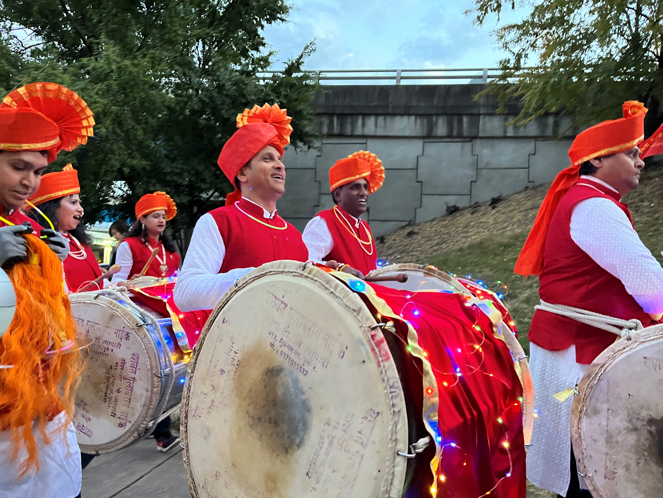
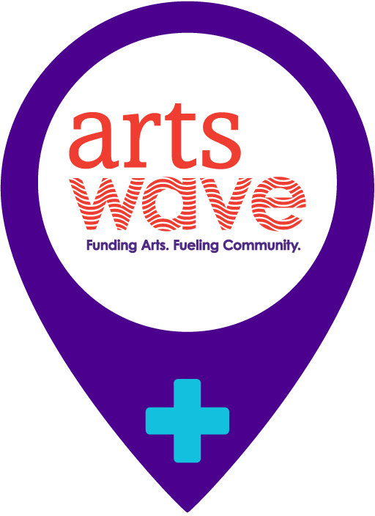
WIDENING IMPACT
Grants to Organizations, Artists and Projects
8
The Circle Grants for African American Arts
7
ArtsWave Pride Grants
36
Catalyzing Impact Grants
8
ArtsWave YP Grants
18
Black & Brown Artist Program
36
Strategic Partnership, Sponsorship and Local Illuminations Grants
Notes:
And that impact is broadening to affect more in our region through what is being accomplished.

Slide 14
This year, we want to have the
LARGEST CAMPAIGN EVER!
The most ArtsWave has raised in a campaign is
$12,493,871
Notes:
Alecia

Slide 15
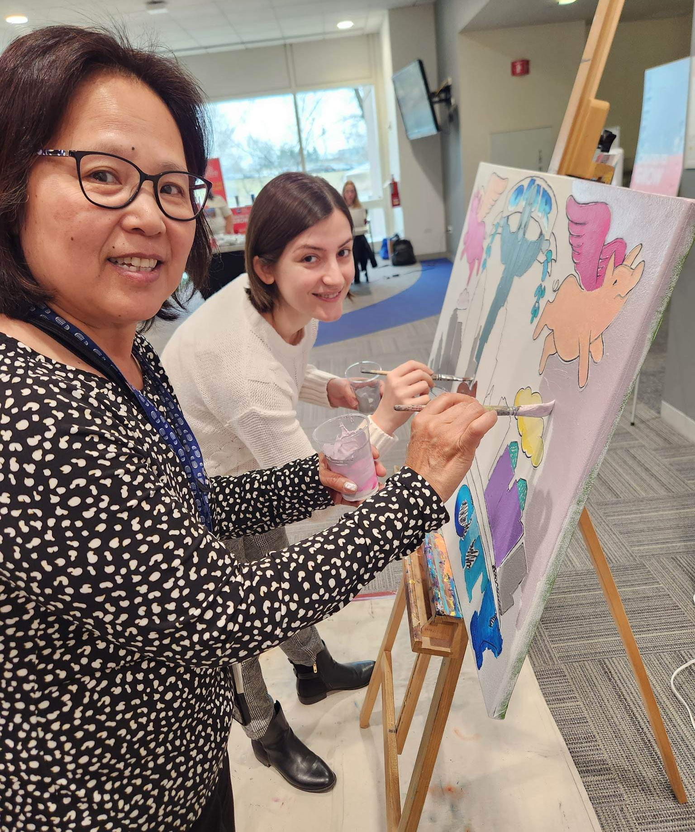
ROLE OF THE COORDINATOR
Promote ArtsWave
What the arts do, how to give, information on events, etc.
Drive Response
Schedule/send communications, organize engagement efforts
Encourage Giving
Be creative!
Tell the Story of the Arts
Use our resources and make it personal!
Notes:
Your role is vitally important, as you saw, 49% of the money raised in our annual campaign last year was from workplace campaigns
You can motivate and inspire your coworkers to give by: (go through bullets)

Slide 16
BEST PRACTICES
Schedule a speaker, artist, entertainment, etc. during a meeting or as a standalone event
Engage Leadership & include them in your events, meetings and communications
Promote ArtsWave’s donor benefits!
If you’re an Epledge company, provide data ASAP
Highlight any internal incentives (PTO, gift cards, etc.)
Emphasize that every gift makes an impact!

Slide 17
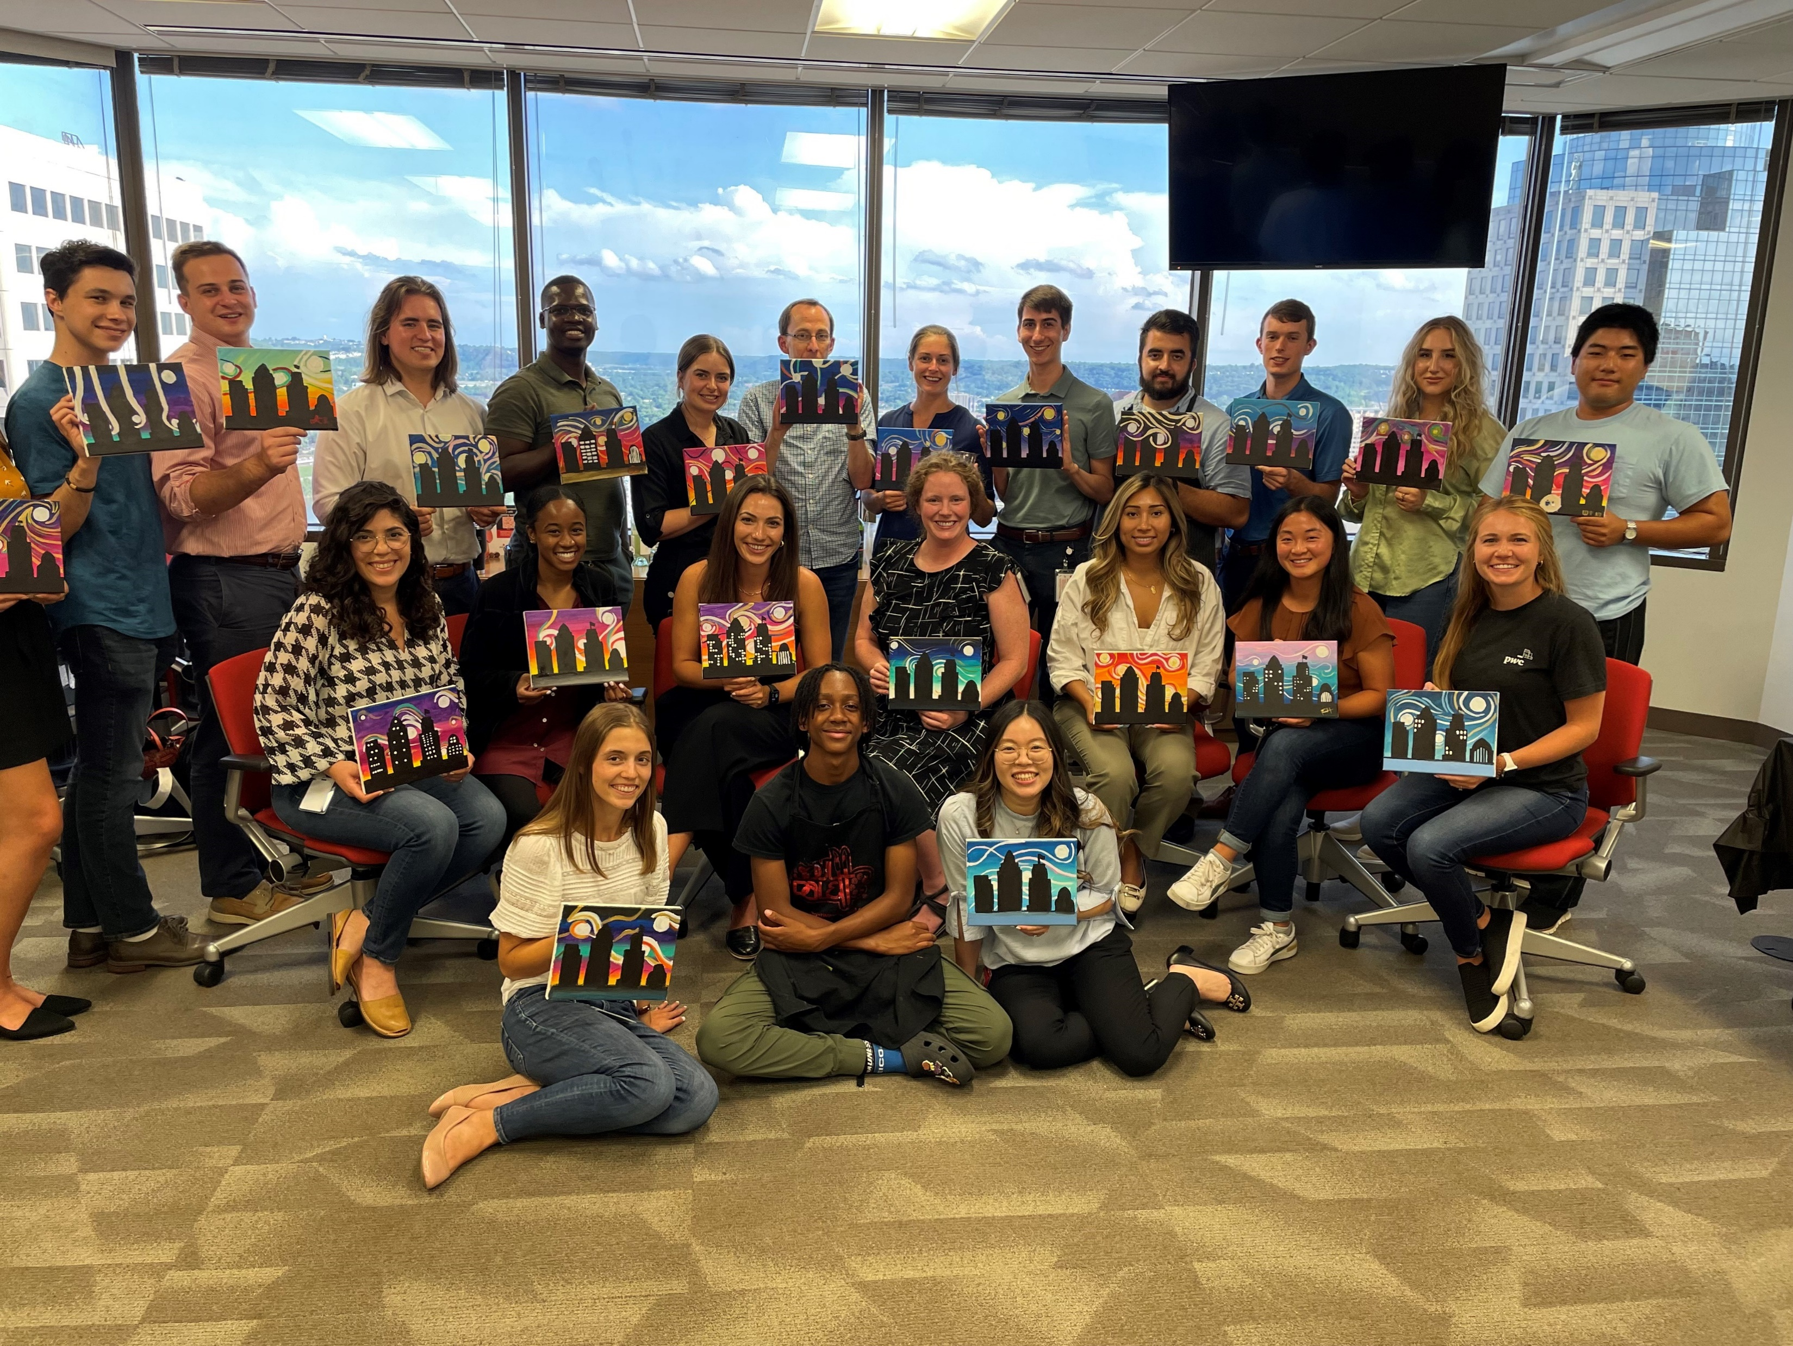
DISCUSSION
Guiding Topics:
Differentiating the ArtsWave campaign and making it different each year
Engaging employees and attracting new donors – how to get people interested!!
Creative incentives/raffles beyond ArtsWave benefits
Special events ideas:
In-person or Virtual
Leadership’s role in your campaign
Involving ERG/BRG/Affinity Groups
Communication plans
Setting goals
Notes:
Folks who are new to ArtsWave - who learned something that will inspire your company?
Folks who have done this before - who learned something new?
There’s always something new to share to engage your people.
Let’s discuss how to engage them most effectively. Use these 4 steps.

Slide 18
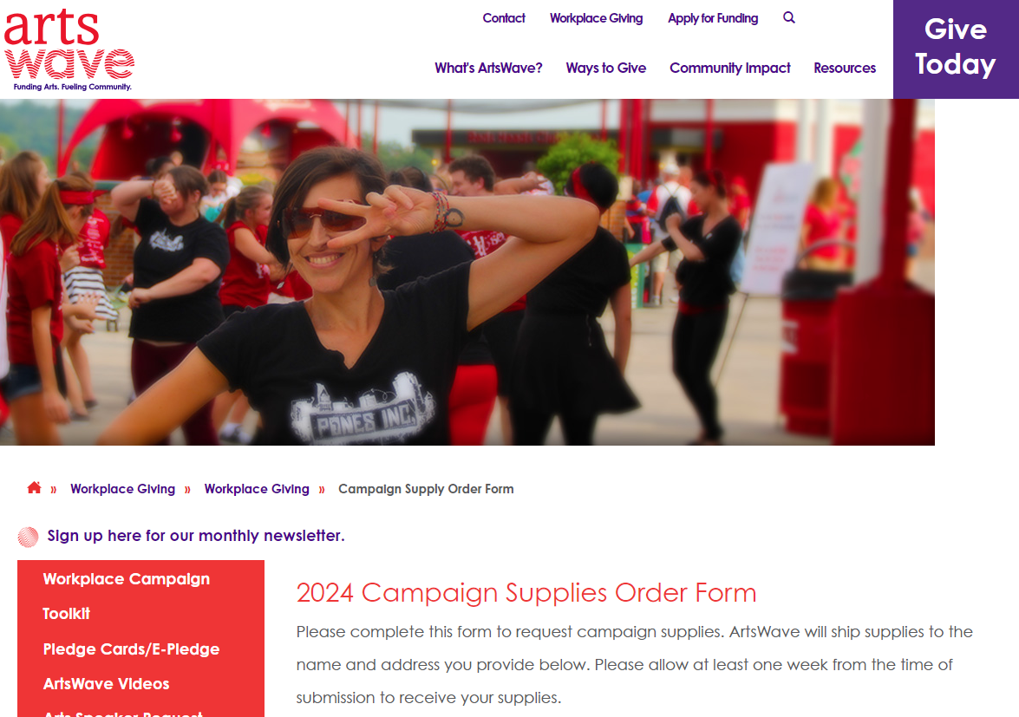
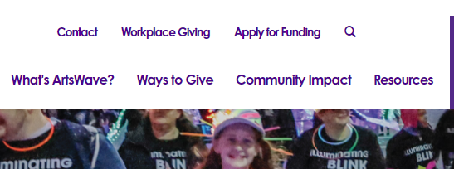
MATERIALS & TOOLS
Workplace Giving Toolkit
Email, letter and presentation templates
Campaign supplies
Speaker, artist, entertainment requests
Campaign video library… and more!
Employee Coordinator Handbook
Campaign Ideas, Themes & Examples
Campaign Checklist
General Campaign Info
Donor Benefits
Notes:
How do we help you accomplish these goals and how do you get started? Well we have a number of materials and tools to help you raise awareness and run your campaign.
Our website has almost everything you need – this is one of the major takeaways from this presentation, that most materials, one-pagers, information, and more can be found at our website artswave.org under the Workplace Giving tab. That will become your friend.

Slide 19
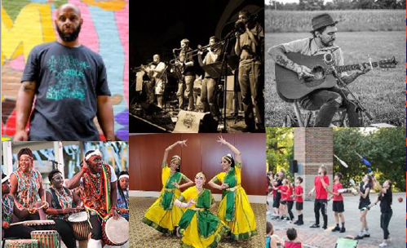
SPEAKERS & PERFORMERS
ArtsWave Artist @ Your Meeting
Need to bring some entertainment to an event or meeting? Schedule one of the Cincinnati region's top artists!
Arts Speakers
These are INCREDIBLY important …and FREE! Featuring leaders from our incredible arts organizations all over the region.
Notes:
An arts speaker should be used at your kick-off or at other gatherings to speak for 10-15 minutes about the impact your gifts have on their organization. This is your chance to show the true and life-changing impact a gift to ArtsWave can have.
Performances can range from an evening of live, in-person entertainment to a quick 5-10 minute virtual drop-in. All art forms are available to fit you and your team. Examples:
At a retirement party, the lyrics to a popular song are rewritten about the person retiring, then sung by a professional who pops in to the meeting (virtually or in-person) to share in the fun.
A company has someone in leadership who loves classical music, so to surprise that person, an instrumentalist visits the office or joins a call to perform a piece.
A jazz band provides ambient music for a lunch event.
A local actor performs a stirring monologue to get the team ready for a major project that's about to begin.

Slide 20
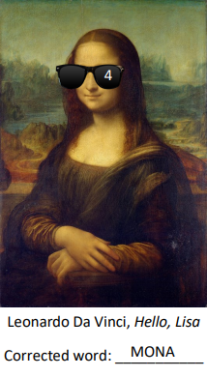
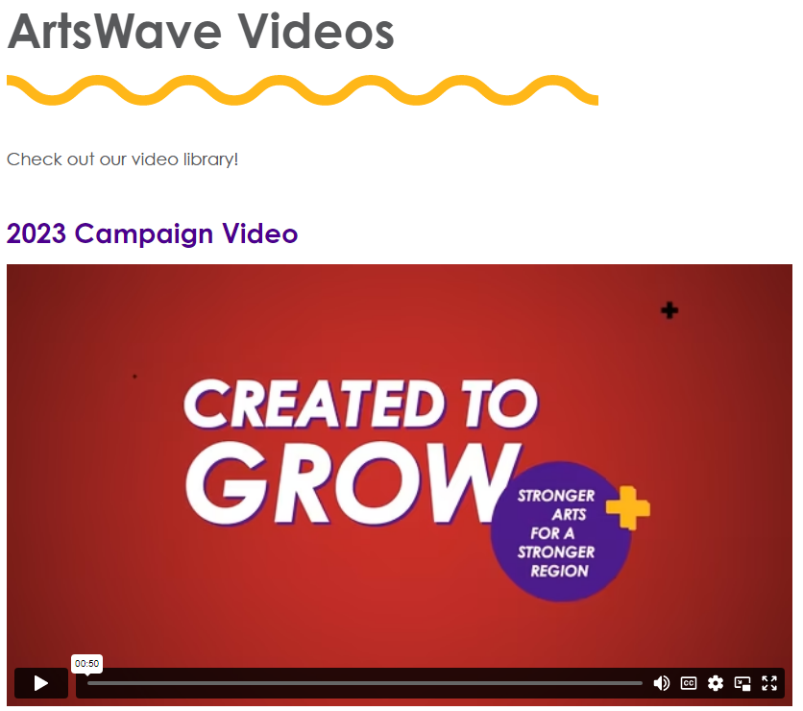
HYBRID RESOURCES
ArtsWave Puzzle Crawl
Solve a series of arts-based puzzles and be the first team to win!
ArtsWave Trivia
Local arts trivia game for up to 100 players at a time!
Campaign Videos
Video library to effectively & quickly tell ArtsWave’s story
Notes:
ArtsWave Trivia can be requested via the form in the ArtsWave Workplace Giving Toolkit – FREE and an ArtsWave rep will run the game for you.
ArtsWave Puzzle Crawl is available on our website anytime and can be run without ArtsWave staff – but let your ArtsWave rep know if you have questions on how it works! (we will see an example in just a moment)
Videos are also free and available on the toolkit – can also be downloaded from our Vimeo site (which you can link to from the videos section of the toolkit).

Slide 21
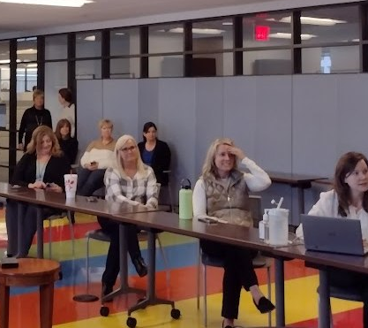
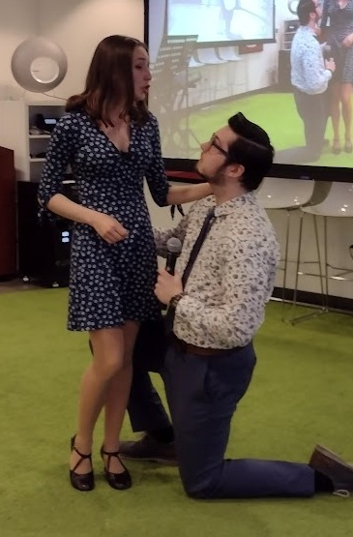
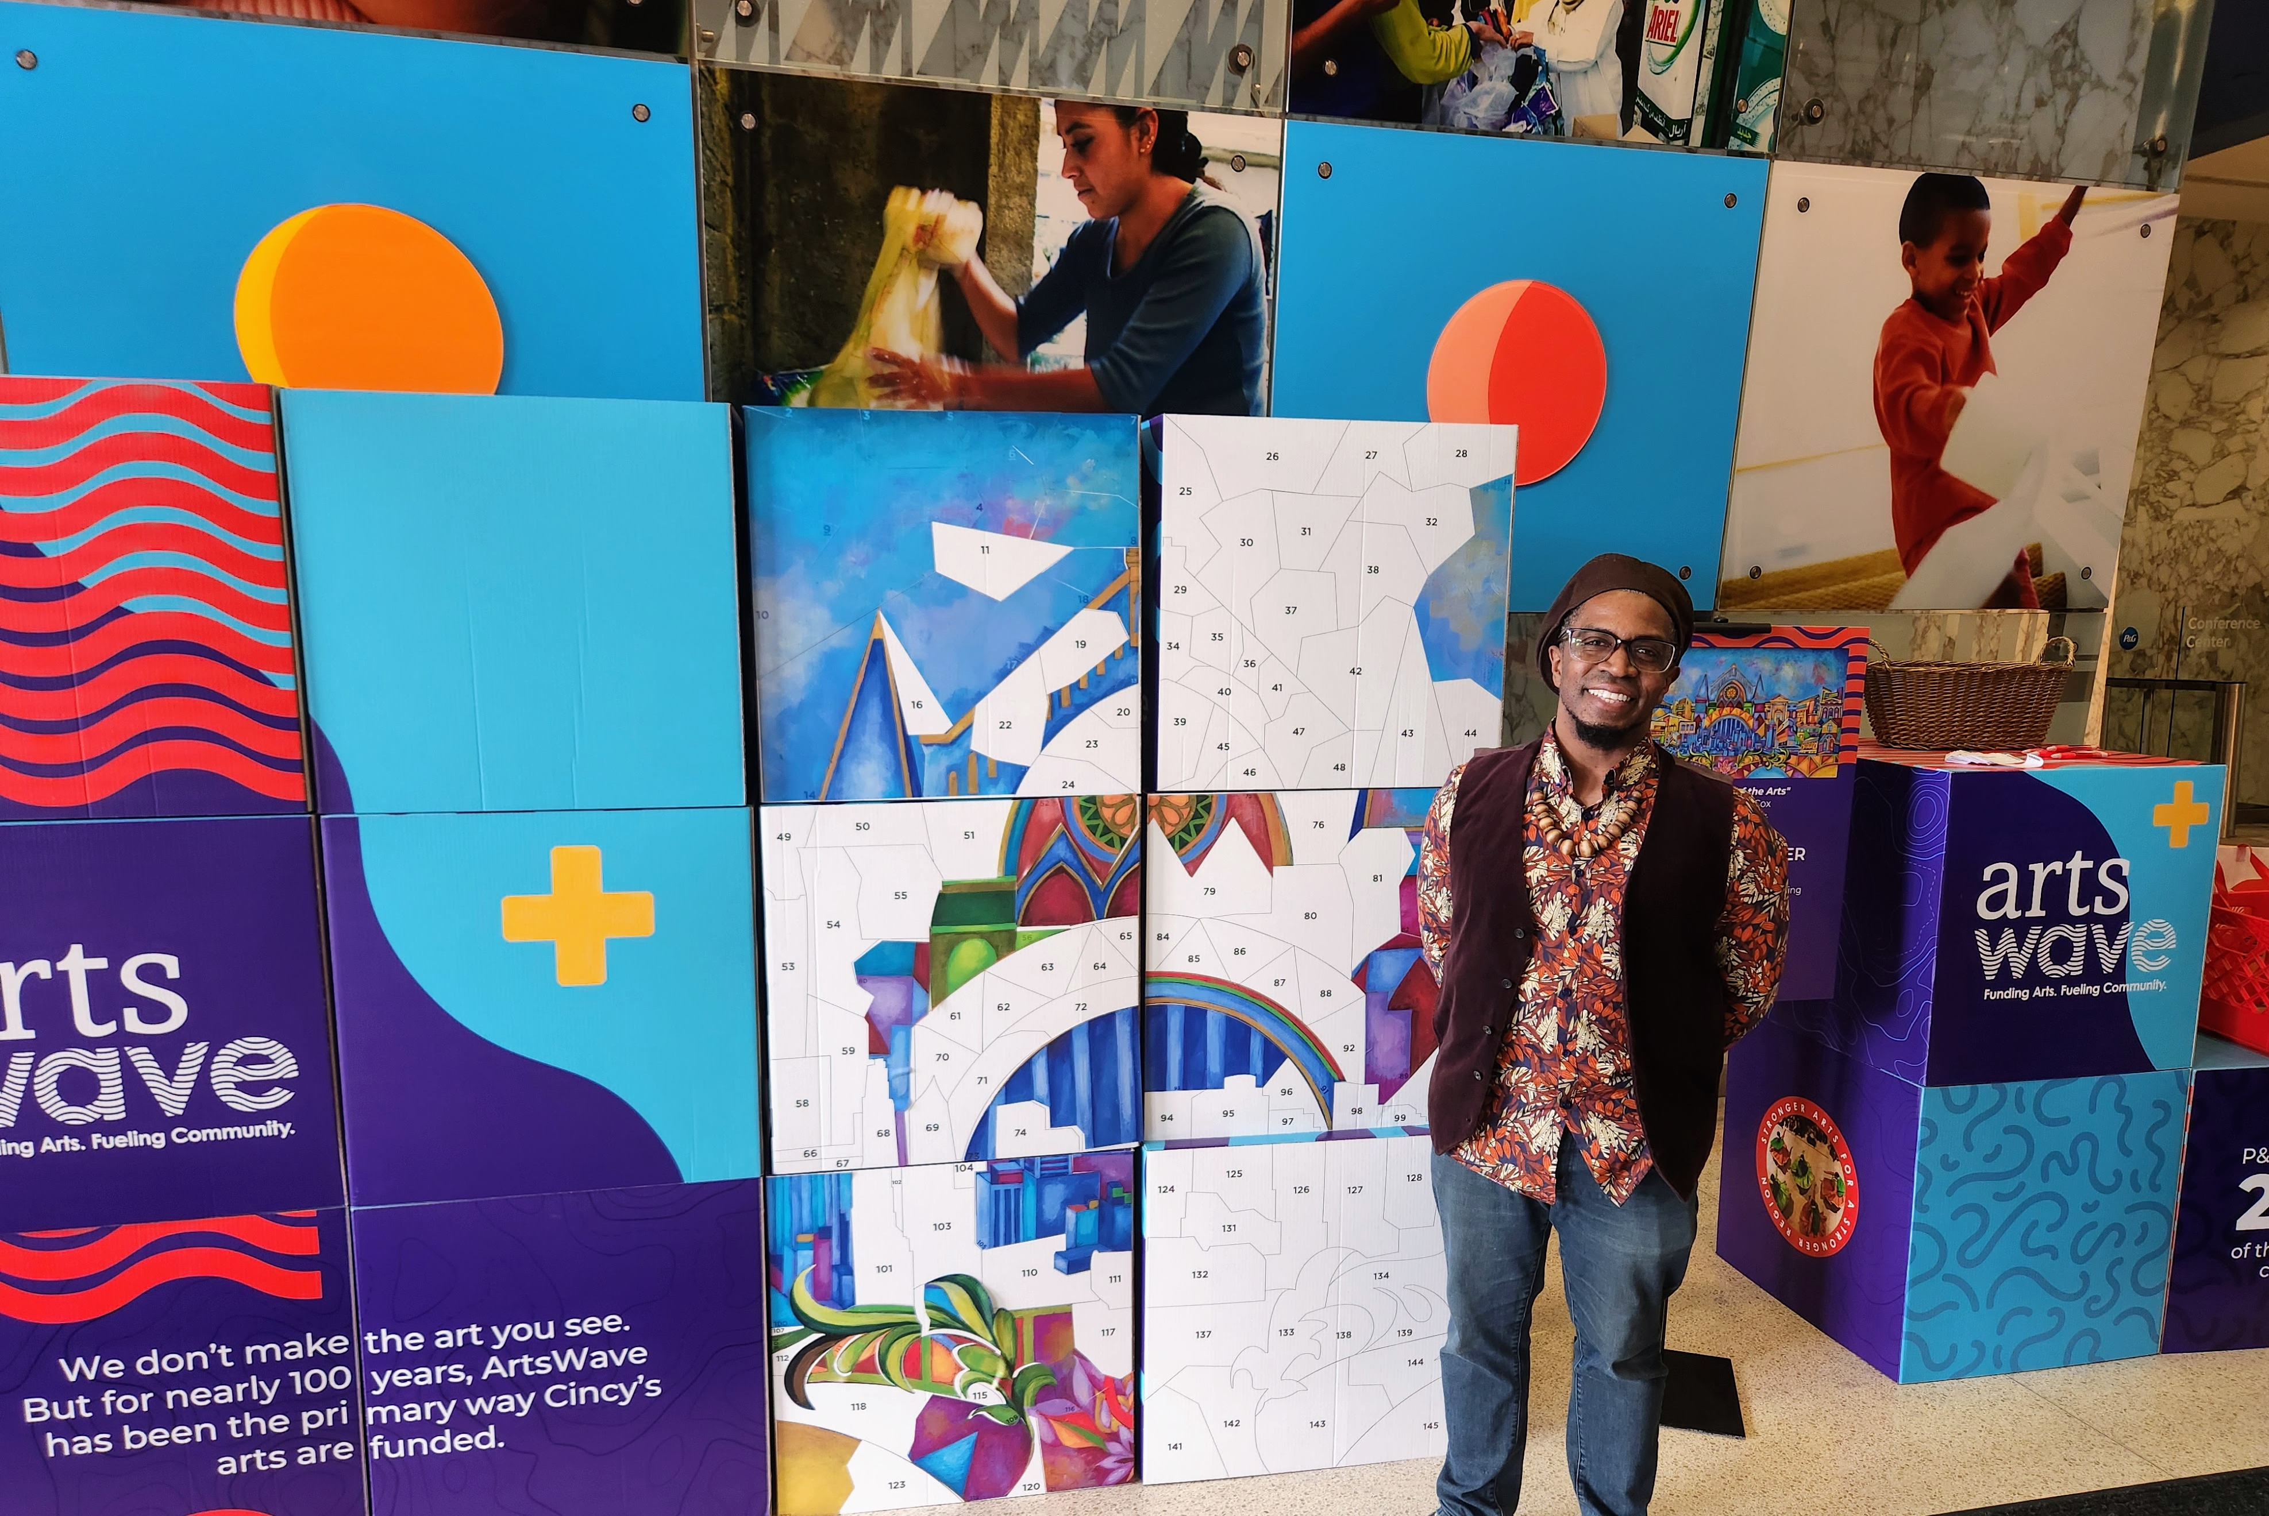
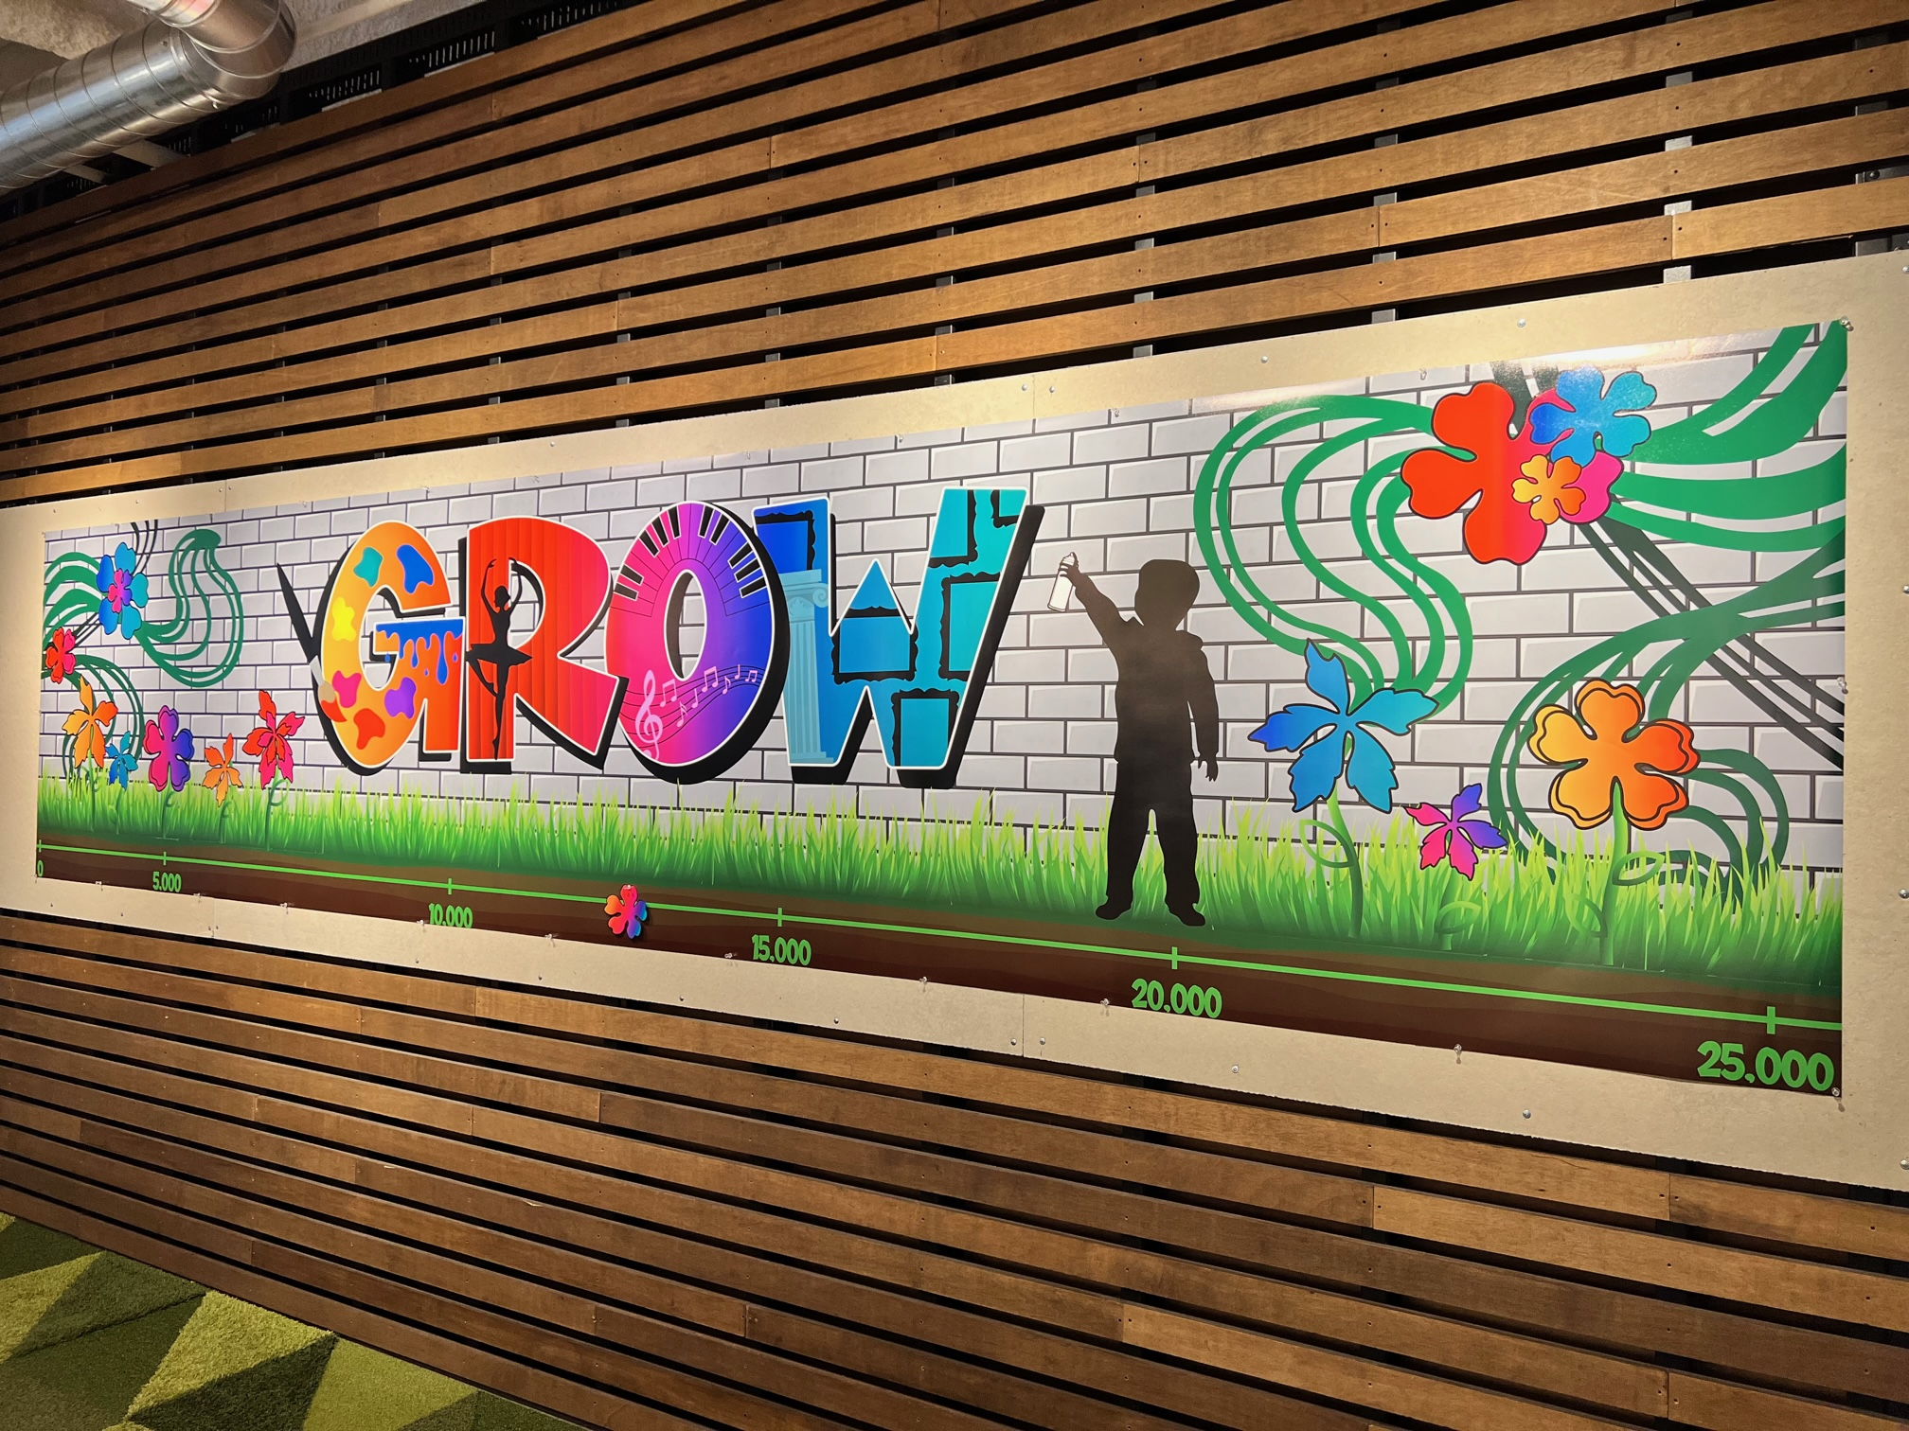
ACTIVITY EXAMPLES
Notes:
Aside from the specific activities ArtsWave offers/provides, you can get creative and come up with your own. Here are some examples:
E.W. Scripps hosted actors from Cincinnati Landmark Productions “Kiss Me, Kate” who performed scenes from the show to spice up their campaign and workday
P&G brought in Brandon Hawkins from Soul Palette to guide employees through a group-created work of art! (see photo below)
SHP took our 2023 “Created to Grow” theme to heart and centered around how the arts grow figuratively and literally! They brought experts in to create floral arrangements, created themed artswork, and even installed a Grow mural on their wall!
Finally, back at P&G they created a puzzle from the "Our Golden City of the Arts" mural by Cedric Michael Cox that was completed by the employees.

Slide 22
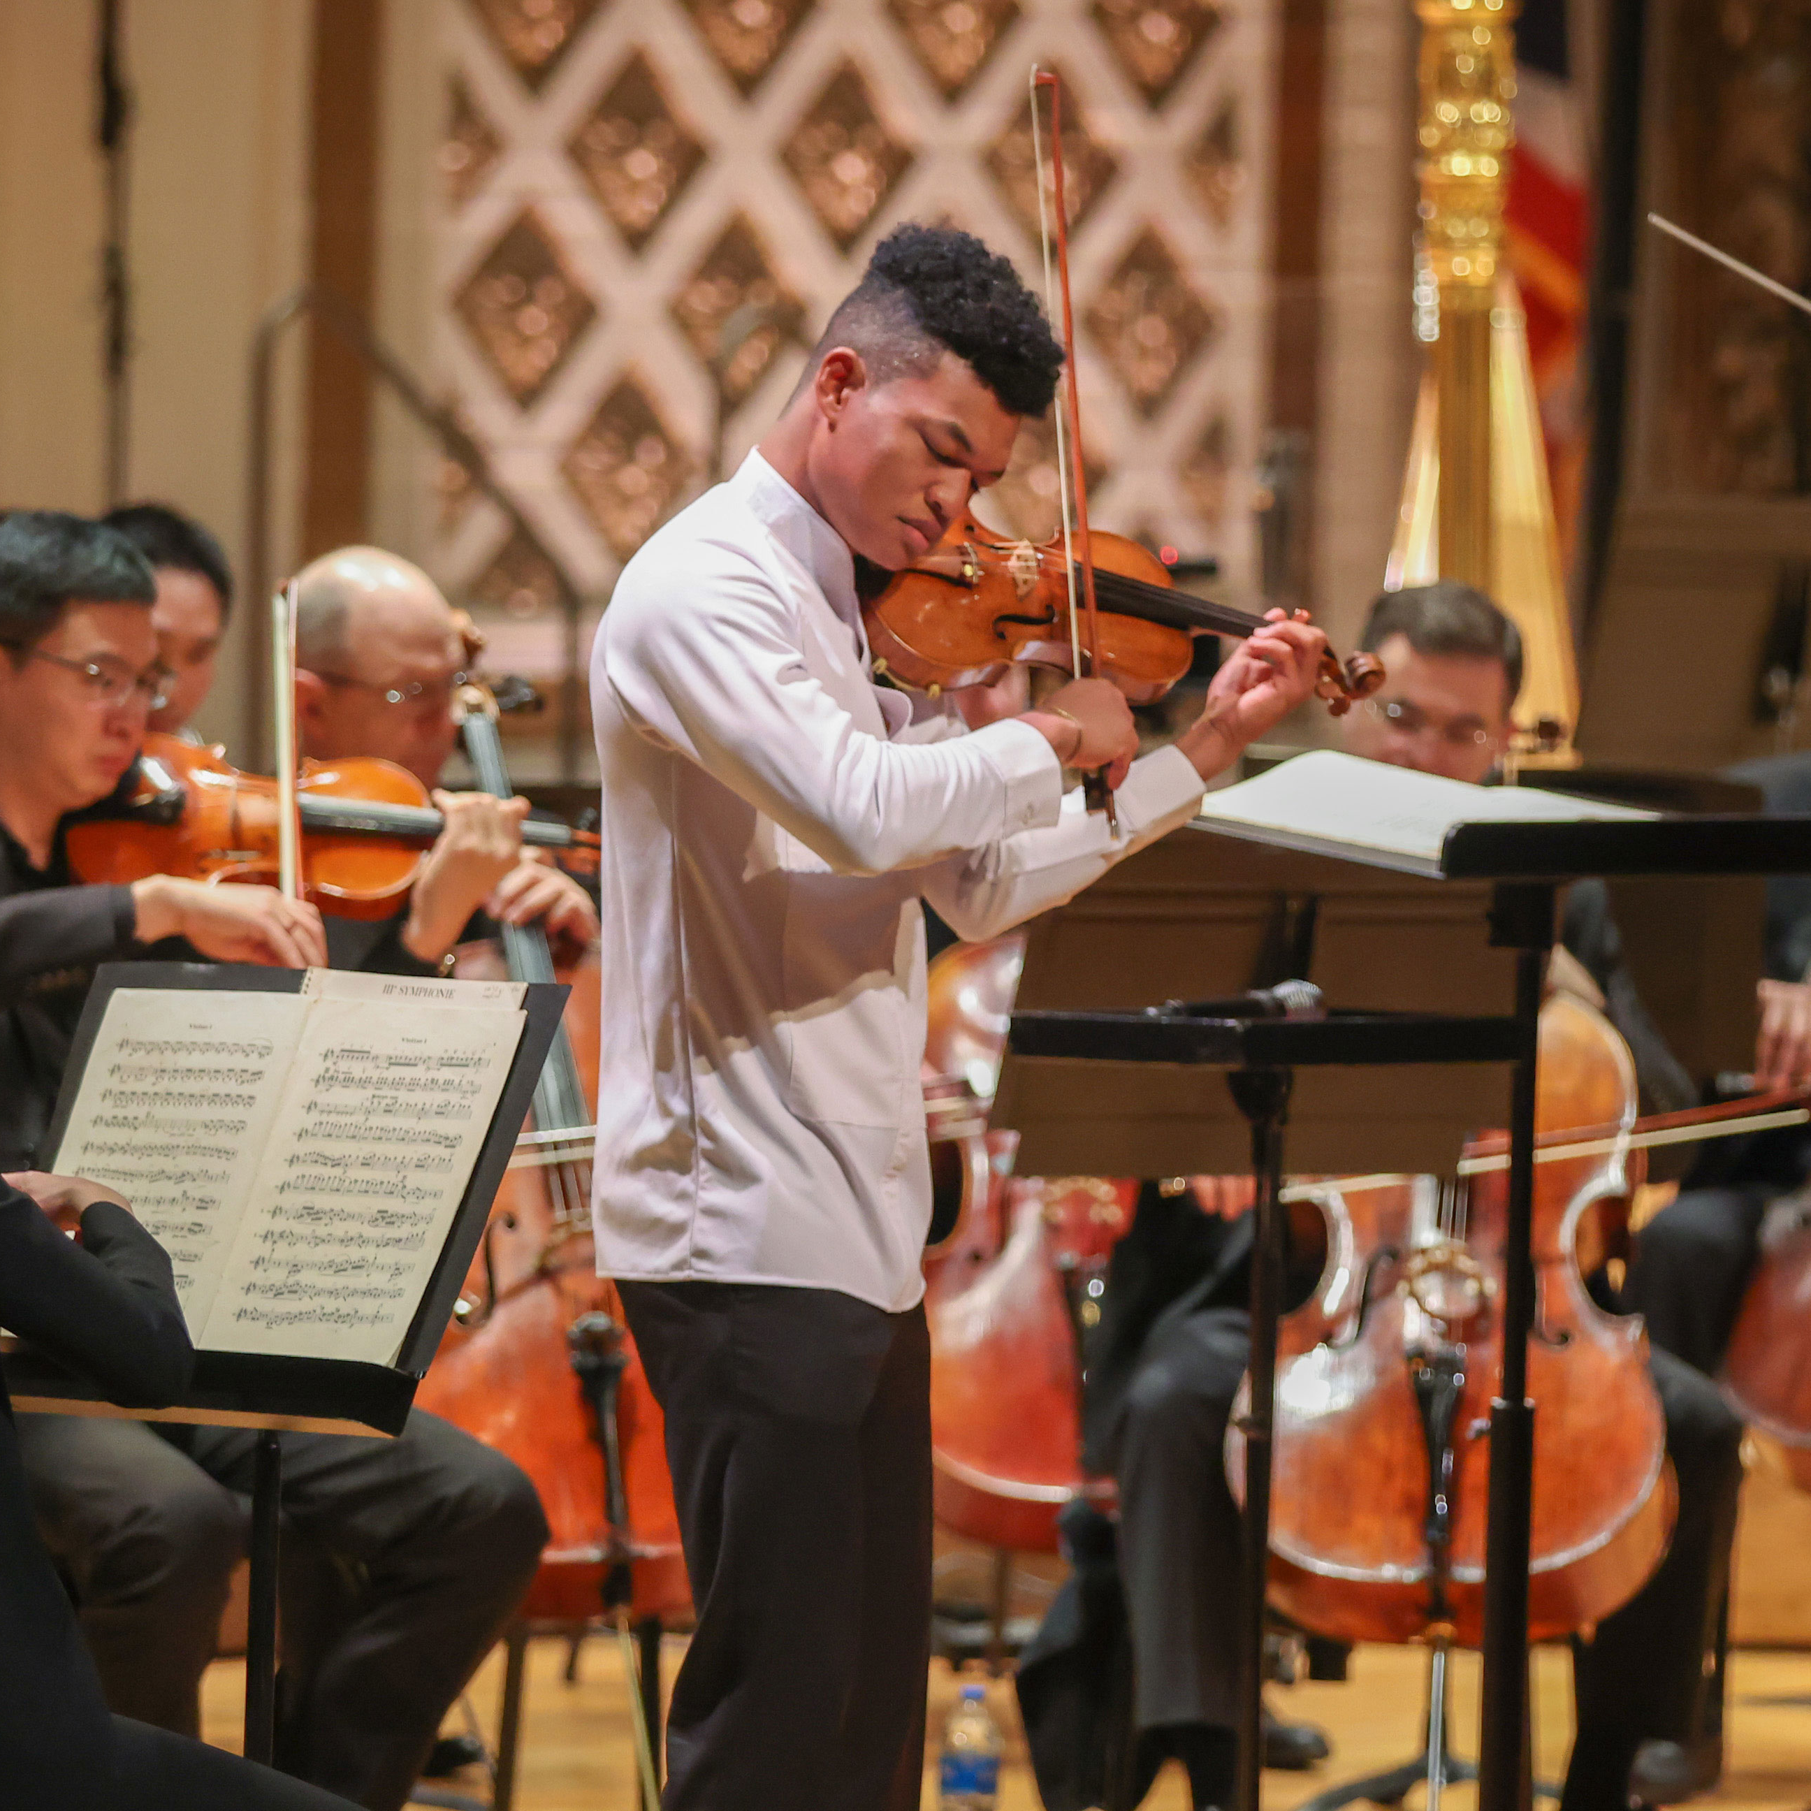
BENEFITS TO GIVING
NEW GIFT OR 10%+ INCREASE
Team Cincinnati
Two tickets to the Reds and an experience with FC Cincinnati.
ArtsWave Pass
One-year membership to BOGO-to-share arts tickets, restaurant and shop offers and more!
$75+
$150+
Enjoy the Arts at BLINK®! ​
Two tickets to one of the most talked about exhibitions at BLINK® 2024, illuminated by ArtsWave.
Notes:
When you give, you not only will be contributing to the impact you’ve been hearing about, but you also get some great benefits for you and your family.
[go over benefits. Each click reveals a new benefit level]
Remember to emphasize Team Cincinnati
[IF YOU HAVE A PARTICULAR BENEFIT THAT YOU RECEIVE, TELL A PERSONAL STORY ABOUT YOUR EXPERIENCE WITH THAT BENEFIT]
[CLICK TO NEXT PAGE]

Slide 23
BENEFITS TO GIVING
$250+
The Children’s Theatre Preview & Hard Hat Tour
Experience the iconic Emery Theater during its transformation into a state-of-the-art performance venue in the heart of OTR.
$500+
BLINK® 2024 VIP Lounge
Make our exclusive Donor Lounge your hub as you experience BLINK 2024, illuminated by ArtsWave.
$1,500+
Leadership Giving
Invitations to special arts events, membership in leadership giving groups, recognition in ArtsWave’s community report and access to the Team Cincinnati benefit.
Notes:
[Read what you’d like, SAME AS LAST SLIDE]
[click to next slide]

Slide 24
JOIN A GROUP, GET CONNECTED
Notes:
When you give to ArtsWave you also have the opportunity to join groups centered around a shared understanding of the arts’ role in our community. You can see first-hand how the arts bring people together in these groups.
[Go over each of the affinity groups if you’d like, if you’re part of one, talk personally about that].
[click to next slide]

Slide 25
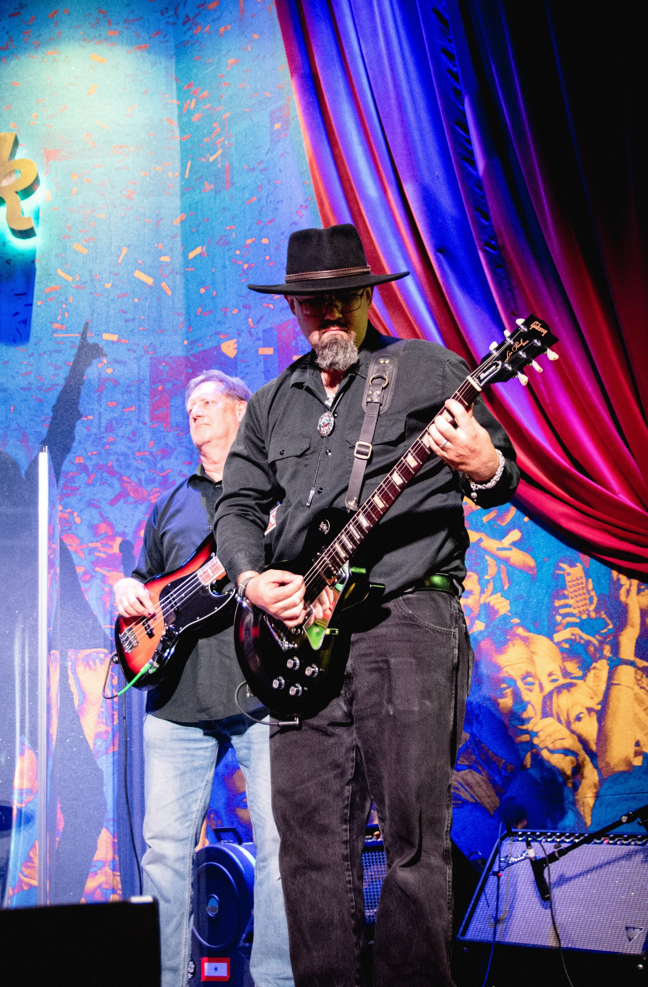
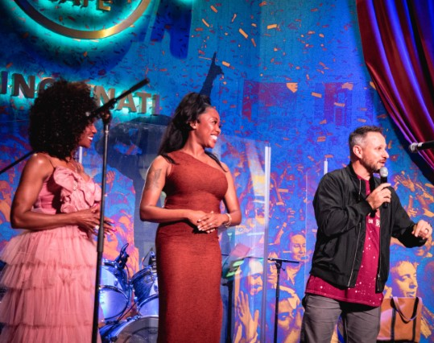
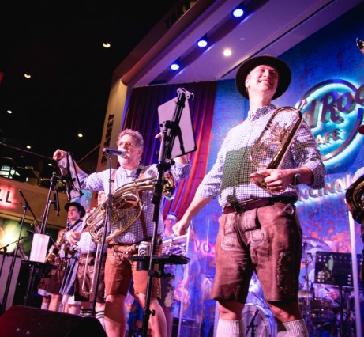
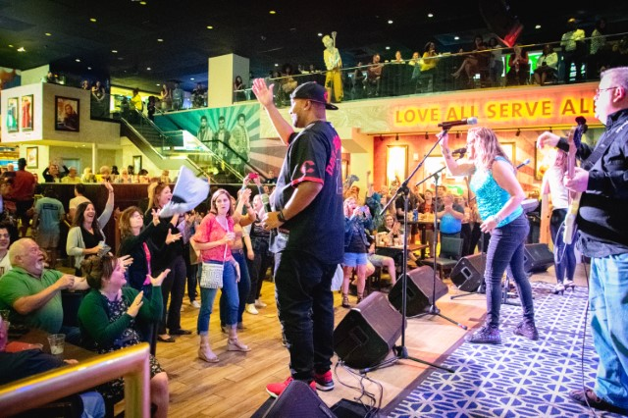
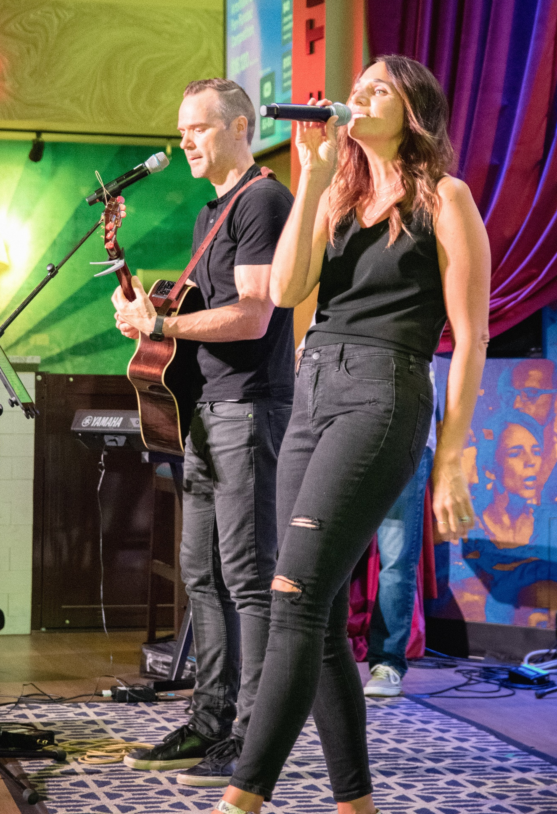
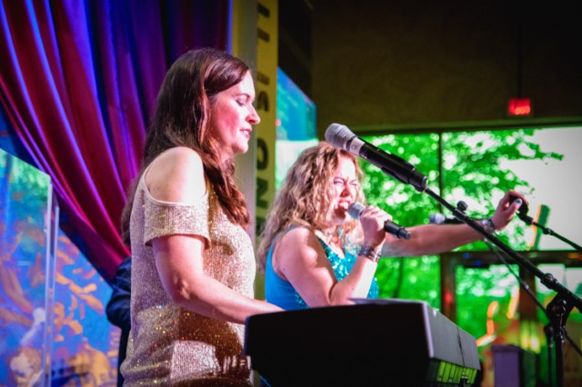

Slide 26
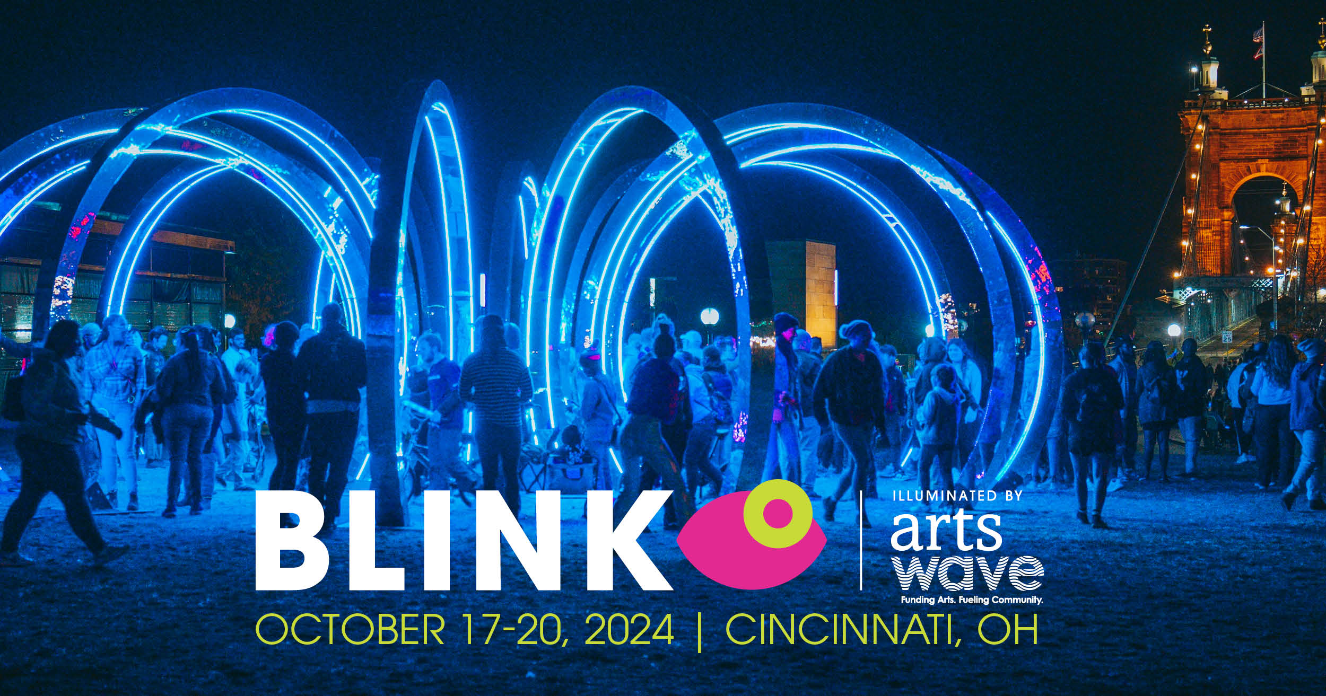

Slide 27
CAMPAIGN DATES
ArtsWave Campaign Kick-Off Tuesday February 6th
ArtsWave CincyJams Friday May 10th
ArtsWave Campaign Finale Thursday May 23rd
BLINK, Illuminated by ArtsWave Thursday October 17th – Sunday October 20th

Slide 28
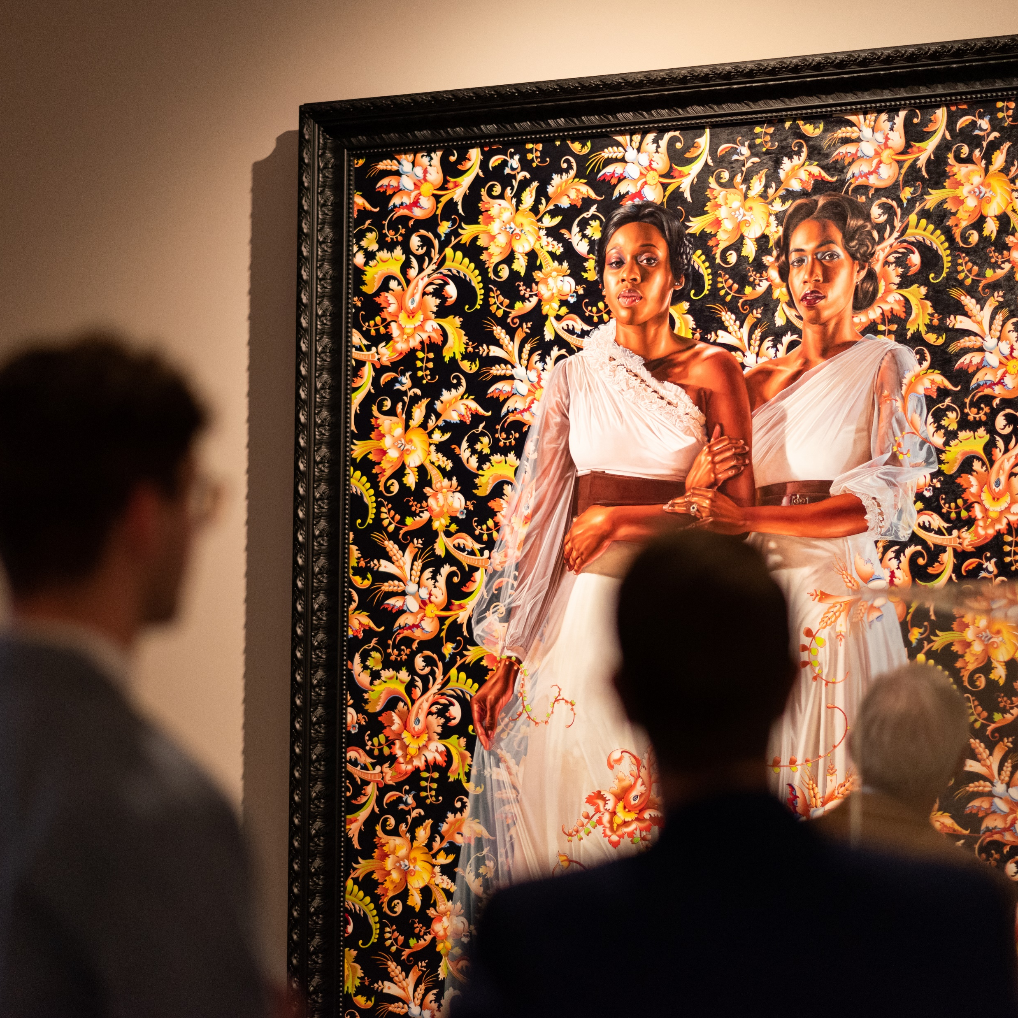
THANK
YOU!
Notes:
Thank you for being here / logging in / etc. today!
[insert any last minute reminders and giving instructions]
Thanks again!

