Slide 1
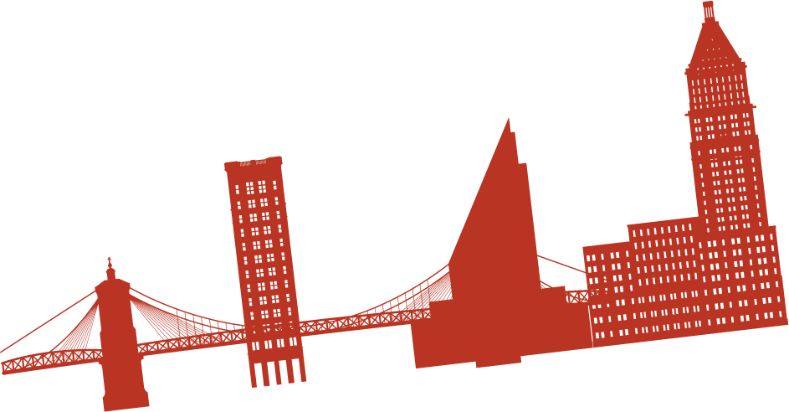
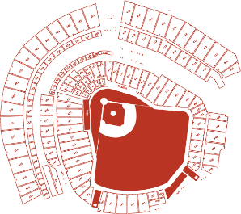
READ ME!
Hello friend! Please either save a copy to your machine to edit this PPT (and delete this slide) or copy/paste the slides you’d like into a new project. When pasting, choose “Keep Source Formatting” to maintain the correct colors. Thanks, and happy presenting!​

Slide 2
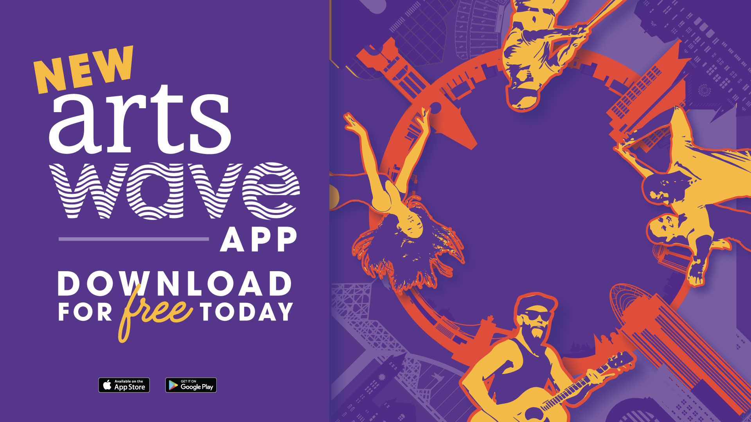
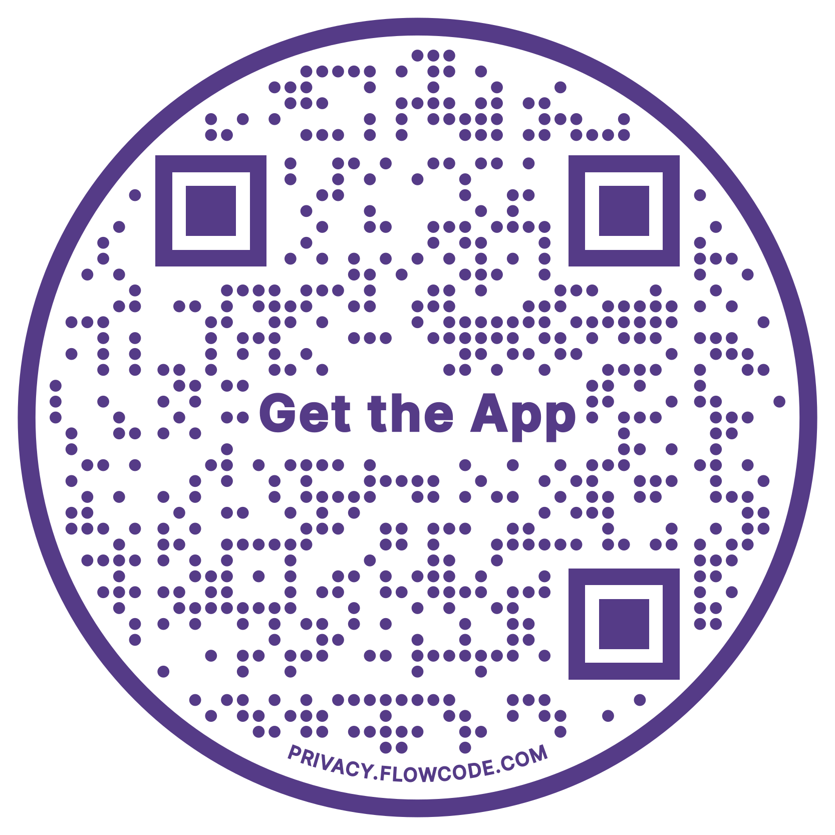
artswave.org/app

Slide 3
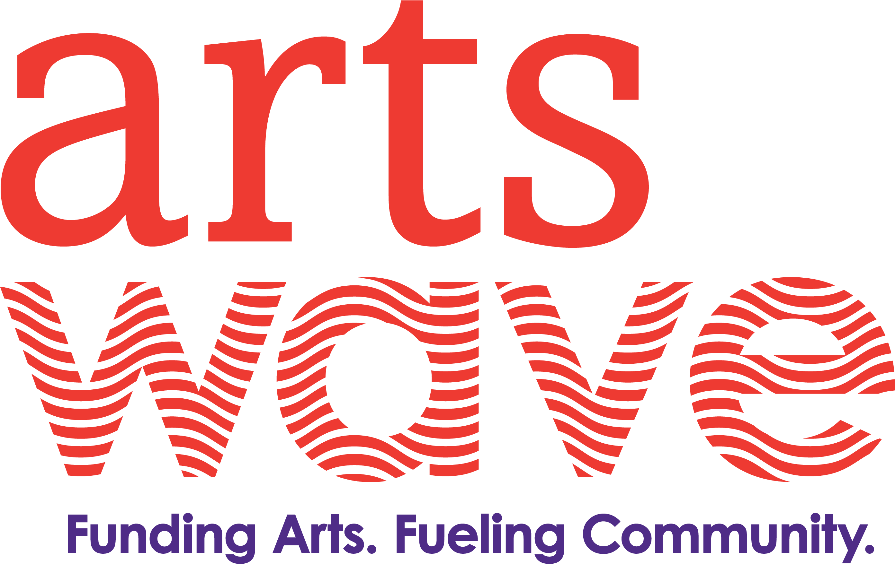
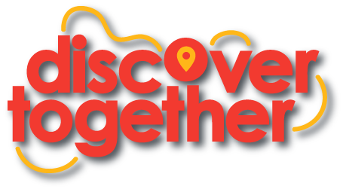
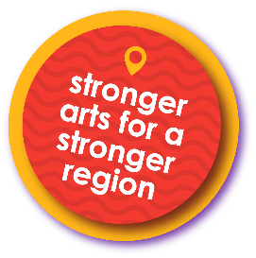
Company XYZ
Kickoff
Notes:
[Introduction]
Welcome to the XYZ company kick-off! I’m ______ from ______. Thank you for being here/tuning in/logging on today!
[insert personal introduction here. Ex. This is my third time heading up the campaign and things are going to look different this year, etc.]

Slide 4
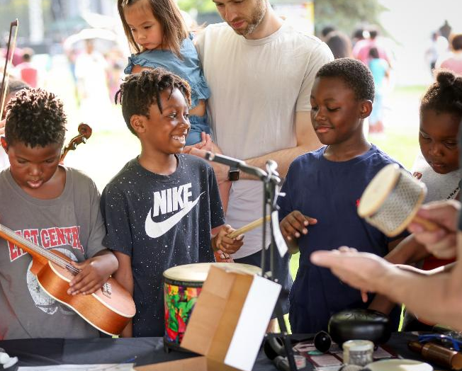
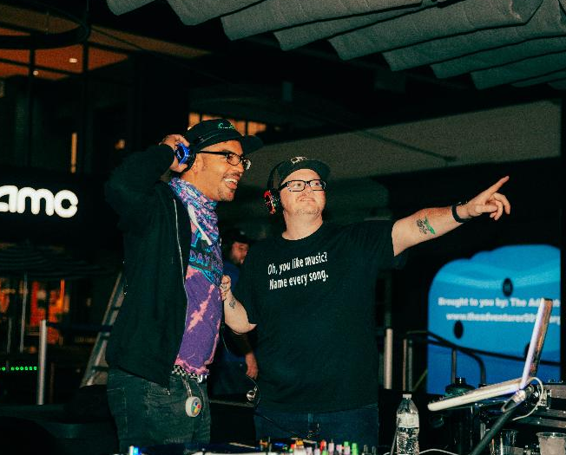
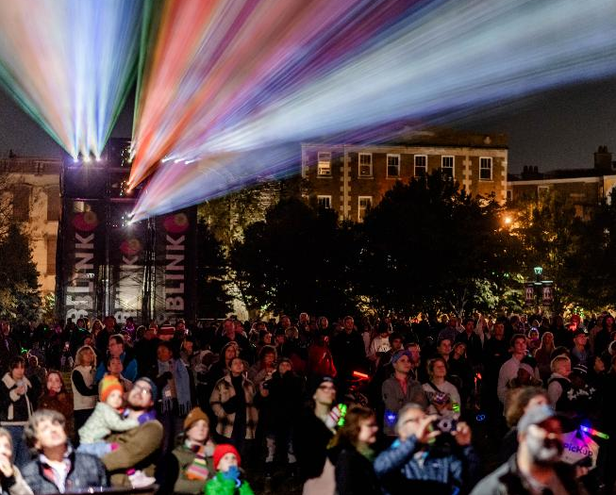
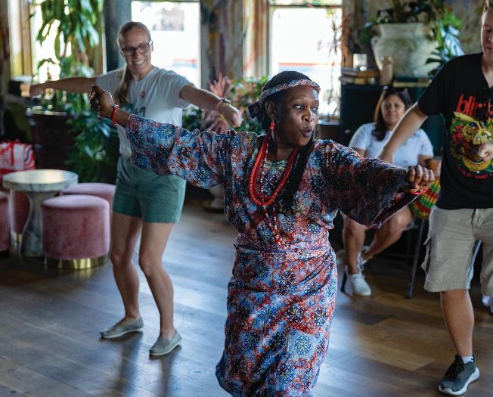
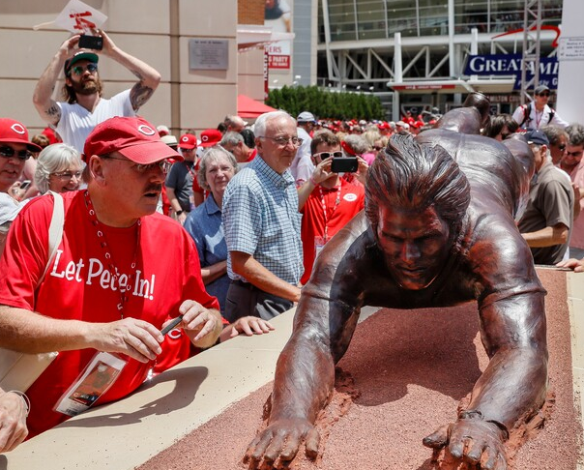
Notes:
I want everyone to take 5 seconds and think of a favorite event over the past year where you were there with other people. Maybe it was a festival in your neighborhood, maybe it was a Reds game, maybe it was BLINK, maybe it was a concert or show?
No matter what you thought of, I would imagine most of those had something in common. [CLICK]
it probably included arts. From your kids concert to the neighborhood Oktoberfest to a visit to Music Hall, even to Great American Ballpark. Our world connects through the arts.
In fact, when people live in arts-rich neighborhoods, they’re nearly 2x as likely to feel connected to each other. In our culture we all know how important is it to feelconnected. Not only is it good for our mental health and well being but it also brings makes our communities stronger. Our region’s arts help us fight against that trend.
​
[CLICK SLIDE]​

Slide 5
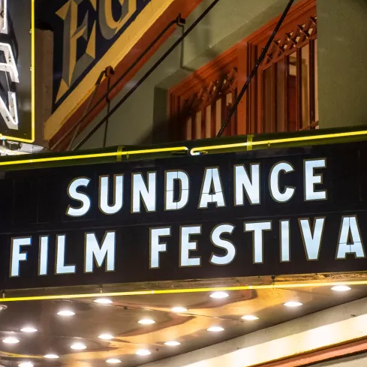
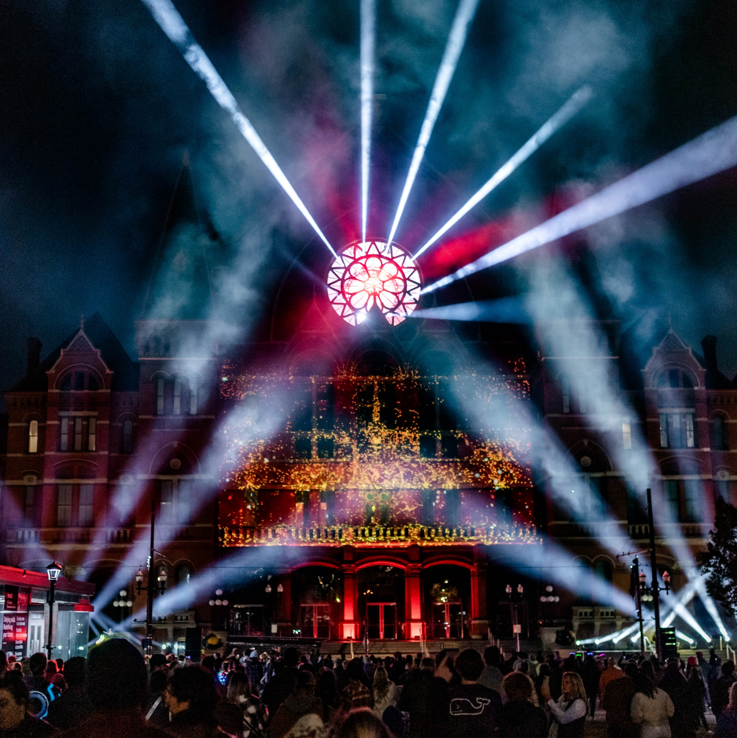
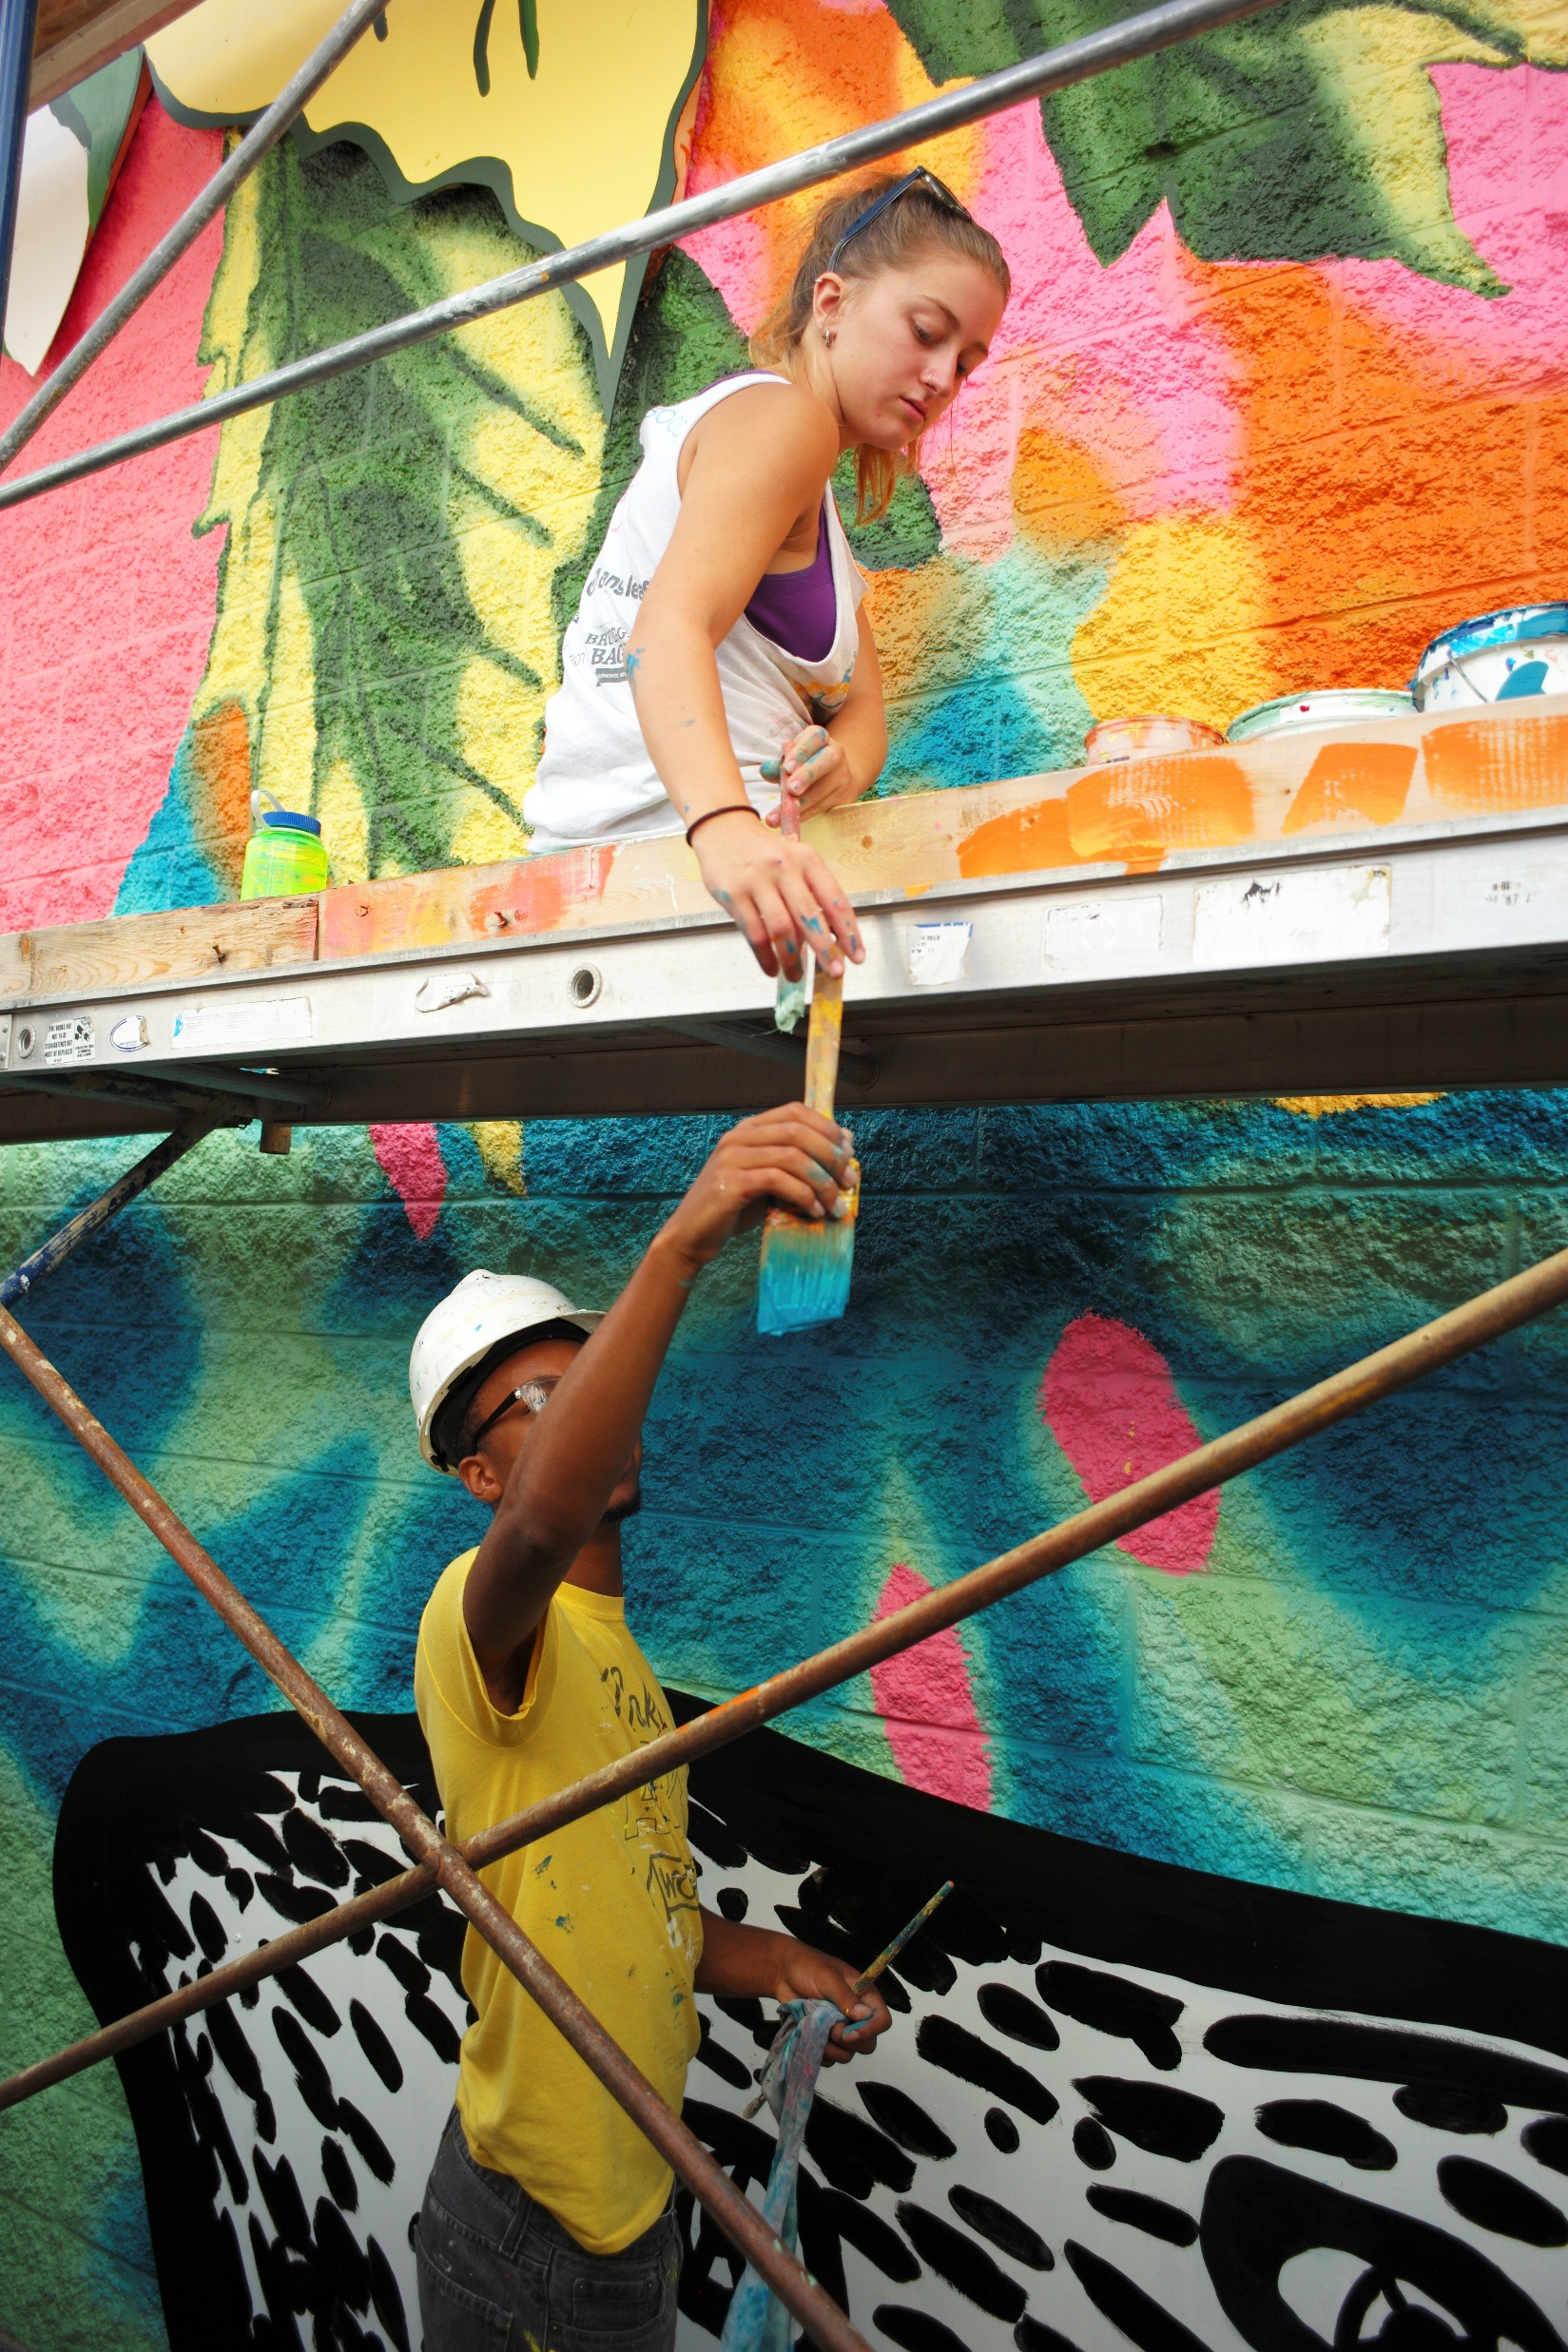
Cincy Leading the Way
Top 20 Arts-Vibrant Region
#1 Region for Street Art
Finalist for Sundance
…so much more!
Notes:
Thankfully, in our region, we’re already bucking the trend.
Just in the past few years we’ve been named a top-20 arts vibrant region four times in a row by SMU. USA Today named us the #1 region for Street art and we’re one of three finalists to be the new home of the Sundance Film Festival, a direct result of the way our community is becoming defined by our arts. Just think about BLINK, illuminated by ArtsWave. That’s the largest event in the region’s history, bringing people together through the magic of the arts.
We may be just the 36th largest media market, but our arts put us on the map in a huge way.
​
[CLICK SLIDE]​

Slide 6
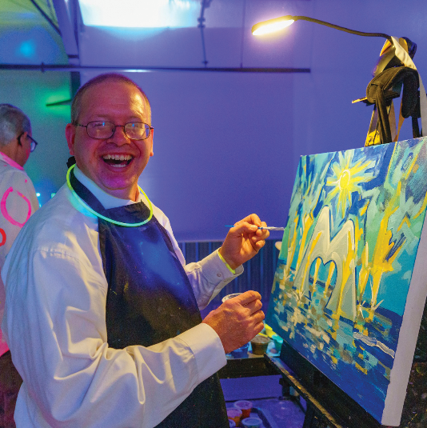
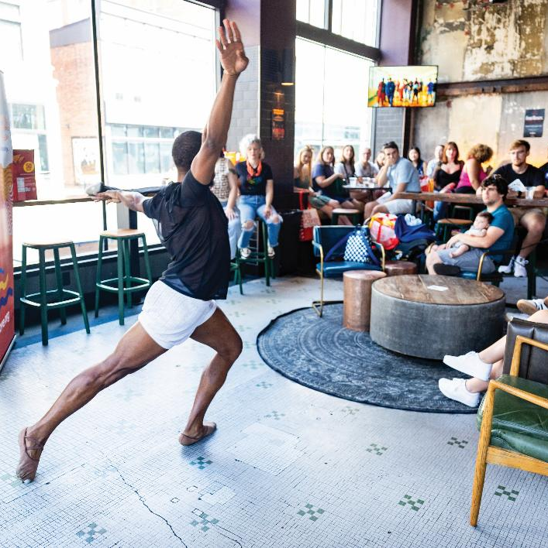
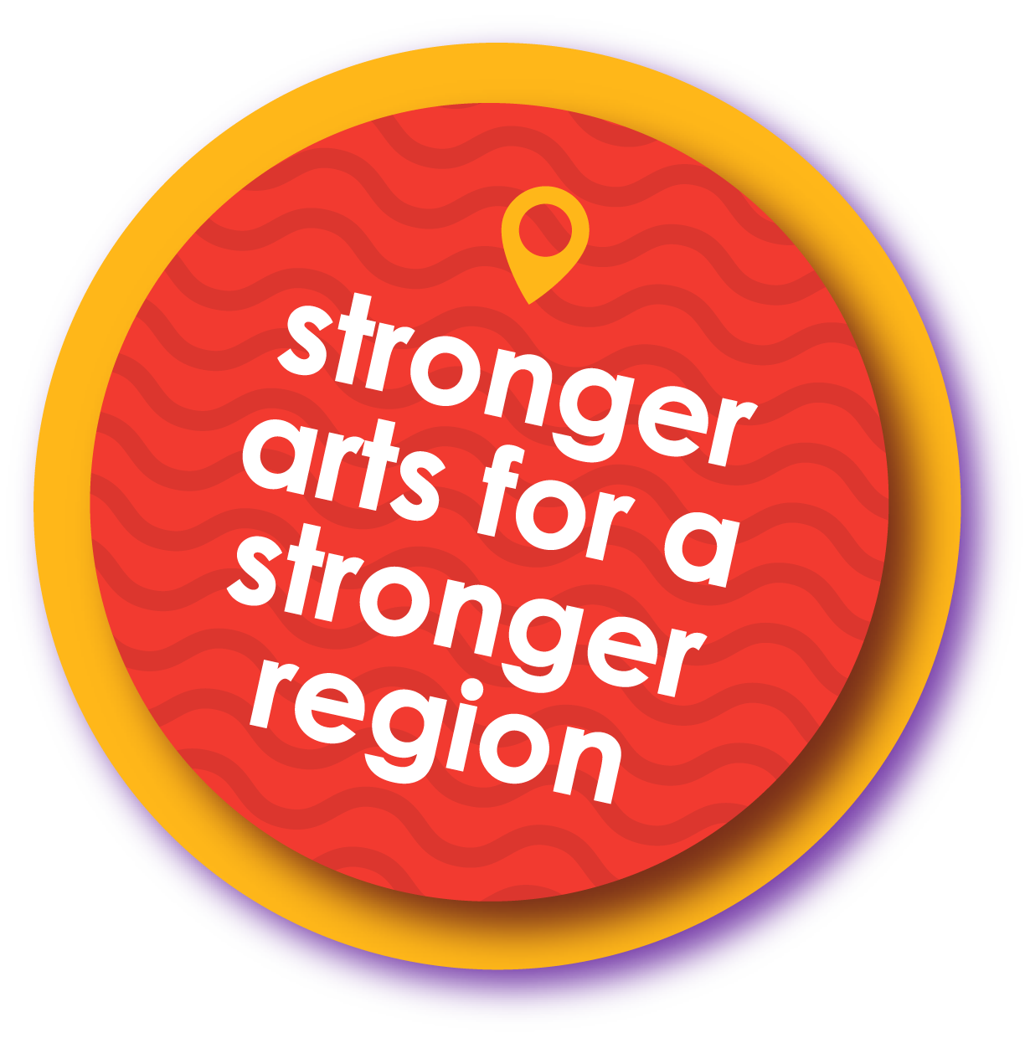
ArtsWave Members Make our Region Stronger
Since 1927, gifts to ArtsWave have been the primary way Cincy’s arts are funded.​
​
Notes:
How have we managed to do this Cincy? ​
Since 1927, the community has invested more than $350 million through ArtsWave, creating a stable and dynamic foundation for our arts and our region to thrive. This started with a lead gift of $1 million from the Taft family, but was then matched and surpassed that same year with 2.5 million from regular folks in the community!
From the beginning, this campaign has relied on thousands of people across the region coming together around a common goal.​ The community-first way that we fund our arts is both unique, and an asset for our region that has allowed us to overachieve.
[CLICK SLIDE]​

Slide 7
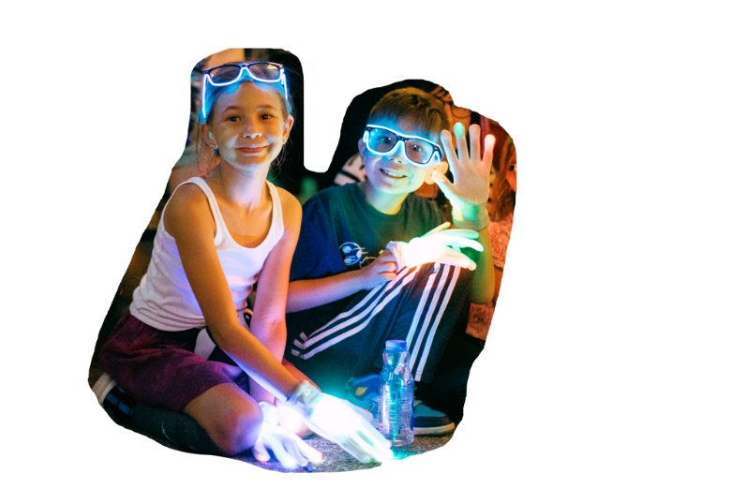
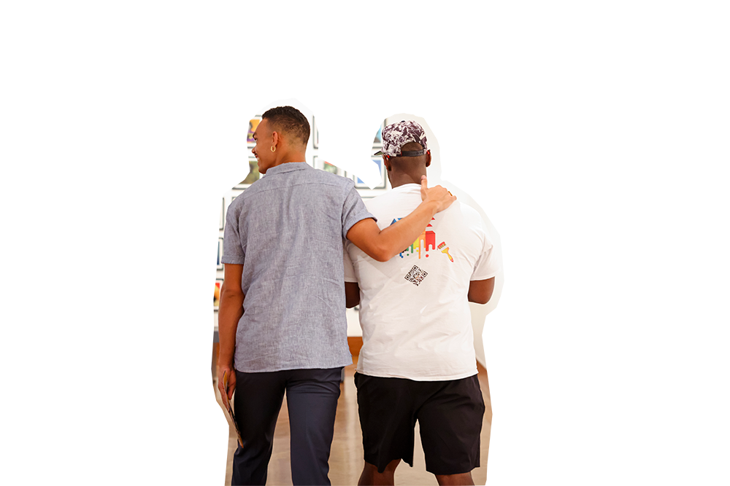
ArtsWave Members Make our Region Stronger
& More Stable
Student Success
Massive Impact
Connected Communities
Notes:
Even more important than the region-wide stats we mentioned earlier is how gifts to ArtsWave can impact our neighbors.
ArtsWave’s support is creating so many amazing impacts across the region, here’s just a few:
There’s ArtsWave’s “More Arts, More Kids” initiative that’s sending thousands of children on field trips that have been cut out of schools. Coming out of the pandemic, school corporations are facing growing budget difficulties and field trips are one of the things that often get cut. We’re actively working with our partner organizations to change that. Last year the program sent 5,000 kids oin field trips to The Children’s Theatre of Cincinnati, Cincinnati Symphony Orchestra and other ArtsWave-funded organizations. With another 15,000 students planned this year, the program gives kids experiences that have been shown to increase empathy, tolerance, academic performance and in-class engagement. [CLICK]
Gifts to ArtsWave are having a massive impact. ArtsWave did a study with the Cincinnati USA Regional Chamber of Commerce that showed that from 2019-2023, the arts as a sector had a $1.6 BILLION economic impact in our region. That rivals the impact of sports and other industries that bring attention and jobs to the community. Now, if that 1.6 billion is hard to grasp or relate back to an individual gift, in that same study, they found that for every $1 given to ArtsWave, the organizations receiving those funds turned it into $43 of economic impact. [CLICK]
That’s impacting our community as a whole, but your gifts are also going back to where you live. In addition to all the big organizations that are having big impacts on a region-wide scale, ArtsWave also funds community arts centers in Covington, Clifton, Finneytown, Hamilton, Kennedy Heights, Newport, Oxford, and so many more, that are the creative and cultural hubs of these communities. [CLICK]
ArtsWave Members are providing the stability and foundation for these organizations to truly have an impact without being worried that one wrong move, or a bad business cycle will put them out of business.
[CLICK]

Slide 8
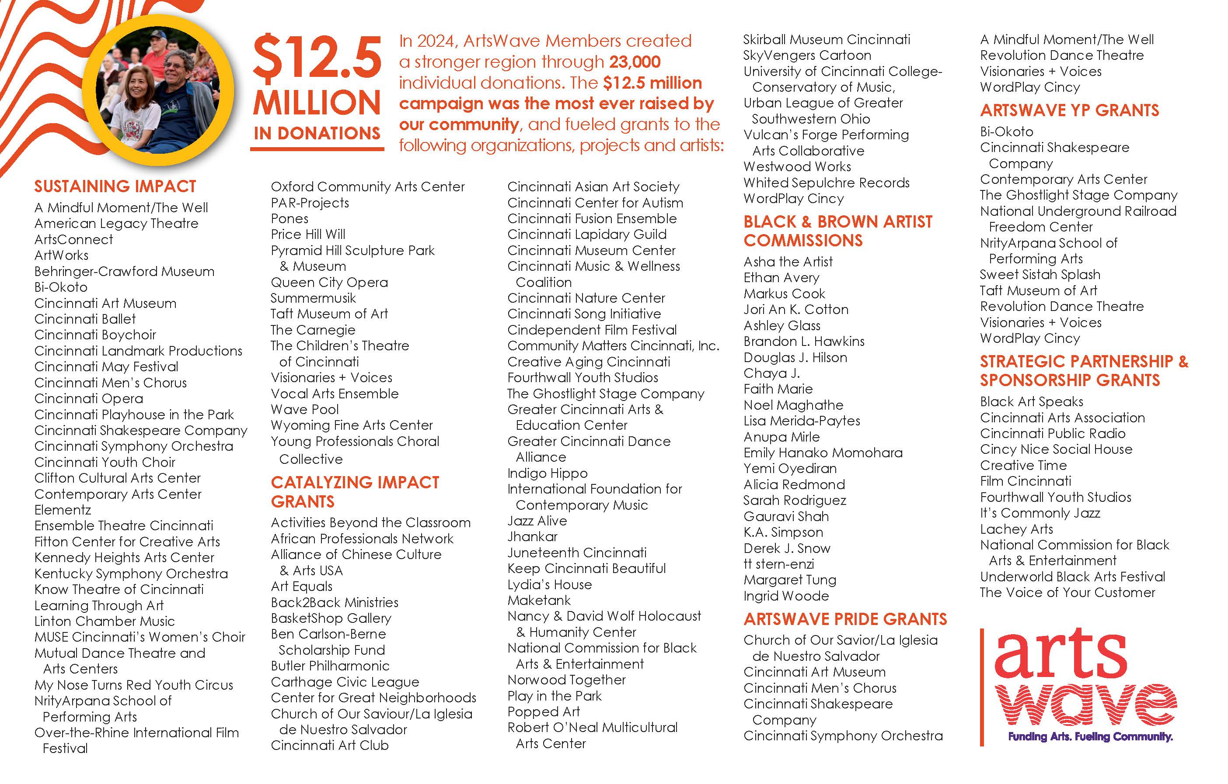
Notes:
Your gift goes to create the impact we just spoke about, and it does that through grants and support to over 150 organizations, projects and artists.
Obviously you can’t read this, there are too many! This is the list of all the places that your gift ends up going. There are grants for operating support, grants for YP and LGBTQIA-focused projects, grants for new projects around the community to get off the ground, grants for under-represented artists and so much more.
Your gift truly impacts the whole community, most likely including where you live as well!
[CLICK SLIDE]

Slide 9
YOUR GIFT AT WORK
Visionaries + Voices
​
Notes:
Let’s find out more about how your gifts impact our community by diving into one of the 150 organizations that ArtsWave supports.
[CLICK FOR VIDEO] [3 minutes]
That was an episode
All videos can be found here: https://www.youtube.com/watch?v=8Zm3VxrpjB0&list=PL11Mf4ImOIZfKm43uAucjiYK1_7OEK7Bg

Slide 10
REPLACE PHOTO
[Speaker Name]
Company/Organization XYZ
Job Title
Notes:
[IF YOU HAVE A SPEAKER. IF NOT, DELETE AND SKIP THIS SLIDE]
That’s just one of the organizations that ArtsWave supports, there are so many others, including [company of speaker].
We have [name] here from [company] to tell us a bit more about what your gifts to ArtsWave allow them to do.

Slide 11
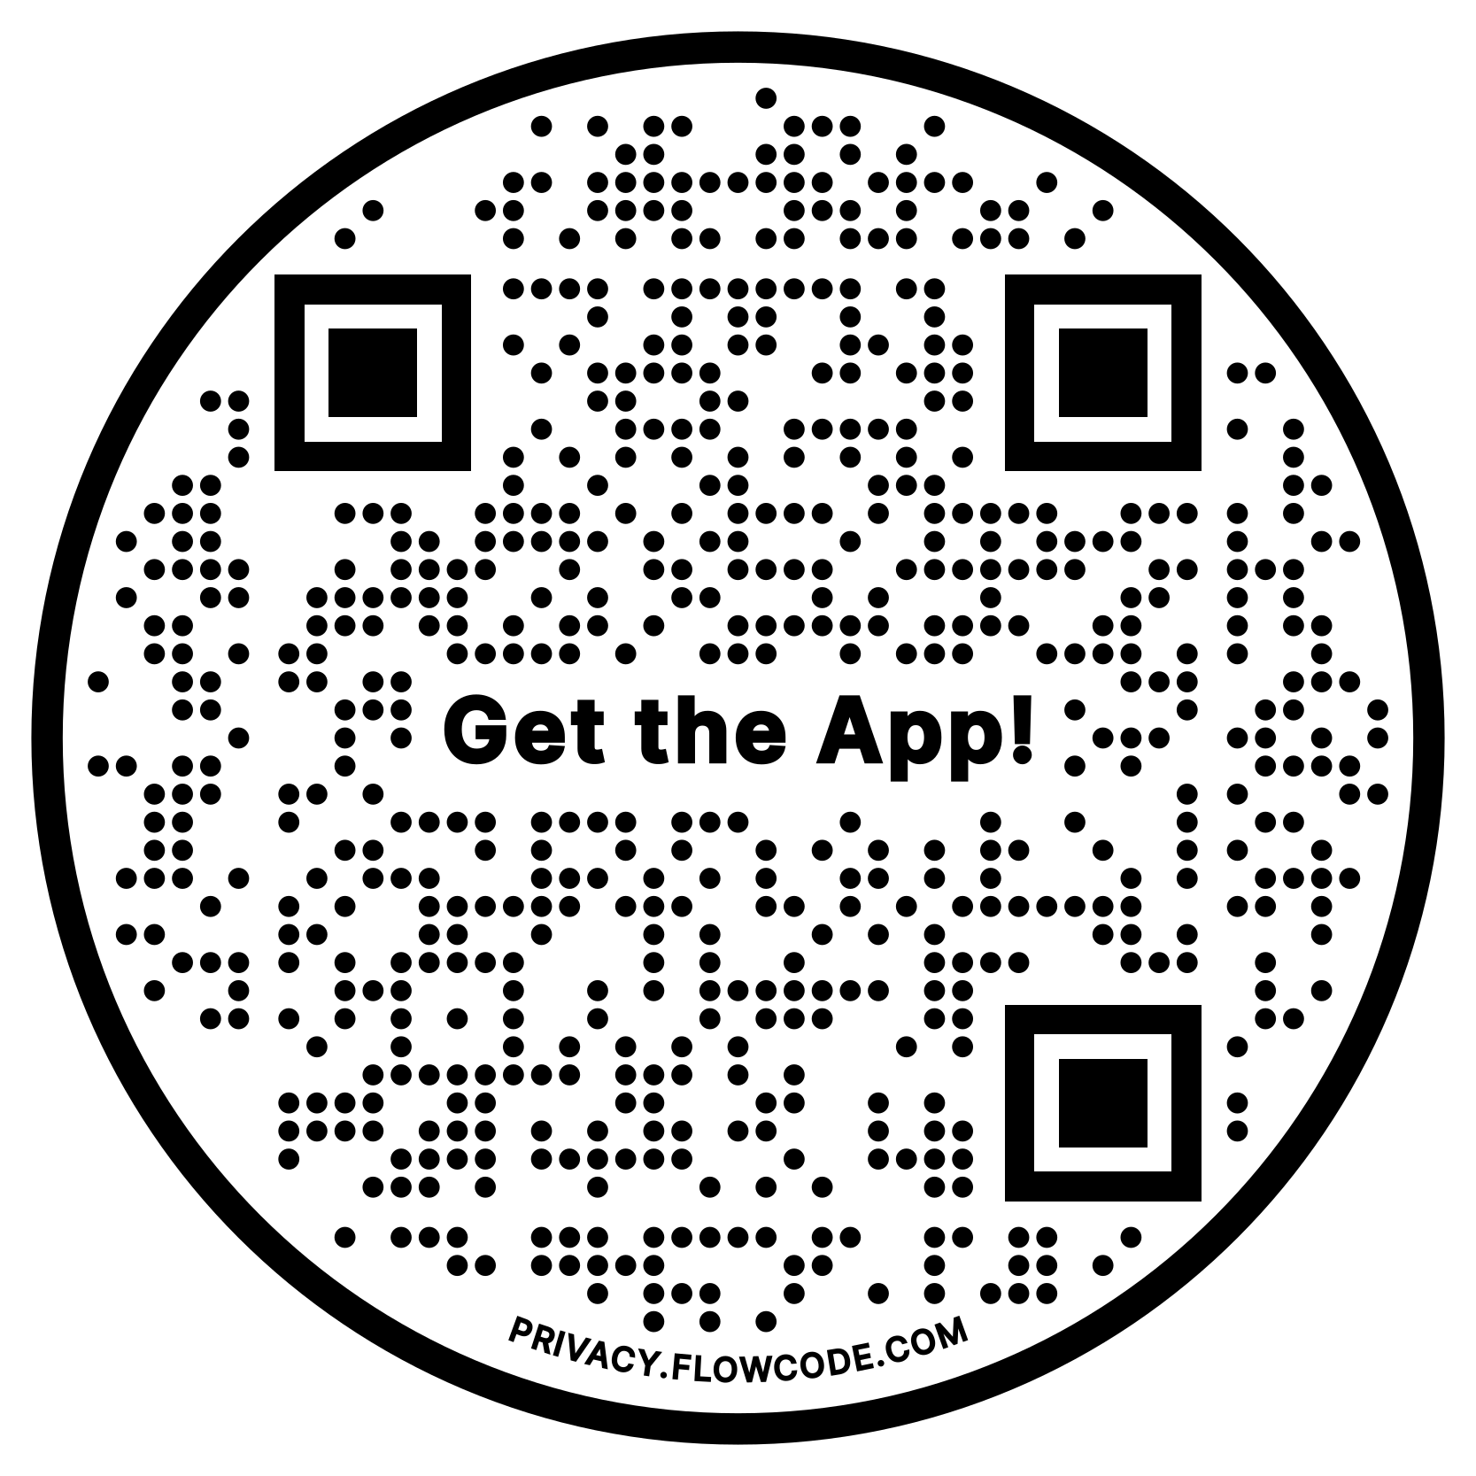
Giving Benefits
$100+
ARTSWAVE PASS + EXCLUSIVE CONTENT
Enjoy the expanded ArtsWave Pass for a full year! The Pass includes 100s of half-price, free and last-minute passes to our region’s arts, plus so much more.
Discover on the new ArtsWave App!
Notes:
[IF SPEAKER] Thanks [name] for being with us!
When you give, you’ll not only be contributing to the impact you’ve been hearing about, but you also get some great benefits for you and your family. These have been reimagined this year, so there’s more than ever before.
Let’s start with the Unlimited Membership which comes with access to the expanded ArtsWave Pass. When I say expanded, I mean EXTREMELY expanded. There are dozens of half-off arts ticket deals at all times, plus there’s now over 60 restaurant and shopping discounts on there. At $100, it’s likely that if you use it for a night out with dinner and a show, it will pay for itself in that one evening. Just right now, there are half-off deals at Playhouse in the Park, Cincinnati Symphony and Pops, the Children’s Theatre of Cincinnati, and a lot more. There’s also new discounts at Madtree, luscious q, Sleepy Bee, Sugar n Spice, Taste of Belgium… I could go on and on, but The ArtsWave Pass has become quite the money saver over the past year.
[CLICK]
PLUS, It’s now easier than ever to access. This is because it’s housed on the recently launched ArtsWave App. The app is free to download, you can do it now actually, and is the largest arts and entertainment calendar in the region. You can find shows, concerts, sports, festivals, events plus access behind the scenes content and so much more.
[CLICK TO NEXT PAGE]

Slide 12
Open…
Find…
Redeem…
Notes:
When you’ve downloaded the app, your ArtsWave Pass is easier than ever to use. Let’s take a look at just how easy:
[watch video]
So again, in one motion on the app, you can search for events, find a deal, redeem the deal and then get your tickets or discount all at the same time, right in the app. It’s never been easier to do and usually the pass plays for itself with one night of use.
[CLICK TO NEXT PAGE]

Slide 13
Giving Benefits
$100+
ARTSWAVE PASS + EXCLUSIVE CONTENT
Enjoy the expanded ArtsWave Pass for a full year! The Pass includes 100s of half-price, free and last-minute passes to our region’s arts, plus so much more.
Discover on the new ArtsWave App!
$250+ ($21+ monthly)
$500+ ($42+ monthly)
$1,500+
CINCINNATI MUSIC HALL PACKAGE
A voucher for two tickets to a performance of your choice: Cincinnati Ballet, Cincinnati Opera, Cincinnati Symphony Orchestra, Cincinnati Pops or May Festival.
ENJOY THE ARTS
You and a guest are invited to a Members-only event at the newly expanded American Sign Museum
Enjoy all Unlimited PLUS Member Benefits, plus invitations to special arts events, membership in leadership giving groups, recognition in ArtsWave’s community report and access to the Cincinnati Sports Package benefit.
Notes:
Okay, there are other benefits too though as we move up the ladder.
[go over benefits. Each click reveals a new benefit level]
[IF YOU HAVE A PARTICULAR BENEFIT THAT YOU RECEIVE, TELL A PERSONAL STORY ABOUT YOUR EXPERIENCE WITH THAT BENEFIT]
[CLICK TO NEXT PAGE]

Slide 14
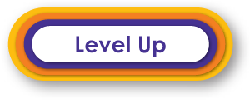
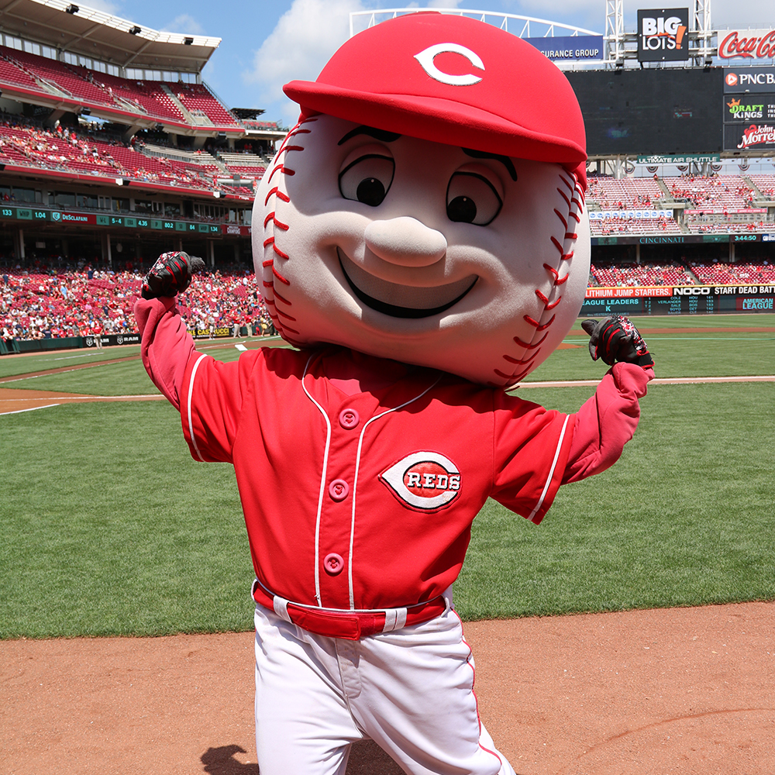
Giving Benefits
NEW GIFT, 10%+ INCREASE OR A LEADERSHIP GIFT
CINCINNATI SPORTS PACKAGE
Two tickets to the Reds and a special experience with FC Cincinnati!
3 WAYS TO QUALIFY:
1. Make a first-time gift at $100 or more
2. Increase your last gift by at least 10% ($100 min.)
3. Give any Leadership gift
Notes:
We also have the Level Up benefit, which includes the Cincinnati Sports Package. We’ve partnered again with the Reds to provide two free tickets and with FC Cincinnati to do an exclusive behind-the-scenes event. Last year we heard from coaches and the starting goalkeeper Roman Celentano about what it’s like playuing for FC. Pretty cool!
There are three ways to qualify for this one.
[Read slide]
Also, both the Reds and FC games are included on the app. Yet another reason to download!
[CLICK]

Slide 15
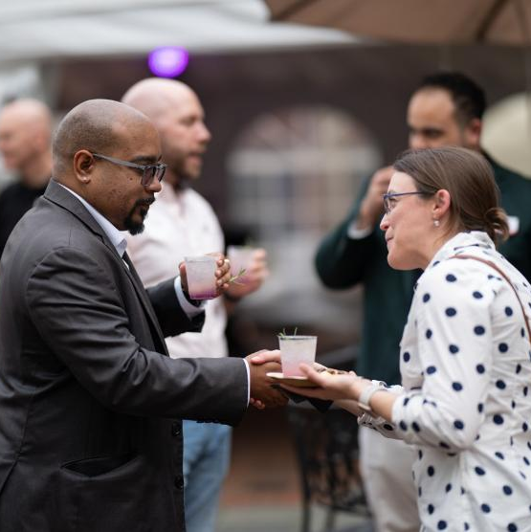
Join a Group
Get Connected
Notes:
When you give to ArtsWave, you join a community. Within that, we have some groups where you can experience the arts together with other like-minded neighbors.
There are three leadership groups: The first is for all Leadership Donors, then we have the Circle of African Americans for the arts and the Women’s Leadership Roundtable. Folks who give $1,500 or more OR who join the Step Up to Leadership program at $500 qualify for these groups.
We also have ArtsWave Pride and ArtsWave YP which can be joined at any gift level, just check the box [on your pledge card / in the Epledge portal]
There’s more about these groups in your brochure and at artswave.org/groups.
[CLICK]

Slide 16
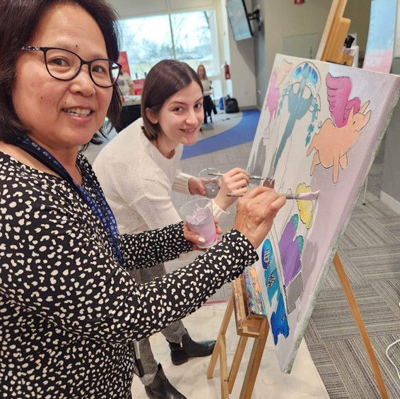
Company XYZ
Initiatives/Events
Fill in company-specific campaign events, items, giveaways, info, etc. here. Feel free to copy this page.
Be sure to remember to let people know how they should give to the campaign! (e-pledge, pledge cards, online, etc.)
Notes:
[Fill this slide in with your company’s information, including how to give]
[click to next slide]

Slide 17
Notes:
Before we go, I want to leave you with one last video that sums up how your gift to ArtsWave impacts our region.
[play video] [1 minute]

Slide 18
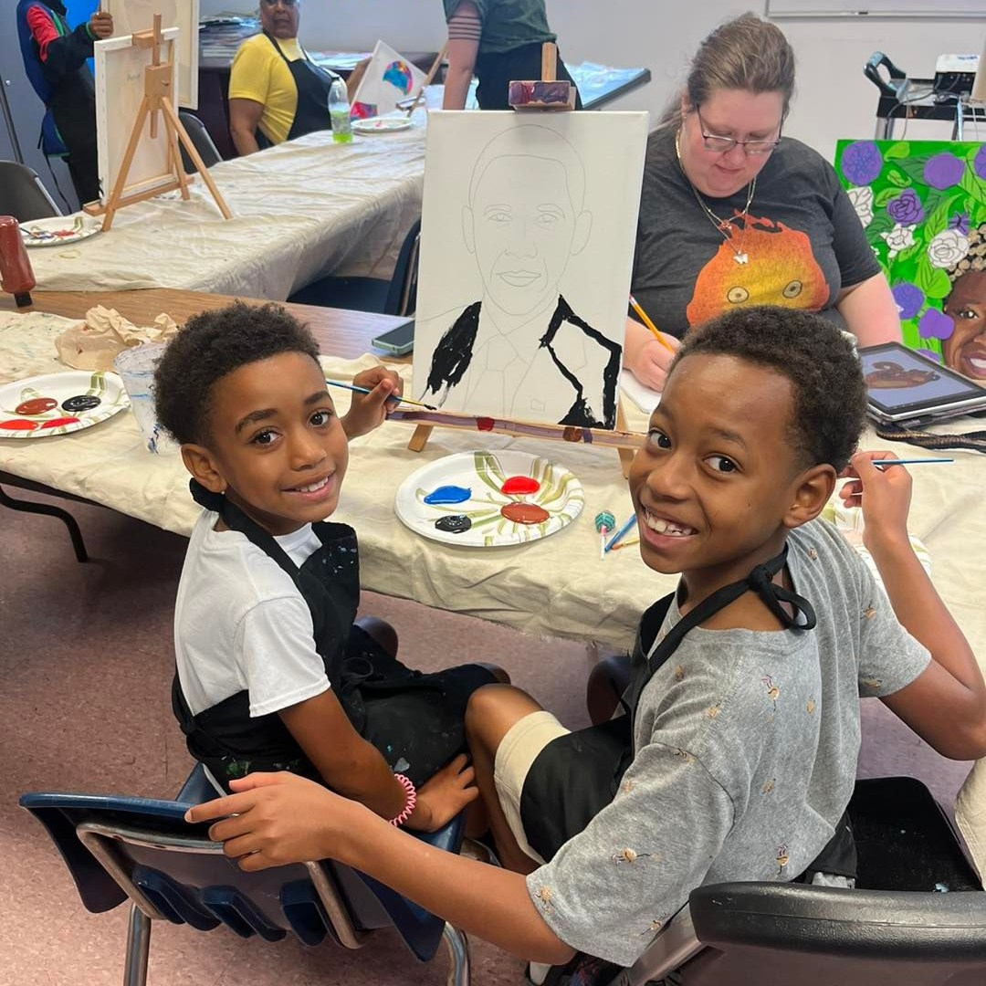
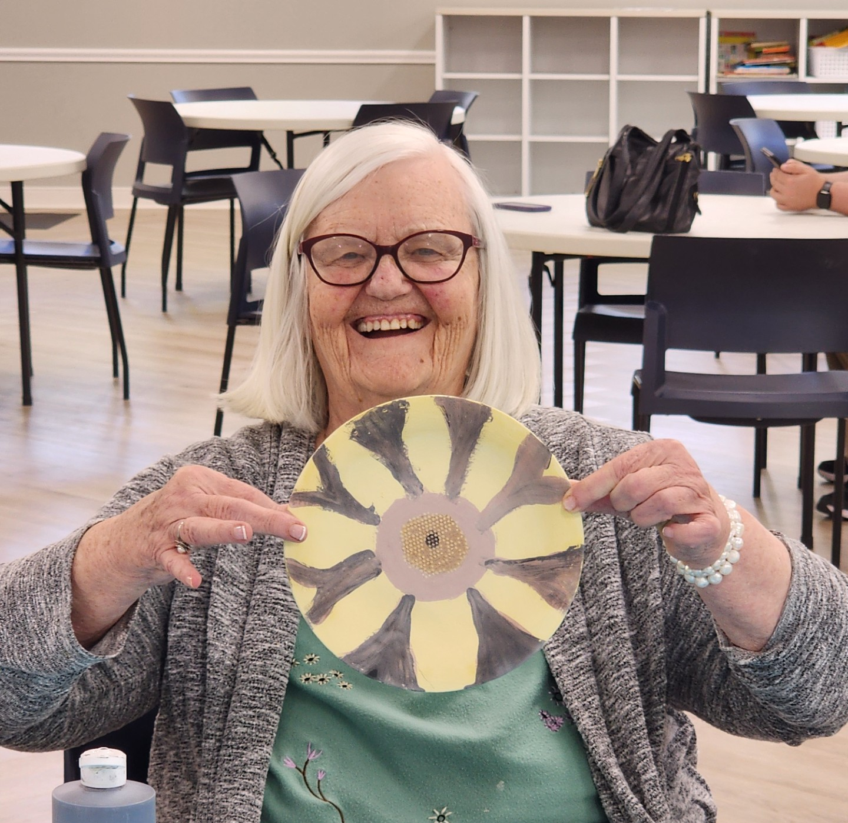
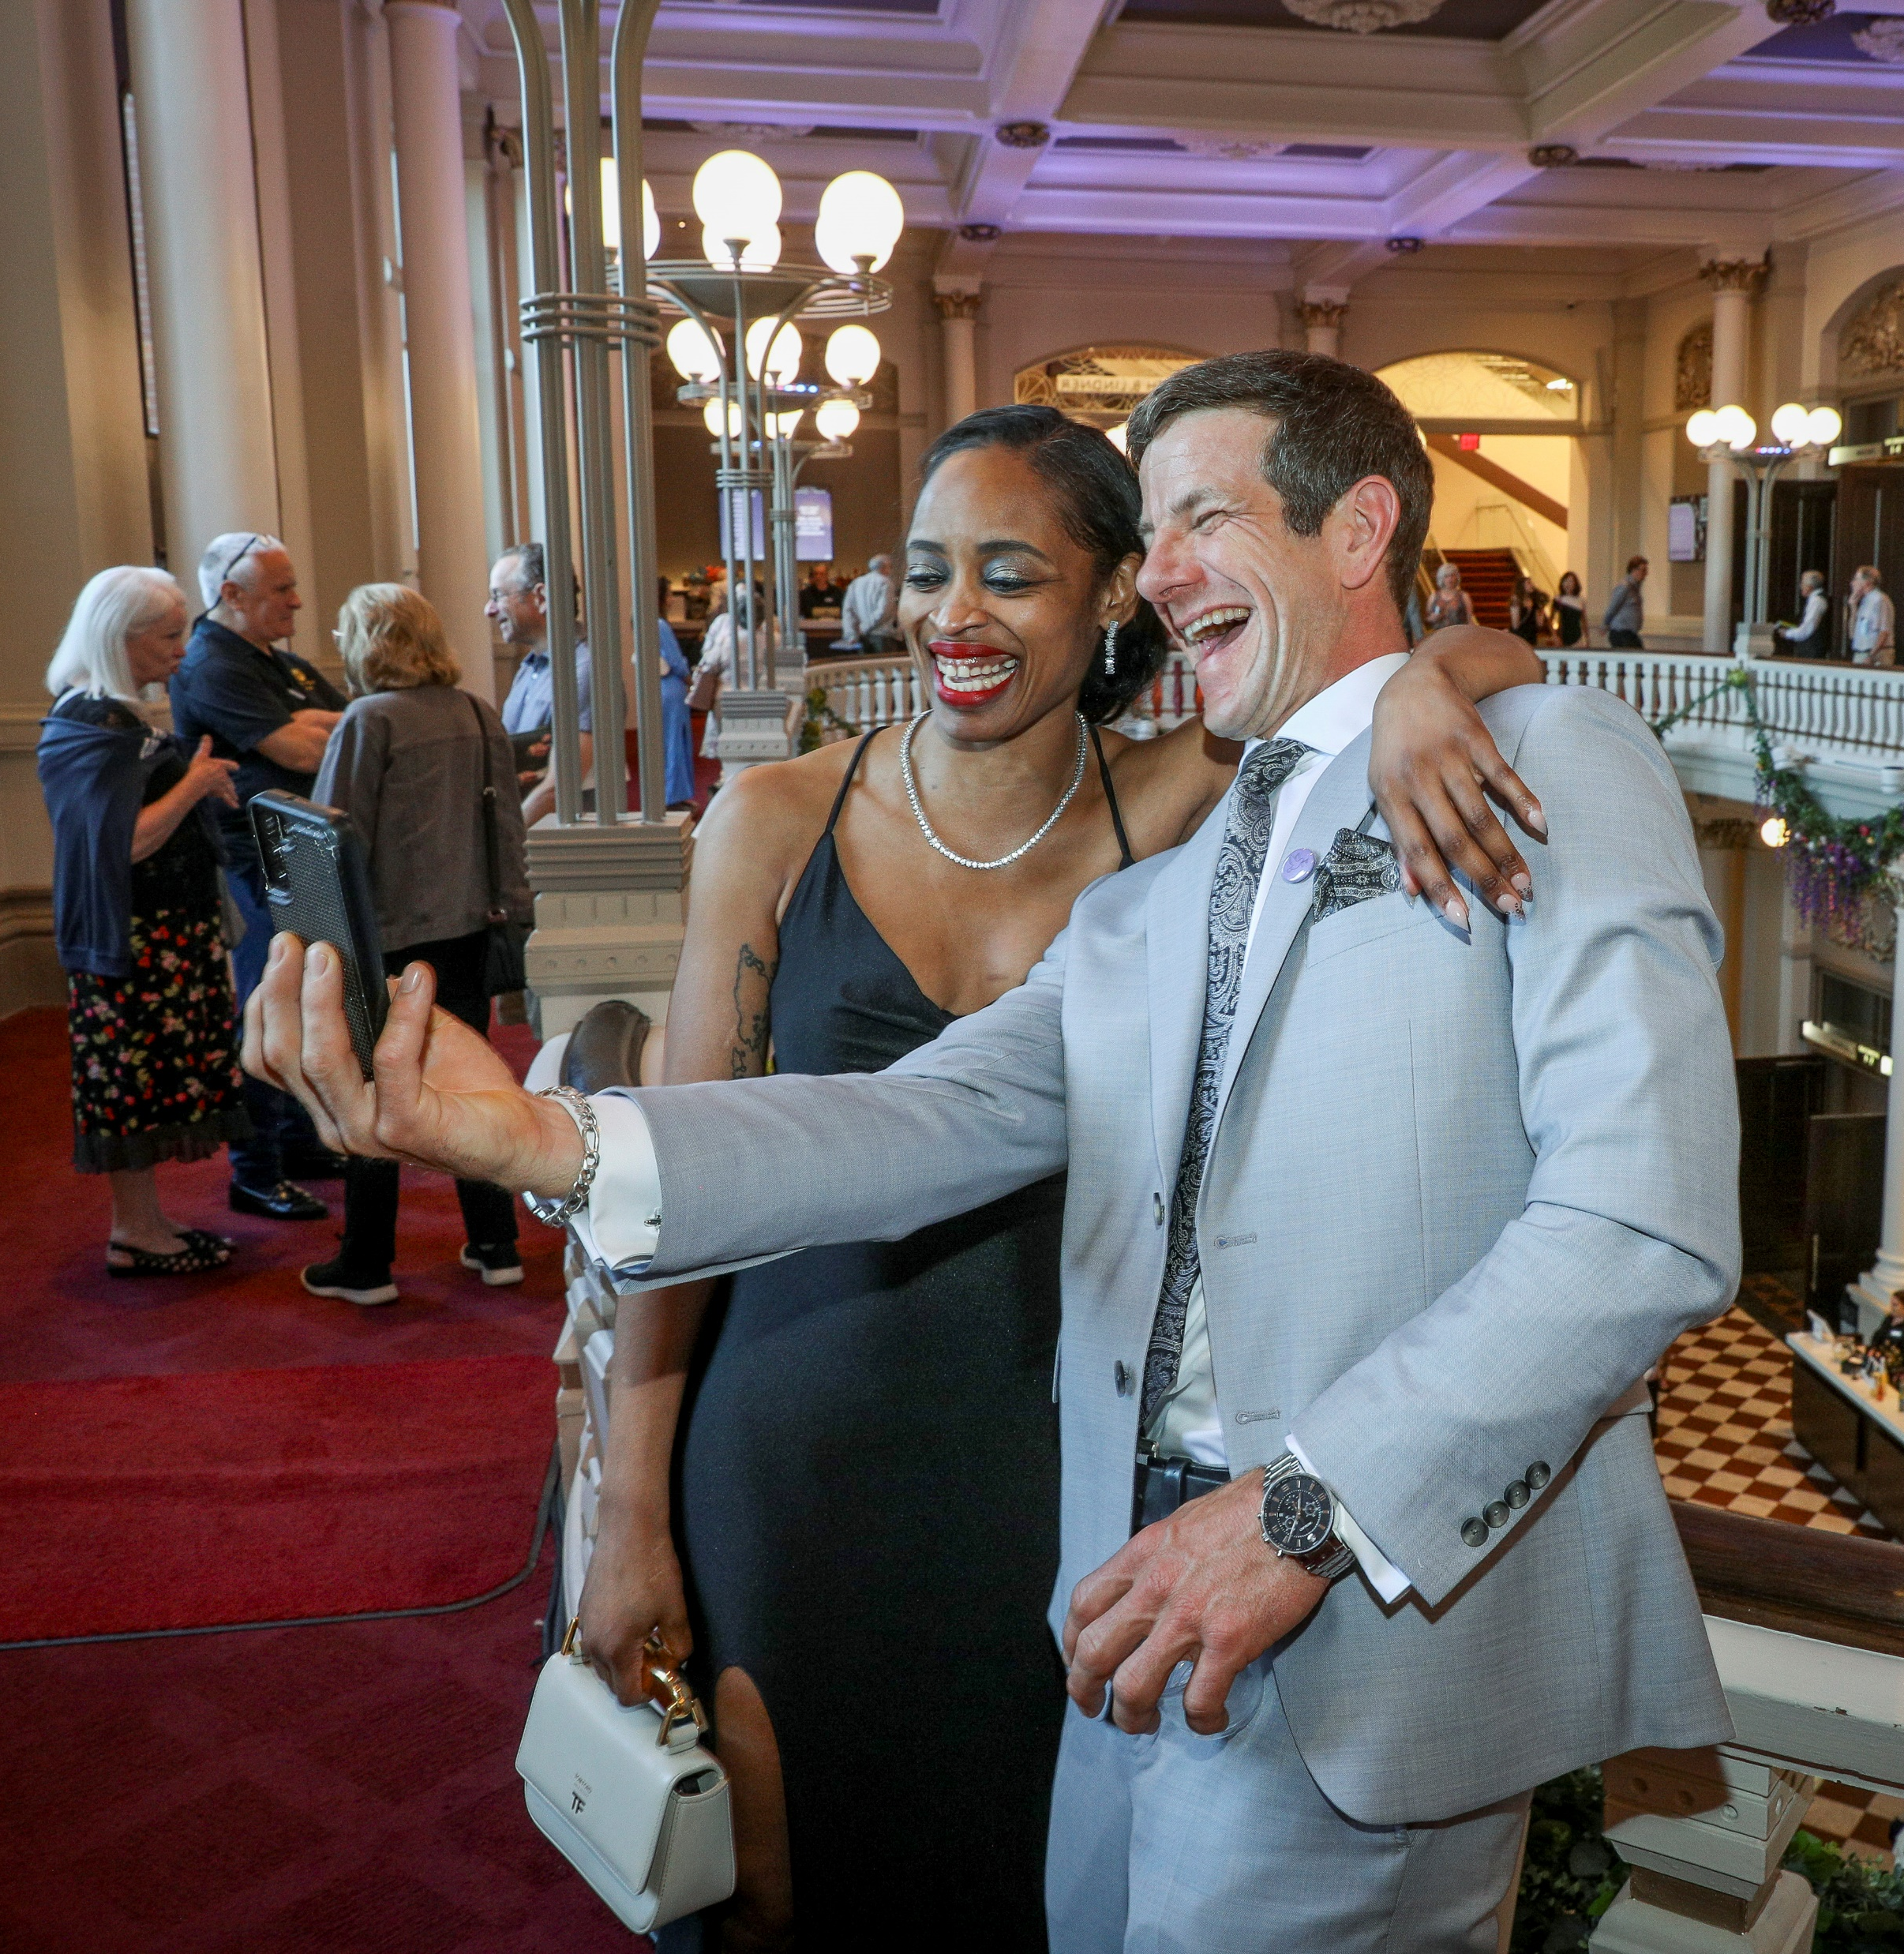
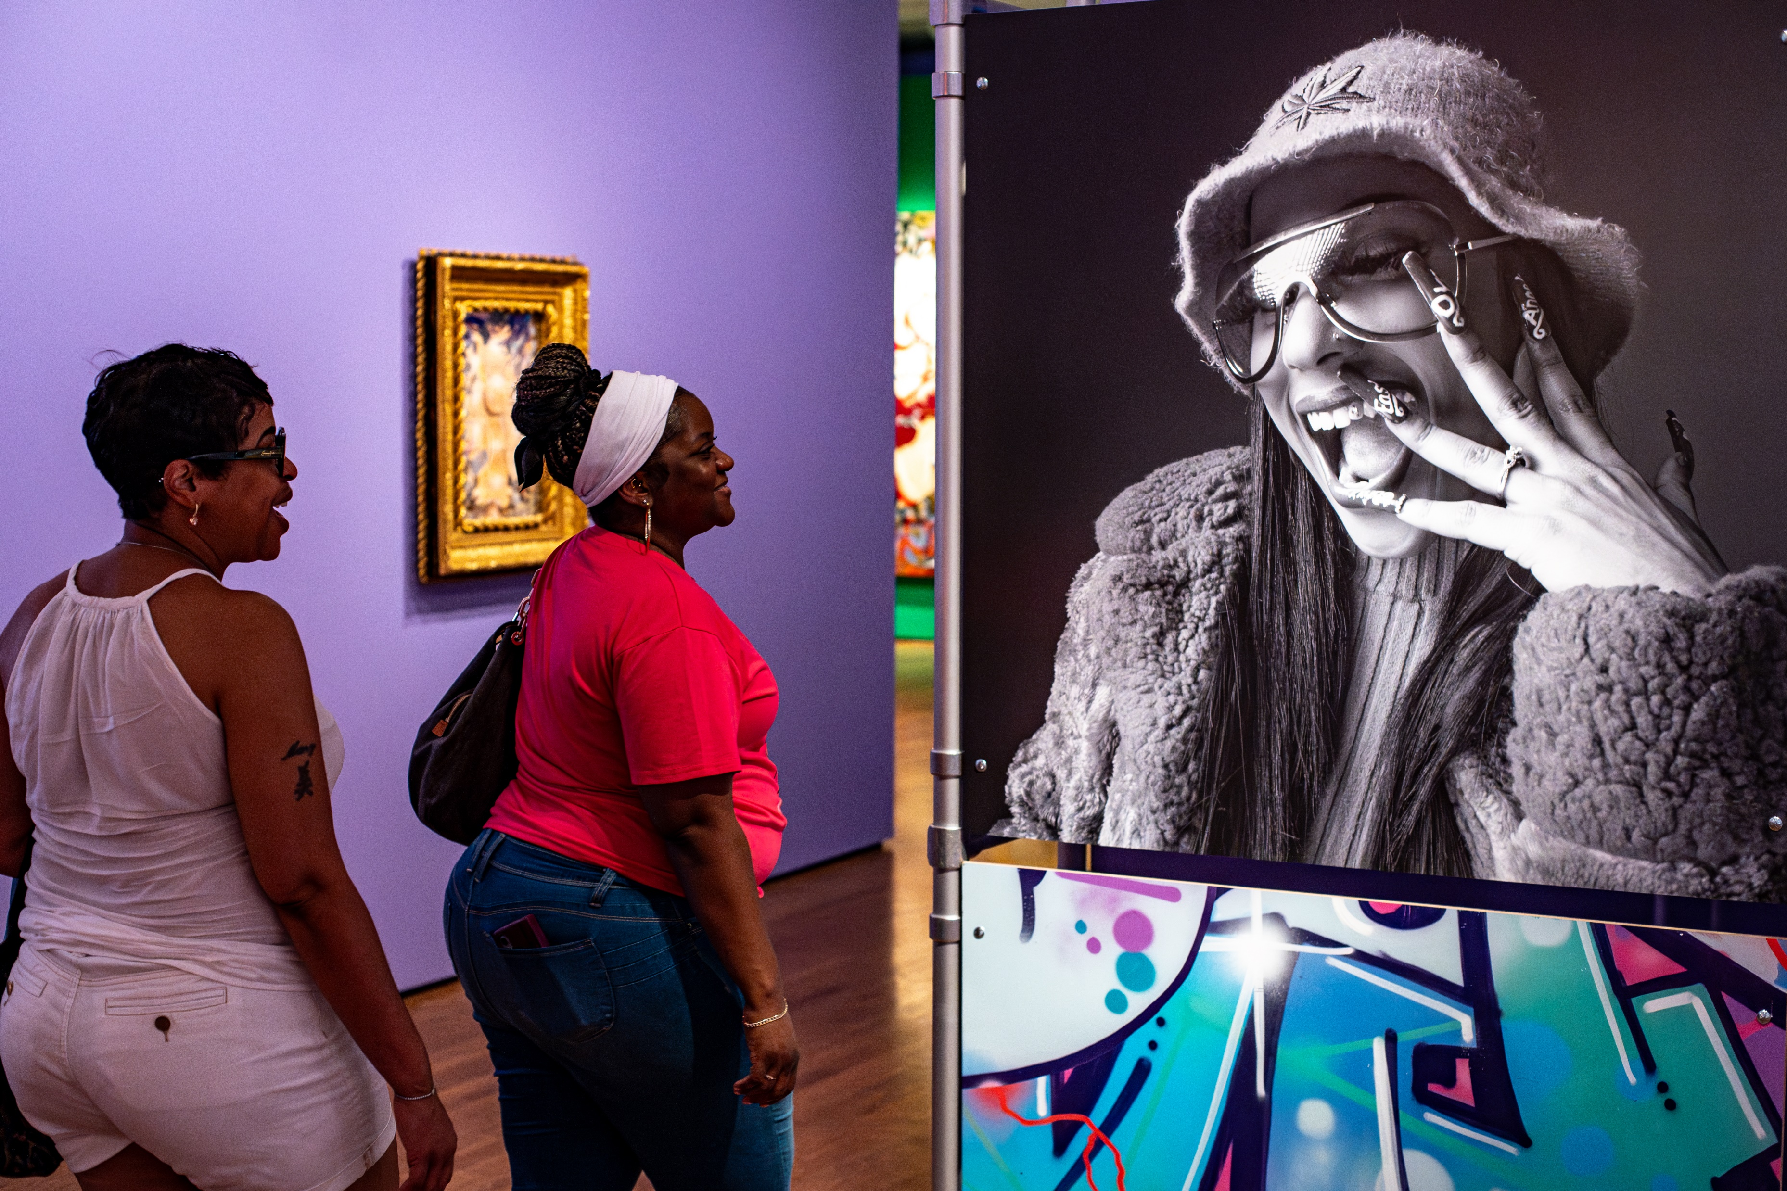
Your Gift: Bringing us Together
Notes:
Thank you for being here today. I hope you’ve seen how our arts make our region stronger and that those effects ripple out to the community from Northern Kentucky to the Northern Suburbs. For nearly a century, the collective action of ArtsWave members has been the primary way to support our arts. I hope you’ll continue that legacy and give today.
​
[CLICK SLIDE]​

Slide 19
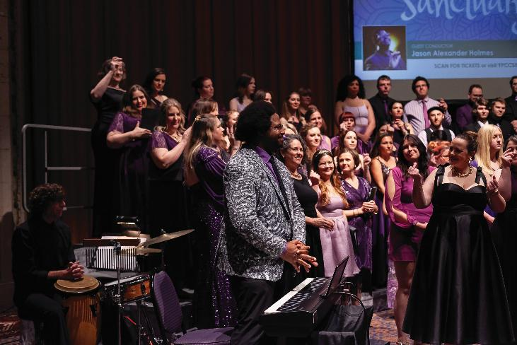
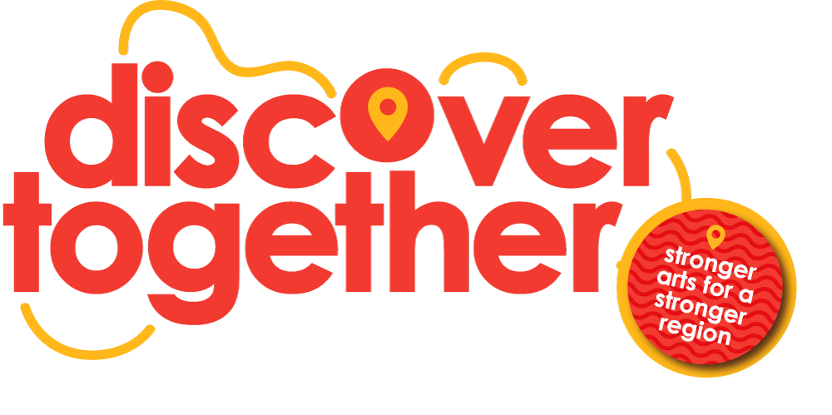
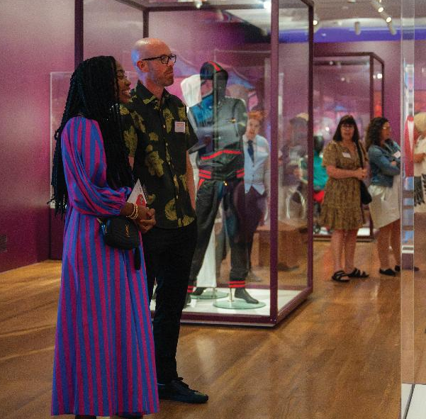
THANK YOU!
Notes:
Thank you again for joining me! Don’t forget to download the app, and then thanks in advance for considering a gift to ArtsWave.
[SLIDE WILL AUTOMATICALLY GO TO THE NEXT ONE AFTER 10 SECONDS]

Slide 20
artswave.org/app
Notes:
Speaking of community, how many of you are always looking for things to do, but never have a place to actually find those things? What do you do? Google? Maybe the enquirer, maybe CityBeat, others?
We’ve got the solution for you, the ArtsWave App
It just launched this year and is powered by the most comprehensive calendar in the region, Cincy A&E. It’s got arts, enteratinemtn, sports, restaurants. You can customize suggested events that are unique to you, create shareable itineraries and, if you’re an unlimited member of ArtsWave, this is the place to find 50% off tickets, plus free and flash deals for dozens of arts organizations at any point.
The app is free to download and really easy to use, so use the qr code or go to artswave.org/app to get it today.

