Slide 1
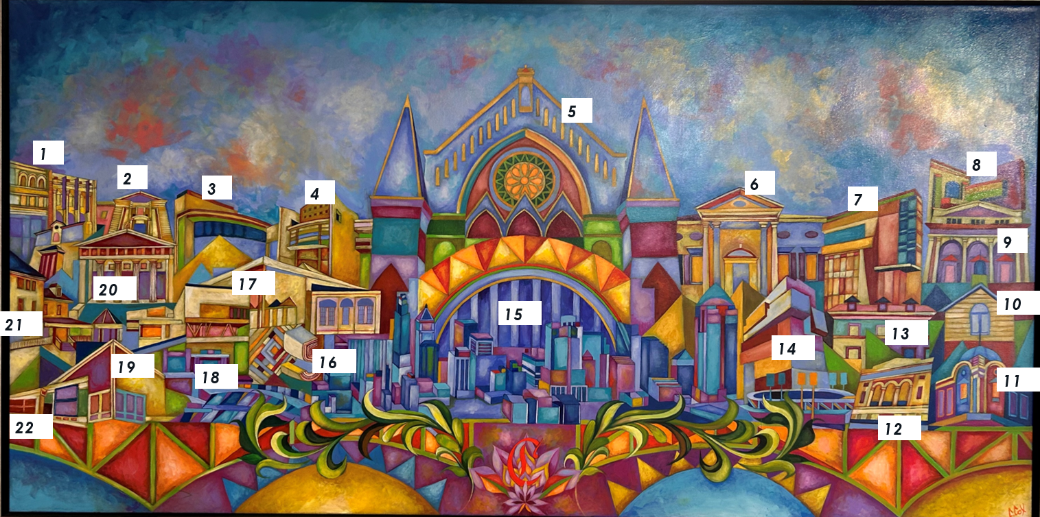

“Our Golden City of the Arts” (2022) by Cedric Michael Cox
Commissioned for ArtsWave 100
Identify the 22 organizations included in the piece for a chance to win a prize.

Slide 2
“Our Golden City of the Arts” (2022) by Cedric Michael Cox
Commissioned for ArtsWave 100
# | Organization
1
2
3
4
5
6
7
# | Organization
8
9
10
11
12
13
14
15
# | Organization
16
17
18
19
20
21
22

Slide 3
On the following page is a randomized list of the buildings represented in the painting (copied three times so you may print and cut).
You may have players guess the buildings outright, or you may make things a little easier by providing this list of available choices.

Slide 4
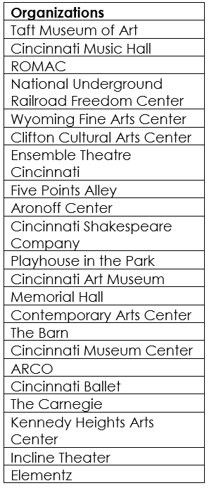

Slide 5
The following page contains the building answers for each spot for your reference. Be sure that you do NOT share with any players before you are ready!

Slide 6
“Our Golden City of the Arts” (2022) by Cedric Michael Cox
Commissioned for ArtsWave 100
# | Organization
1 | Ensemble Theatre Cincinnati
2 | The Carnegie
3 | Playhouse in the Park
4 | Nat’l Underground Railroad Freedom Center
5 | Cincinnati Music Hall
6 | Taft Museum of Art
7 | Clifton Cultural Arts Center
# | Organization
8 | Incline Theater
9 | Memorial Hall
10 | The Barn
11 | ROMAC
12 | ARCO
13 | Wyoming Fine Arts Center
14 | Contemporary Arts Center
15 | Cincinnati Museum Center
# | Organization
16 | Five Points Alley
17 | Cincinnati Ballet
18 | Aronoff Center
19 | Cincinnati Shakespeare Company
20 | Cincinnati Art Museum
21 | Kennedy Heights Arts Center
22 | Elementz

